Slide 1
62-6
This work is licensed under a Creative Commons Attribution-ShareAlike 4.0 International License.
Please add this statement to all the videos you create.
English Bible quotes are from the World English Bible US, which is in the public domain.
Notes:
Ch
P05 Kingdom Parables
1. The Wise and Foolish Builders - Luke 6:46-49 (Left Top)
2. The Rich Man and Lazarus Luke 16:19-31 (Right Top)
3. The Weeds - Matthew 13:24-30; 36-43 (Right Center)
4. The Hidden Treasure - Matt 13:44 (Center)
5. The Rich Fool - Luke 12:13-34 (Right Bottom)
6. The Ten Virgins - Matthew 25:1-13 (Left Bottom)
7. The Talents - Matthew 25:14-30 (Left Center)

Slide 2
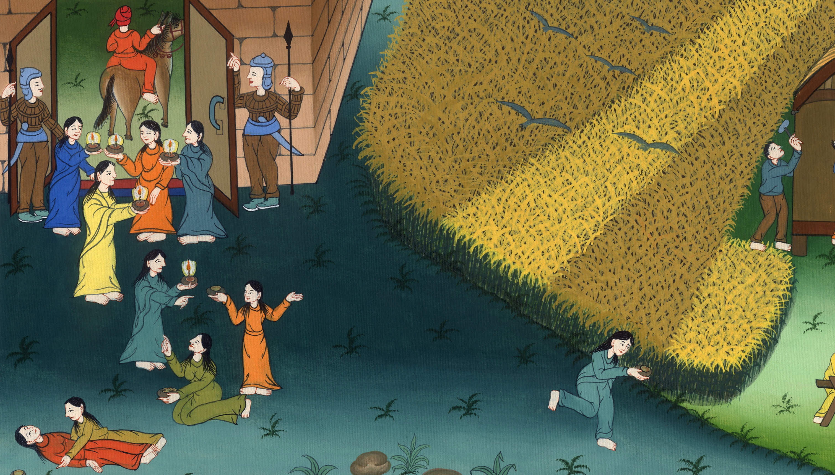
The Ten Virgins - Matthew 25:1-13

Slide 3
The Ten Virgins - Matthew 25:1-13
མད་ཐཱ། 25
བག་རོགས་བཅུ་ཡི་དཔེ།

Slide 4
The Ten Virgins - Matthew 25:1-13

Slide 5
1“Then the Kingdom of Heaven will be like ten virgins who took their lamps and went out to meet the bridegroom.

Slide 6
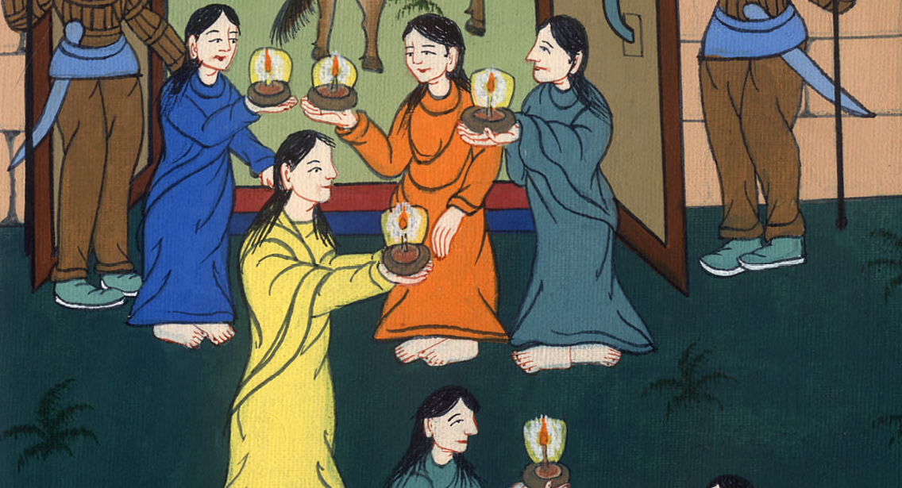
Matthew 25:1

Slide 7
² Five of them were foolish, and five were wise. 3Those who were foolish, when they took their lamps, took no oil with them,

Slide 8
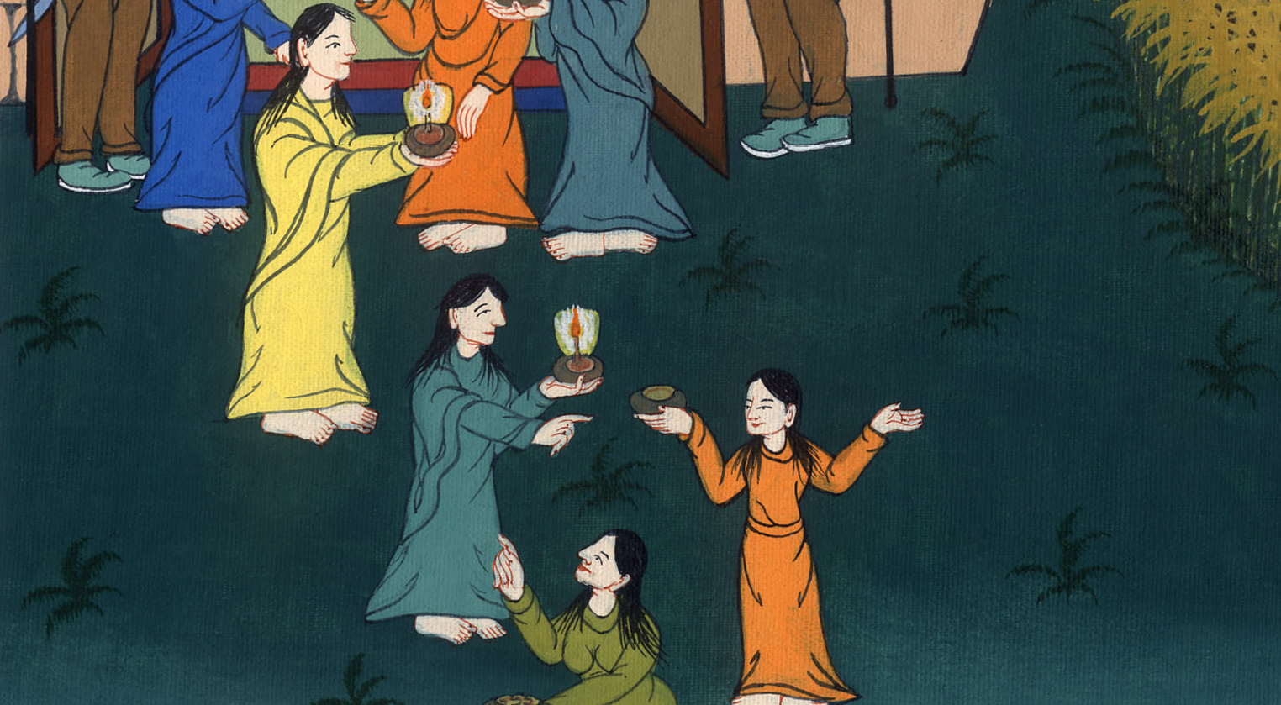
Matthew 25:2,3

Slide 9
⁴ but the wise took oil in their vessels with their lamps.

Slide 10
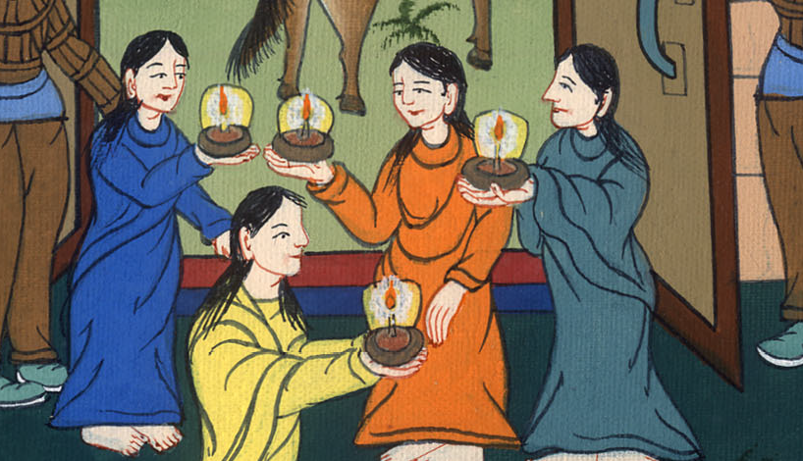
Matthew 25:4

Slide 11
⁵ Now while the bridegroom delayed, they all slumbered and slept.

Slide 12
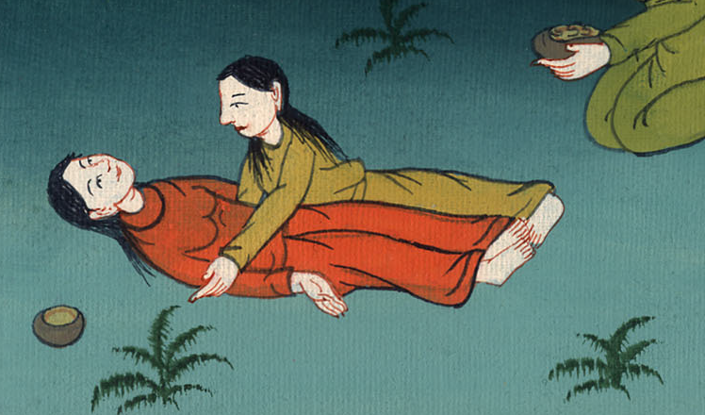
Matthew 25:5

Slide 13
⁶ But at midnight there was a cry, ‘Behold! The bridegroom is coming! Come out to meet him!’

Slide 14
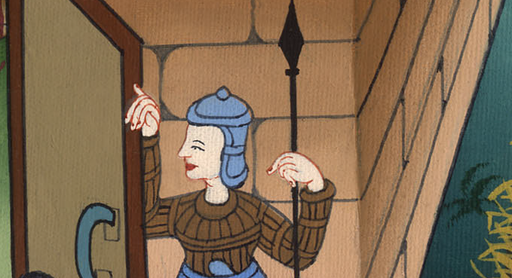
Matthew 25:6

Slide 15
⁷ Then all those virgins arose, and trimmed their lamps.

Slide 16
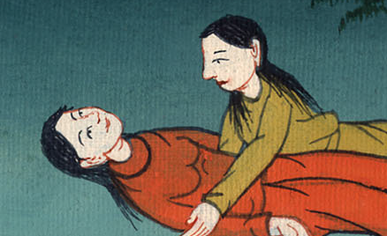
Matthew 25:7

Slide 17
⁸ The foolish said to the wise, ‘Give us some of your oil, for our lamps are going out.’

Slide 18
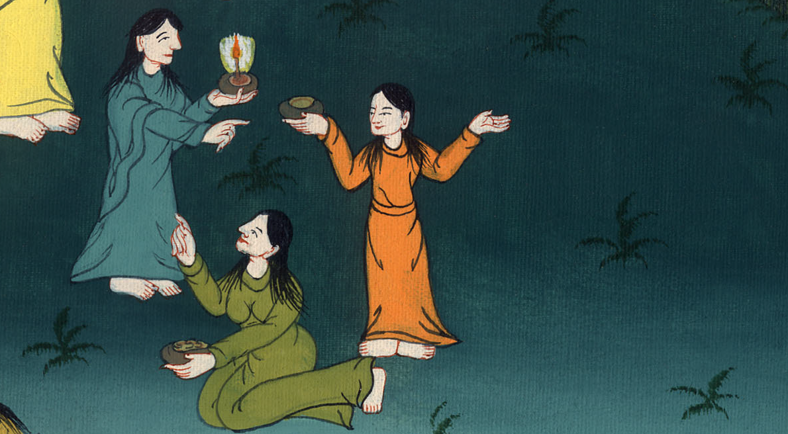
Matthew 25:8

Slide 19
⁹ But the wise answered, saying, ‘What if there isn’t enough for us and you? You go rather to those who sell, and buy for yourselves.’

Slide 20
Matthew 25:9

Slide 21
¹⁰ While they went away to buy, the bridegroom came, and those who were ready went in with him to the wedding feast, and the door was shut.

Slide 22
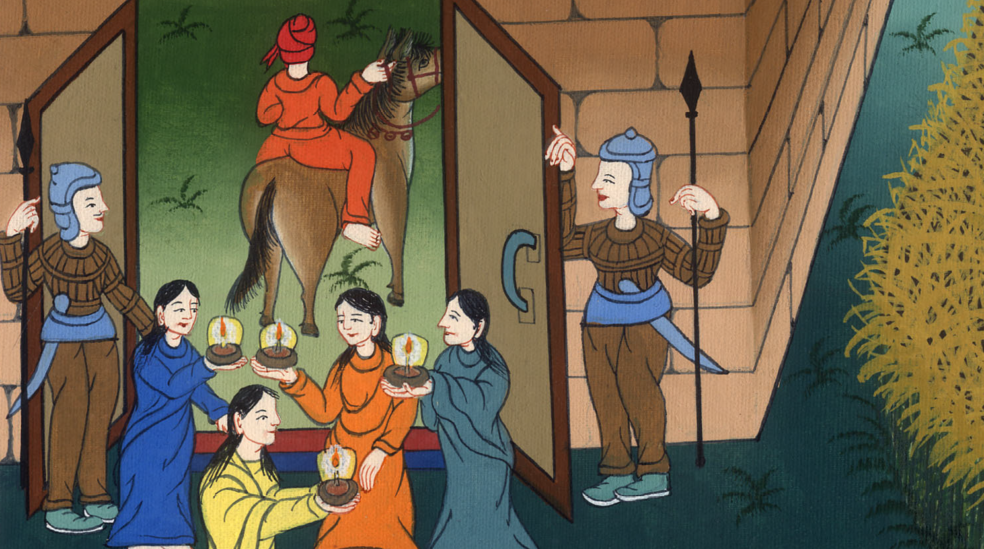
Matthew 25:10

Slide 23
¹¹ Afterward the other virgins also came, saying, ‘Lord, Lord, open to us.’

Slide 24
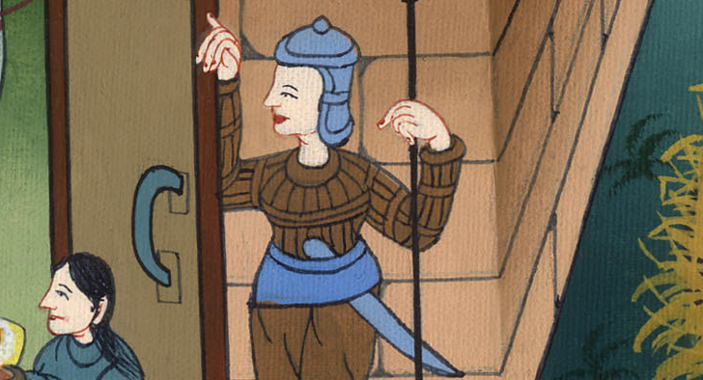
Matthew 25:11

Slide 25
¹² But he answered, ‘Most certainly I tell you, I don’t know you.’

Slide 26
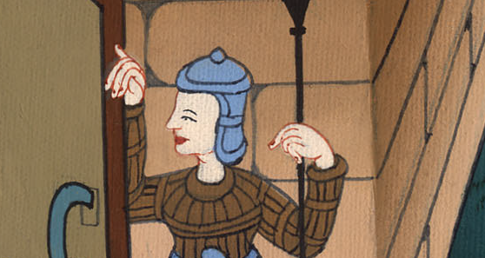
Matthew 25:12

Slide 27
¹³Watch therefore, for you don’t know the day nor the hour in which the Son of Man is coming.

Slide 28
Matthew 25:13

Slide 29
[Conclusion]

