Slide 1
62-7
This work is licensed under a Creative Commons Attribution-ShareAlike 4.0 International License.
Please add this statement to all the videos you create.
English Bible quotes are from the World English Bible US, which is in the public domain.
Notes:
P05 Kingdom Parables
1. The Wise and Foolish Builders - Luke 6:46-49 (Left Top)
2. The Rich Man and Lazarus Luke 16:19-31 (Right Top)
3. The Weeds - Matthew 13:24-30; 36-43 (Right Center)
4. The Hidden Treasure - Matt 13:44 (Center)
5. The Rich Fool - Luke 12:13-34 (Right Bottom)
6. The Ten Virgins - Matthew 25:1-13 (Left Bottom)
7. The Talents - Matthew 25:14-30 (Left Center)

Slide 2
The Talents - Matthew 25:14-30

Slide 3
The Talents - Matthew 25:14-30

Slide 4
The Talents - Matthew 25:14-30

Slide 5
¹⁴ “For it is like a man going into another country, who called his own servants and entrusted his goods to them.

Slide 6
Matthew 25:14

Slide 7
¹⁵ To one he gave five talents, to another two, to another one, to each according to his own ability. Then he went on his journey.

Slide 8
Matthew 25:15

Slide 9
¹⁶ Immediately he who received the five talents went and traded with them, and made another five talents.

Slide 10
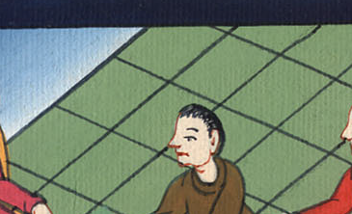
Matthew 25:16

Slide 11
¹⁷ In the same way, he also who got the two gained another two.

Slide 12
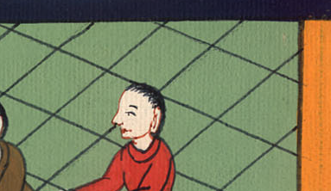
Matthew 25:17

Slide 13
¹⁸But he who received the one talent went away and dug in the earth and hid his lord’s money.

Slide 14
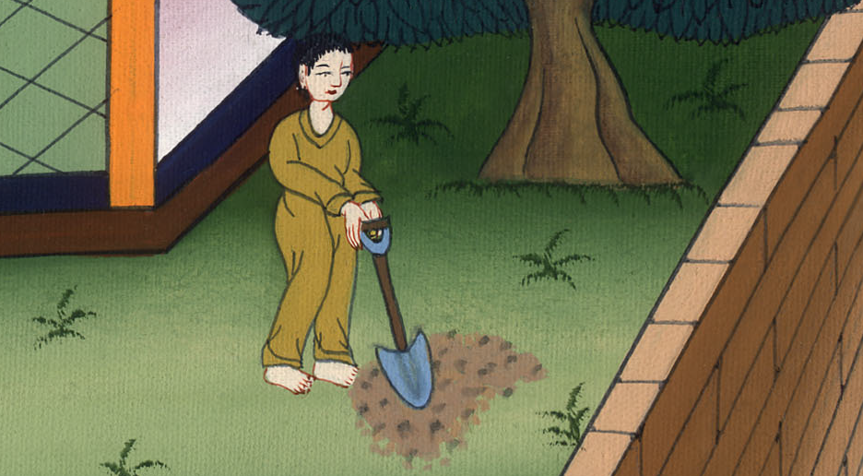
Matthew 25:18

Slide 15
¹⁹ “Now after a long time the lord of those servants came, and settled accounts with them.

Slide 16
Matthew 25:19

Slide 17
²⁰ He who received the five talents came and brought another five talents, saying, ‘Lord, you delivered to me five talents. Behold, I have gained another five talents in addition to them.’

Slide 18
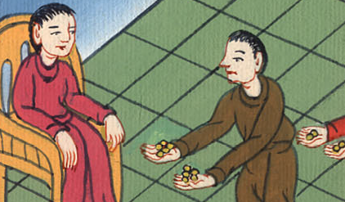
Matthew 25:20

Slide 19
²¹ “His lord said to him, ‘Well done, good and faithful servant. You have been faithful over a few things, I will set you over many things. Enter into the joy of your lord.’

Slide 20
Matthew 25:21

Slide 21
²² “He also who got the two talents came and said, ‘Lord, you delivered to me two talents. Behold, I have gained another two talents in addition to them.’

Slide 22
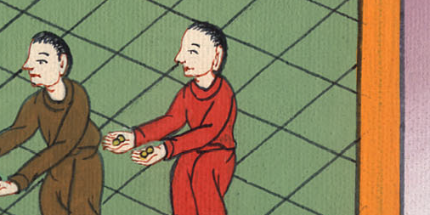
Matthew 25:22

Slide 23
²³ “His lord said to him, ‘Well done, good and faithful servant. You have been faithful over a few things. I will set you over many things. Enter into the joy of your lord.’

Slide 24
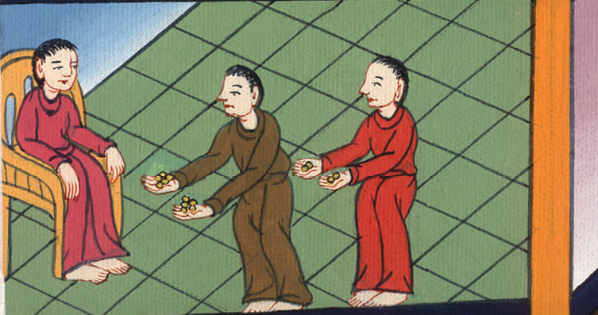
Matthew 25:23

Slide 25
²⁴ “He also who had received the one talent came and said, ‘Lord, I knew you that you are a hard man, reaping where you didn’t sow, and gathering where you didn’t scatter.

Slide 26
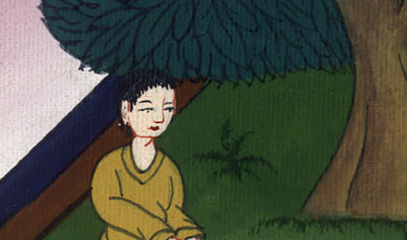
Matthew 25:24

Slide 27
²⁵ I was afraid, and went away and hid your talent in the earth. Behold, you have what is yours.’

Slide 28
Matthew 25:25

Slide 29
²⁶ “But his lord answered him, ‘You wicked and slothful servant. You knew that I reap where I didn’t sow, and gather where I didn’t scatter.

Slide 30
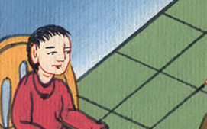
Matthew 25:26

Slide 31
²⁷ You ought therefore to have deposited my money with the bankers, and at my coming I should have received back my own with interest.

Slide 32
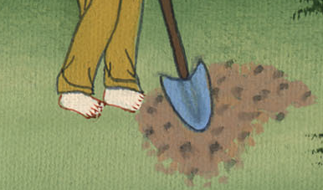
Matthew 25:27

Slide 33
²⁸ Take away therefore the talent from him and give it to him who has the ten talents.

Slide 34
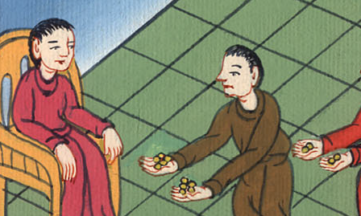
Matthew 25:28

Slide 35
²⁹ For to everyone who has will be given, and he will have abundance, but from him who doesn’t have, even that which he has will be taken away.

Slide 36
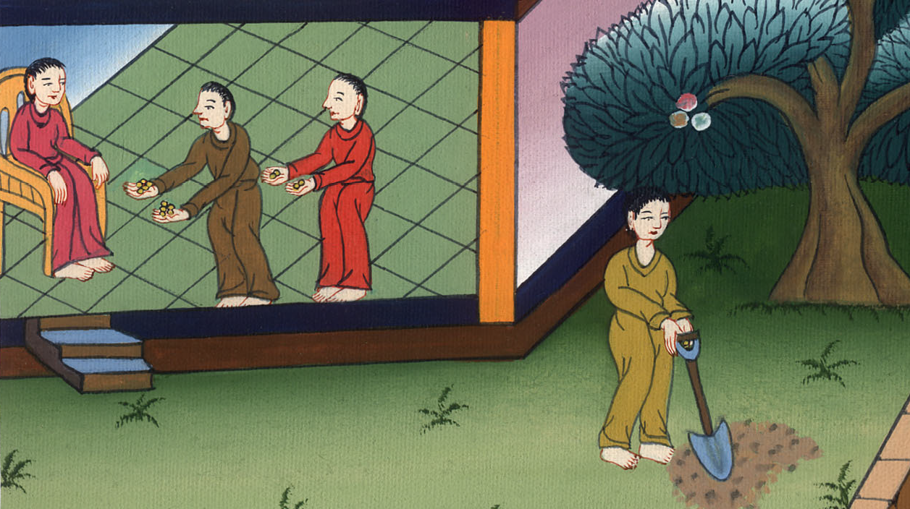
Matthew 25:29

Slide 37
³⁰ Throw out the unprofitable servant into the outer darkness, where there will be weeping and gnashing of teeth.’

Slide 38
Matthew 25:30

