Slide 1
02-2
These materials are by the Kongki Ka Project and are made available to you under the terms of the Creative Commons Attribution ShareAlike license 4.0.
You have permission to share and redistribute these materials in any format and to make reasonable revisions and adaptations of this translation, provided that:
You include the above licence and source information.
If you redistribute these materials or create derivatives, you must distribute your contributions under the same license as the original.
The Holy Bible, Berean Standard Bible, BSB is produced in cooperation with Bible Hub, Discovery Bible, OpenBible.com, and the Berean Bible Translation Committee. This text of God's Word has been dedicated to the public domain.
Hindi text is from Free Bibles India. This translation is made available under the terms of a Creative Commons Attribution-ShareAlike 4.0 International License.

Slide 2
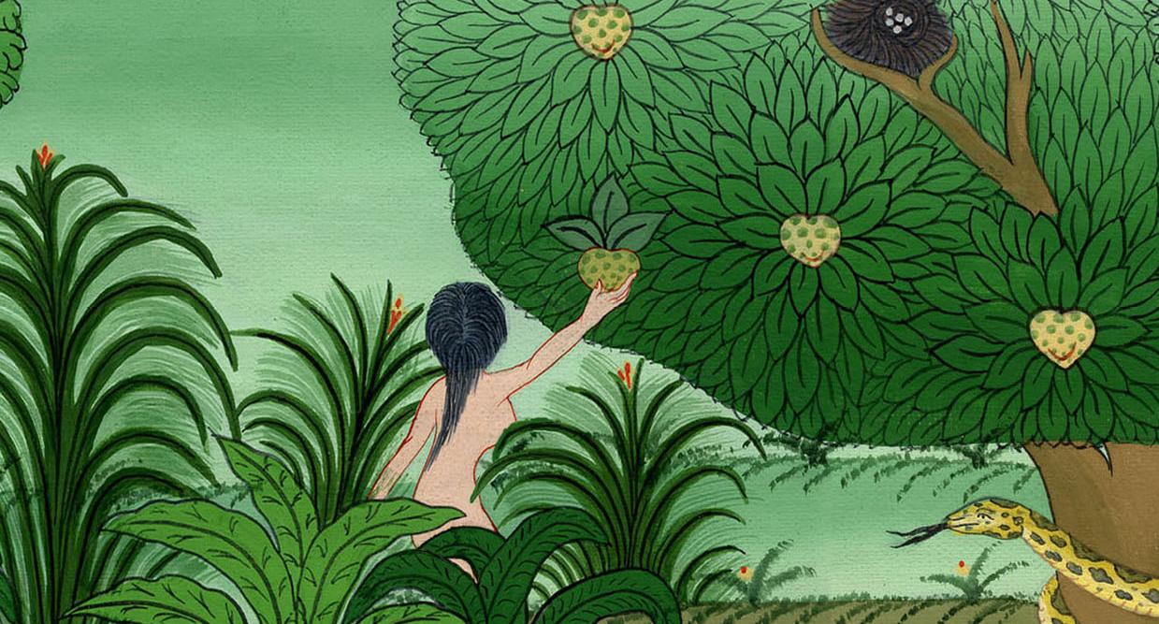
शैतान का औरत को भरमाना - उत्पत्ति 3:1-6
This work is licensed under a Creative Commons Attribution-ShareAlike 4.0 International License

Slide 3
The serpent temps Eve
Genesis 3:1-6
शैतान का औरत को भरमाना –
उत्पत्ति 3:1-6

Slide 4
शैतान का औरत को भरमाना - उत्पत्ति 3:1-6
Notes:
Serpent tempts Eve - Gen 3:1-5

Slide 5
2:15Then the Lord God took the man and placed him in the Garden of Eden to cultivate and keep it.
16And the Lord God commanded him, “You may eat freely from every tree of the garden, 17but you must not eat from the tree of the knowledge of good and evil; for in the day that you eat of it, you will surely die.”
2:15 तब यहोवा परमेश्वर ने आदम को लेकरb अदन की वाटिका में रख दिया, कि वह उसमें काम करे और उसकी रखवाली करे। 16 और यहोवा परमेश्वर ने आदम को यह आज्ञा दी, “तू वाटिका के किसी भी वृक्षों का फल खा सकता है; 17 पर भले या बुरे के ज्ञान का जो वृक्ष है, उसका फल तू कभी न खाना: क्योंकि जिस दिन तू उसका फल खाएगा उसी दिन अवश्य मर जाएगा।”

Slide 6
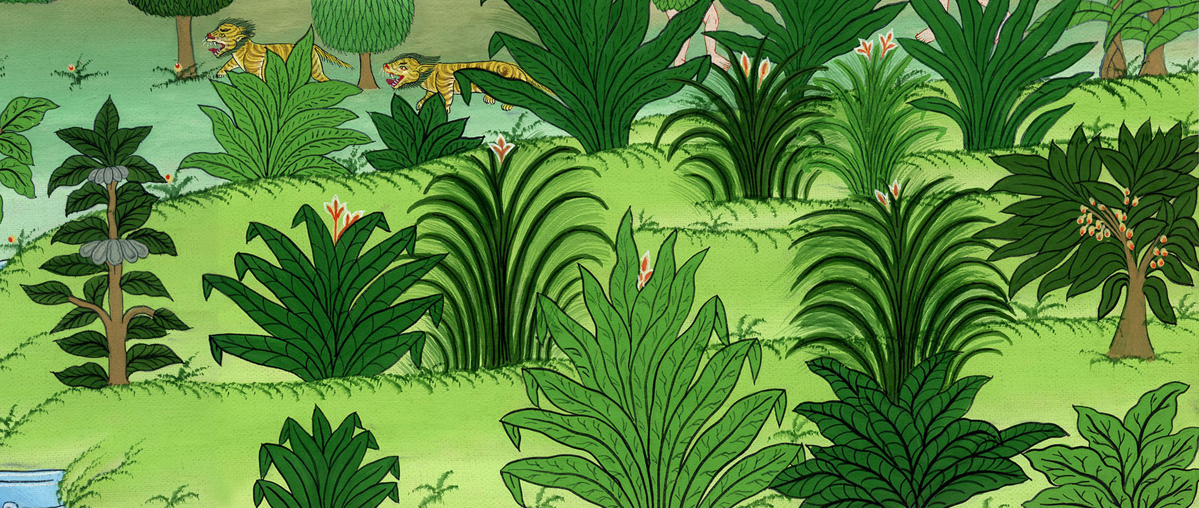
उत्पत्ति 2:15-17
Notes:
GEN 2:15¹⁵ The Lord God put the man in the Garden of Eden. He put him there to farm its land and take care of it. ¹⁶ The Lord God gave the man a command. He said, “You may eat fruit from any tree in the garden. ¹⁷ But you must not eat the fruit from the tree of the knowledge of good and evil. If you do, you will certainly die.”

Slide 7
1Now the serpent was more crafty than any beast of the field that the Lord God had made. And he said to the woman, “Did God really say, ‘You must not eat from any tree in the garden?’”
1यहोवा परमेश्वर ने जितने जंगली पशु बनाए थे, उन सब में सर्प धूर्त था, और उसने स्त्री से कहा, “क्या सच है, कि परमेश्वर ने कहा, ‘तुम इस वाटिका के किसी वृक्ष का फल न खाना’?”

Slide 8
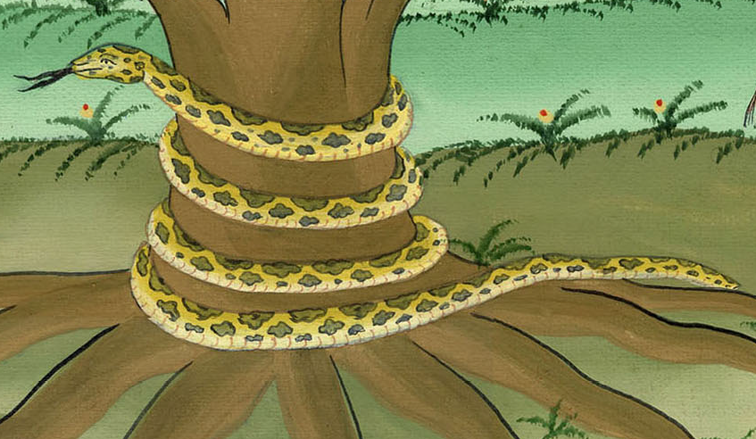
उत्पत्ति 3:1
Notes:
3 The serpent was more clever than any of the wild animals the Lord God had made. The serpent said to the woman, “Did God really say, ‘You must not eat fruit from any tree in the garden’?”

Slide 9
2 The woman answered the serpent, “We may eat the fruit of the trees of the garden,
2तब स्त्री ने उत्तर दिया, “हम बगीचे के वृक्षों के फलों को खा सकते हैं,

Slide 10
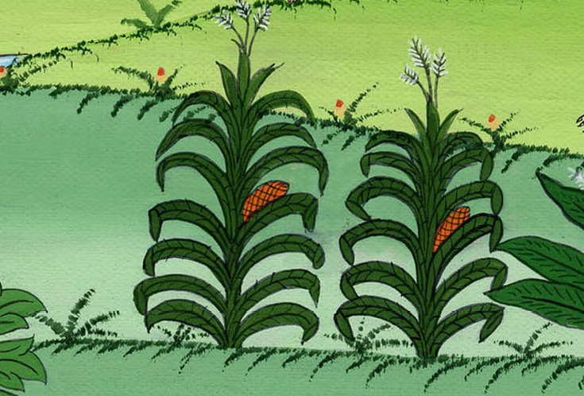
उत्पत्ति 3:2
Notes:
² The woman said to the serpent, “We may eat fruit from the trees in the garden

Slide 11
3 but about the fruit of the tree in the middle of the garden, God has said, ‘You must not eat of it or touch it, or you will die.’”
3 पर जो वृक्ष वाटिका के बीच में है, उसके फल के विषय में परमेश्वर ने कहा है कि न तो तुम उसको खाना और न ही उसको छूना, नहीं तो मर जाओगे।”

Slide 12
उत्पत्ति 3:3
Notes:
. ³ But God did say, ‘You must not eat the fruit from the tree in the middle of the garden. Do not even touch it. If you do, you will die.’ ”

Slide 13
4 “You will not surely die,” the serpent told her.
4 तब सर्प ने स्त्री से कहा, “तुम निश्चय न मरोगे

Slide 14
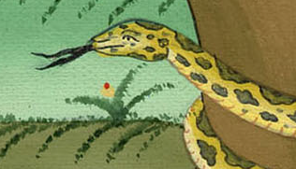
उत्पत्ति 3:4
Notes:
⁴ “You will certainly not die,” the serpent said to the woman.

Slide 15
5“For God knows that in the day you eat of it, your eyes will be opened and you will be like God, knowing good and evil.”
5 वरन् परमेश्वर आप जानता है कि जिस दिन तुम उसका फल खाओगे उसी दिन तुम्हारी आँखें खुल जाएँगी, और तुम भले बुरे का ज्ञान पाकर परमेश्वर के तुल्य हो जाओगे।”

Slide 16
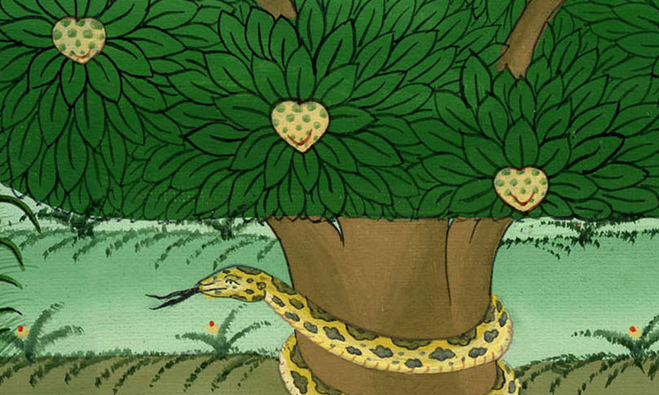
उत्पत्ति 3:5
Notes:
. ⁵ “God knows that when you eat fruit from that tree, you will know things you have never known before. Like God, you will be able to tell the difference between good and evil.”

Slide 17
6 When the woman saw that the tree was good for food and pleasing to the eyes, and that it was desirable for obtaining wisdom,
6 अतः जब स्त्री ने देखाa कि उस वृक्ष का फल खाने में अच्छा, और देखने में मनभाऊ, और बुद्धि देने के लिये चाहने योग्य भी है,

Slide 18
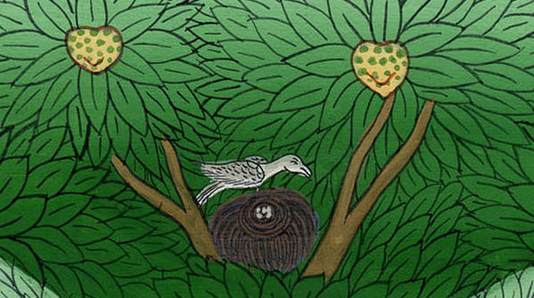
उत्पत्ति 3:6
Notes:
⁶ The woman saw that the tree’s fruit was good to eat and pleasing to look at. She also saw that it would make a person wise

Slide 19
6…. she took the fruit and ate it.
6…तब उसने उसमें से तोड़कर खाया;

Slide 20
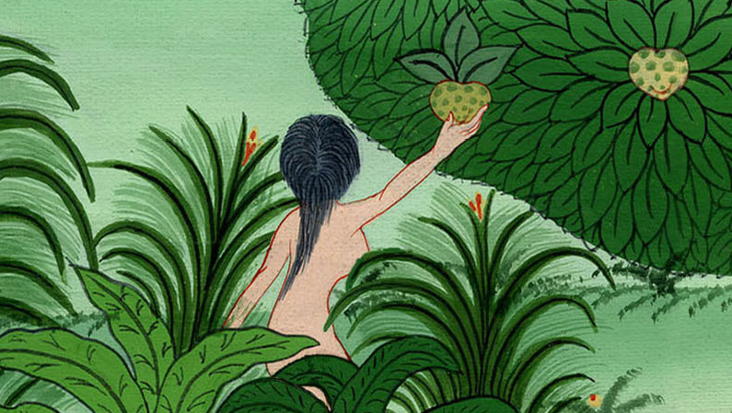
उत्पत्ति 3:6
Notes:
. So she took some of the fruit and ate it

Slide 21
6…She also gave some to her husband who was with her, and he ate it.
और अपने पति को भी दिया, जो उसके साथ था और उसने भी खाया।

Slide 22
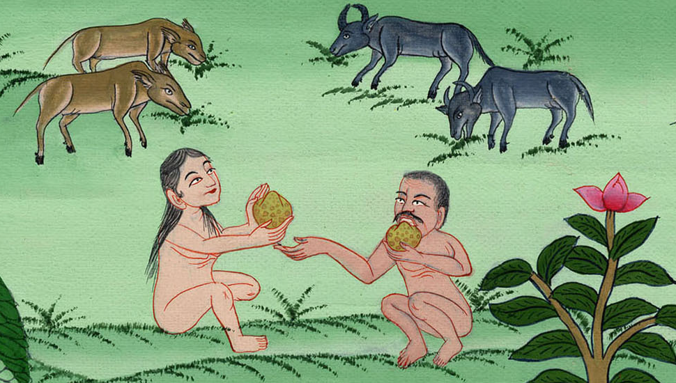
उत्पत्ति 3:6
Notes:
She also gave some to her husband, who was with her. And he ate it. ⁷ Then both of them knew things they had never known before. They realized they were naked.

Slide 23
7 And the eyes of both of them were opened, and they knew that they were naked; so they sewed together fig leaves and made coverings for themselves.
7 तब उन दोनों की आँखें खुल गईं, और उनको मालूम हुआ कि वे नंगे हैं; इसलिए उन्होंने अंजीर के पत्ते जोड़-जोड़कर लंगोट बना लिये।

Slide 24
उत्पत्ति 3:7

Slide 25
This was the first sin that people committed. God gave a command, and they chose to disobey it.
यह पहला पाप था जो लोगों ने किया। परमेश्वर ने एक आज्ञा दी, और उन्होंने उसकी अवज्ञा करना चुना।

Slide 26
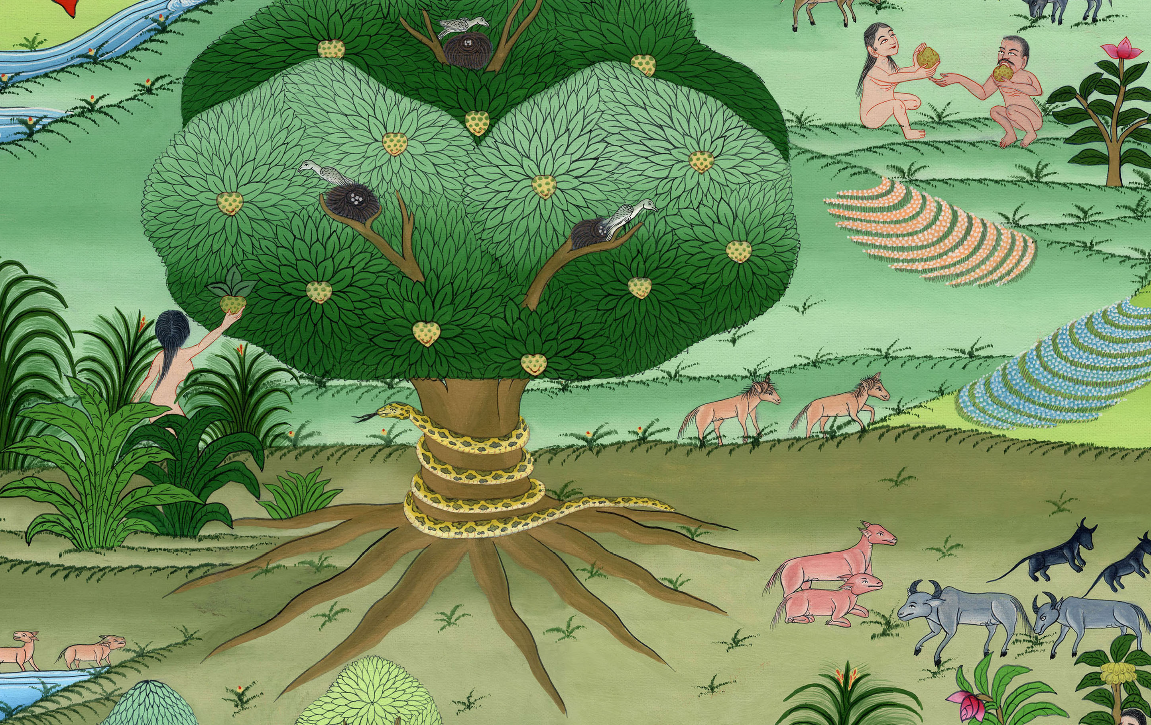
Notes:
This was the first sin that people committed. God gave a command, and they chose to disobey it.

