Slide 1
03-2
These materials are by the Kongki Ka Project and are made available to you under the terms of the Creative Commons Attribution ShareAlike license 4.0.
You have permission to share and redistribute these materials in any format and to make reasonable revisions and adaptations of this translation, provided that:
You include the above licence and source information.
If you redistribute these materials or create derivatives, you must distribute your contributions under the same license as the original.
The Holy Bible, Berean Standard Bible, BSB is produced in cooperation with Bible Hub, Discovery Bible, OpenBible.com, and the Berean Bible Translation Committee. This text of God's Word has been dedicated to the public domain.
Hindi text is from Free Bibles India. This translation is made available under the terms of a Creative Commons Attribution-ShareAlike 4.0 International License.
Notes:
03 Sin Continues – Gen 4-9
1) Cain & Able – Gen 4:1-15 (Left Top)
2) Corruption of Mankind – Gen 6:1-7 (Center Top)
3) Noah found favor – Gen 6:8-12 (Right Top)
4) Noah builds the Arc – Gen 6:13-22 (Right 2nd)
5) Animals board the Arc – Gen 7:1-10 (Right Bottom)
6) Floods come – Gen 7:11-16 (Left Bottom)
7) Flood waters cover the earth – Gen 7:17-8:12 (Center)
8) Floods dry up – Gen 8:13-19 (Left 2nd from Bottom)
9) Rainbow – Gen 8:20-9:17 (Left 3rd from Bottom)

Slide 2
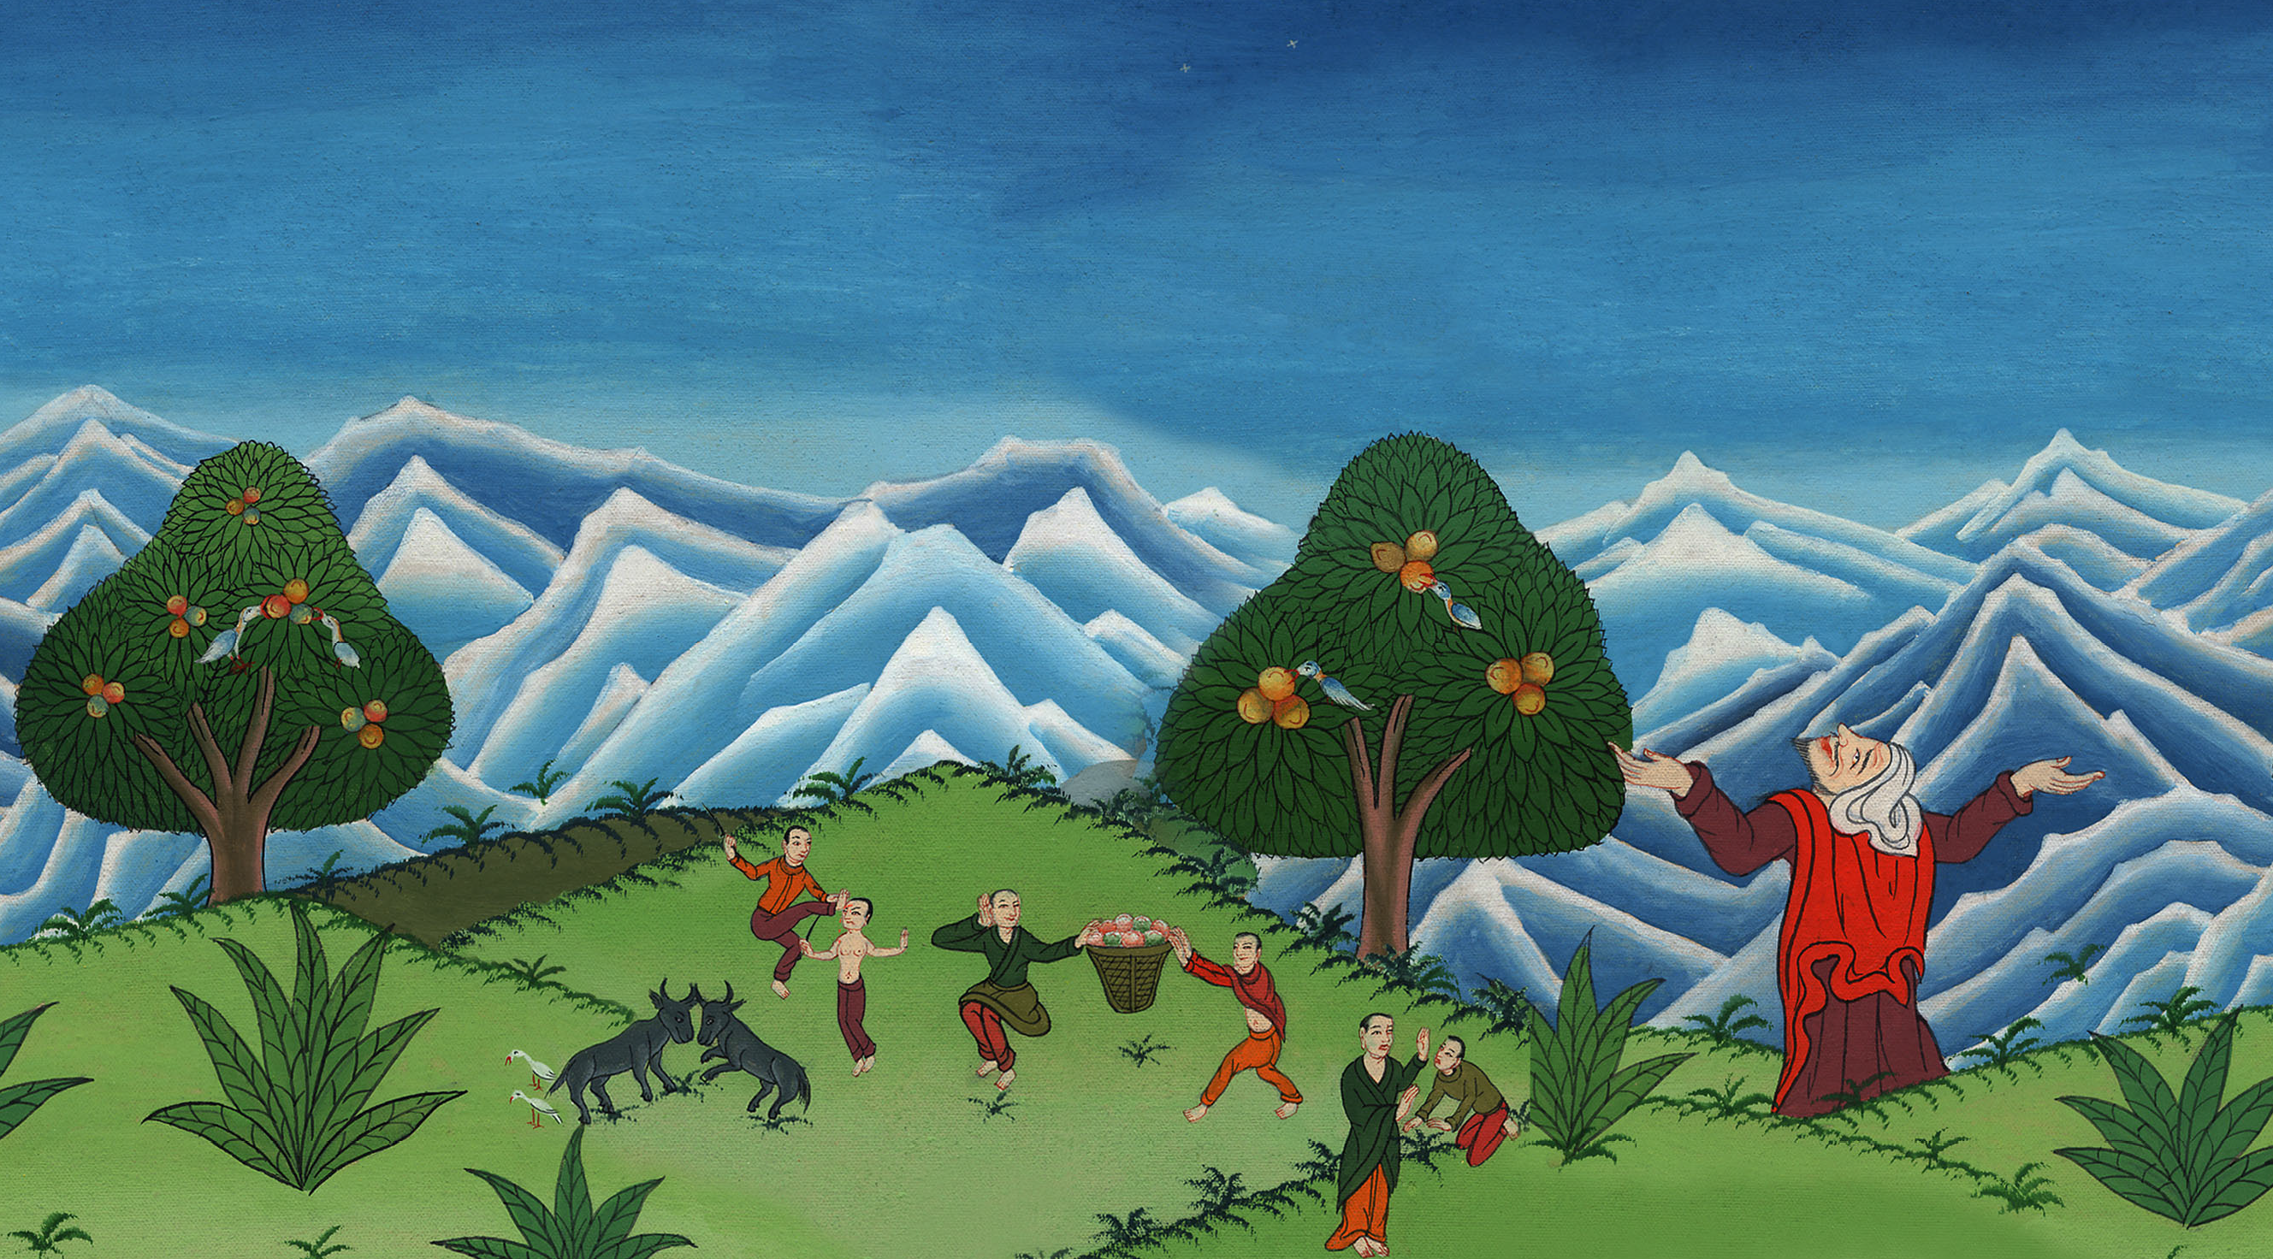
मानव जाति का भ्रष्ट होना - उत्पत्ति 6:1-7
This work is licensed under a Creative Commons Attribution-ShareAlike 4.0 International License

Slide 3
Cain and Abel- Genesis 6:1-7
मानव जाति का भ्रष्ट होना - उत्पत्ति 6:1-7

Slide 4
मानव जाति का भ्रष्ट होना - उत्पत्ति 6:1-7

Slide 5
1Now when men began to multiply on the face of the earth and daughters were born to them,
1फिर जब मनुष्य भूमि के ऊपर बहुत बढ़ने लगे, और उनके बेटियाँ उत्पन्न हुईं,

Slide 6
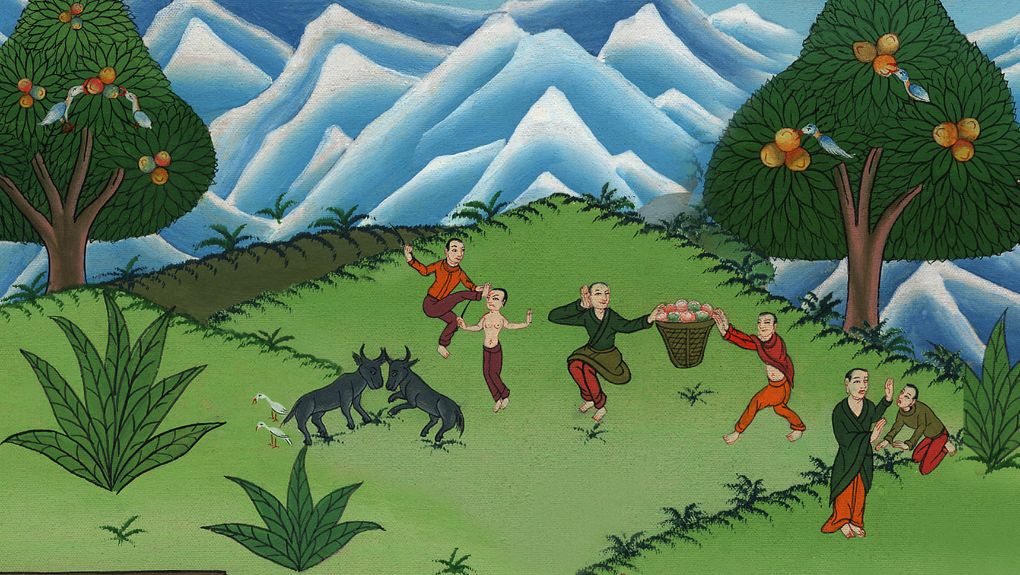
उत्पत्ति 6:1

Slide 7
5Then the Lord saw that the wickedness of man was great upon the earth, and that every inclination of the thoughts of his heart was altogether evil all the time.
5 यहोवा ने देखा कि मनुष्यों की बुराई पृथ्वी पर बढ़ गई है, और उनके मन के विचार में जो कुछ उत्पन्न होता है वह निरन्तर बुरा ही होता है।

Slide 8
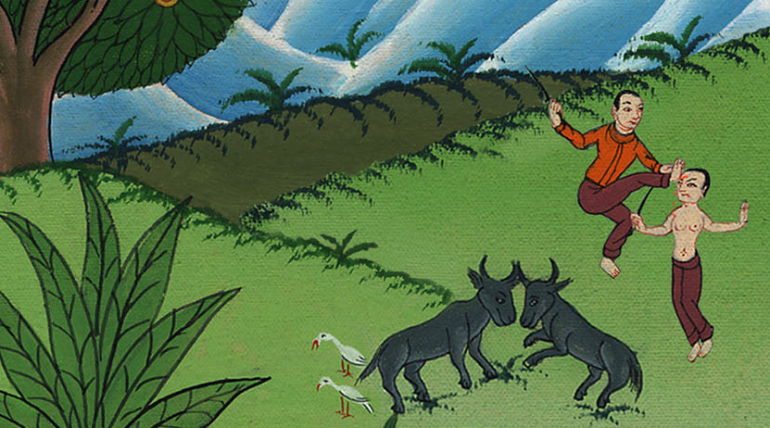
उत्पत्ति 6:5

Slide 9
6And the Lord regretted that He had made man on the earth, and He was grieved in His heart.
6 और यहोवा पृथ्वी पर मनुष्य को बनाने से पछताया, और वह मन में अति खेदित हुआ।

Slide 10
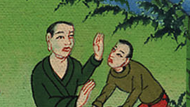
उत्पत्ति 6:6

Slide 11
7So the Lord said, “I will blot out man, whom I have created, from the face of the earth—every man and beast and crawling creature and bird of the air—for I am grieved that I have made them.”
7 तब यहोवा ने कहा, “मैं मनुष्य को जिसकी मैंने सृष्टि की है पृथ्वी के ऊपर से मिटा दूँगाa; क्या मनुष्य, क्या पशु, क्या रेंगनेवाले जन्तु, क्या आकाश के पक्षी, सब को मिटा दूँगा, क्योंकि मैं उनके बनाने से पछताता हूँ।”

Slide 12
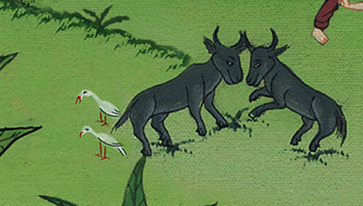
उत्पत्ति 6:7

Slide 13
8Noah, however, found favor in the eyes of the Lord.
8 परन्तु यहोवा के अनुग्रह की दृष्टि नूह पर बनी रही।

Slide 14
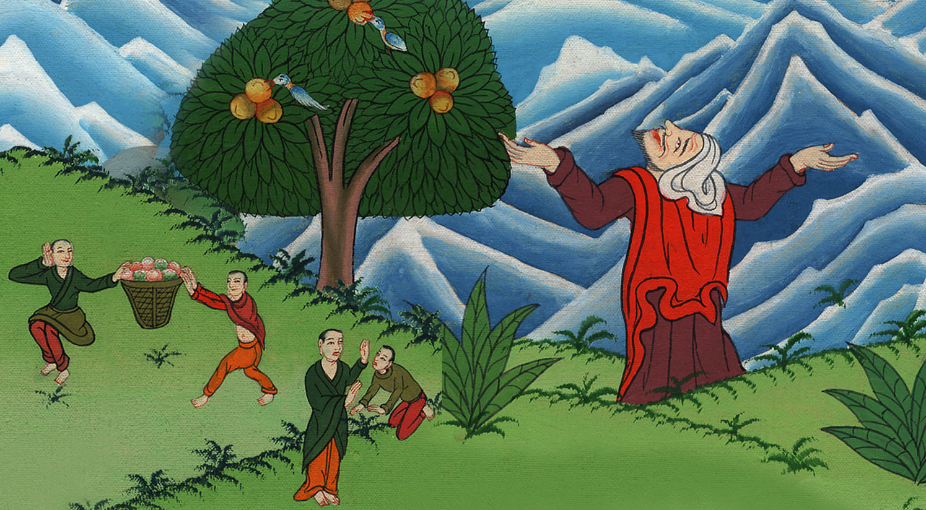
उत्पत्ति 6:8

Slide 15
9This is the account of Noah. Noah was a righteous man, blameless in his generation; Noah walked with God.
9 नूह की वंशावली यह है। नूहb धर्मी पुरुष और अपने समय के लोगों में खरा था; और नूह परमेश्वर ही के साथ-साथ चलता रहा।

Slide 16
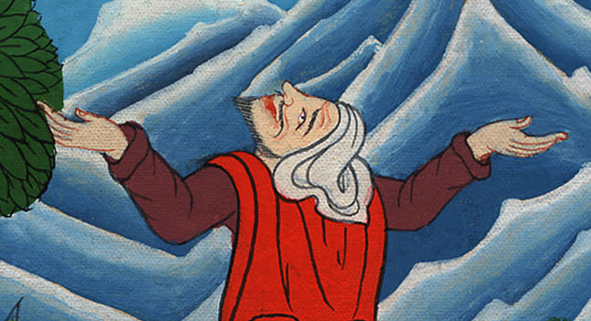
उत्पत्ति 6:9

Slide 17
10And Noah had three sons: Shem, Ham, and Japheth.
10 और नूह से शेम, और हाम, और येपेत नामक, तीन पुत्र उत्पन्न हुए।

Slide 18
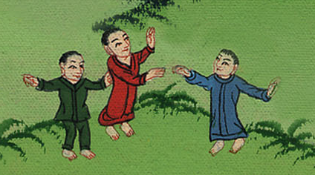
उत्पत्ति 6:10

Slide 19
11Now the earth was corrupt in the sight of God, and full of violence.
11 उस समय पृथ्वी परमेश्वर की दृष्टि में बिगड़ गईc थी, और उपद्रव से भर गई थी।

Slide 20
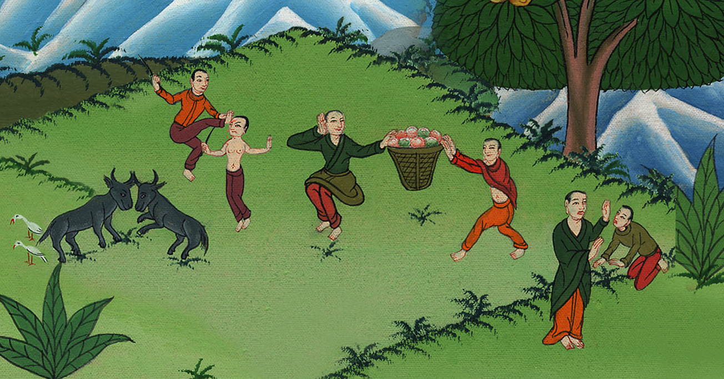
उत्पत्ति 6:11
Notes:
.

