Slide 1
03-3
These materials are by the Kongki Ka Project and are made available to you under the terms of the Creative Commons Attribution ShareAlike license 4.0.
You have permission to share and redistribute these materials in any format and to make reasonable revisions and adaptations of this translation, provided that:
You include the above licence and source information.
If you redistribute these materials or create derivatives, you must distribute your contributions under the same license as the original.
The Holy Bible, Berean Standard Bible, BSB is produced in cooperation with Bible Hub, Discovery Bible, OpenBible.com, and the Berean Bible Translation Committee. This text of God's Word has been dedicated to the public domain.
Hindi text is from Free Bibles India. This translation is made available under the terms of a Creative Commons Attribution-ShareAlike 4.0 International License.
Notes:
03 Sin Continues – Gen 4-9
1) Cain & Able – Gen 4:1-15 (Left Top)
2) Corruption of Mankind – Gen 6:1-7 (Center Top)
3) Noah found favor – Gen 6:8-12 (Right Top)
4) Noah builds the Arc – Gen 6:13-22 (Right 2nd)
5) Animals board the Arc – Gen 7:1-10 (Right Bottom)
6) Floods come – Gen 7:11-16 (Left Bottom)
7) Flood waters cover the earth – Gen 7:17-8:12 (Center)
8) Floods dry up – Gen 8:13-19 (Left 2nd from Bottom)
9) Rainbow – Gen 8:20-9:17 (Left 3rd from Bottom)

Slide 2
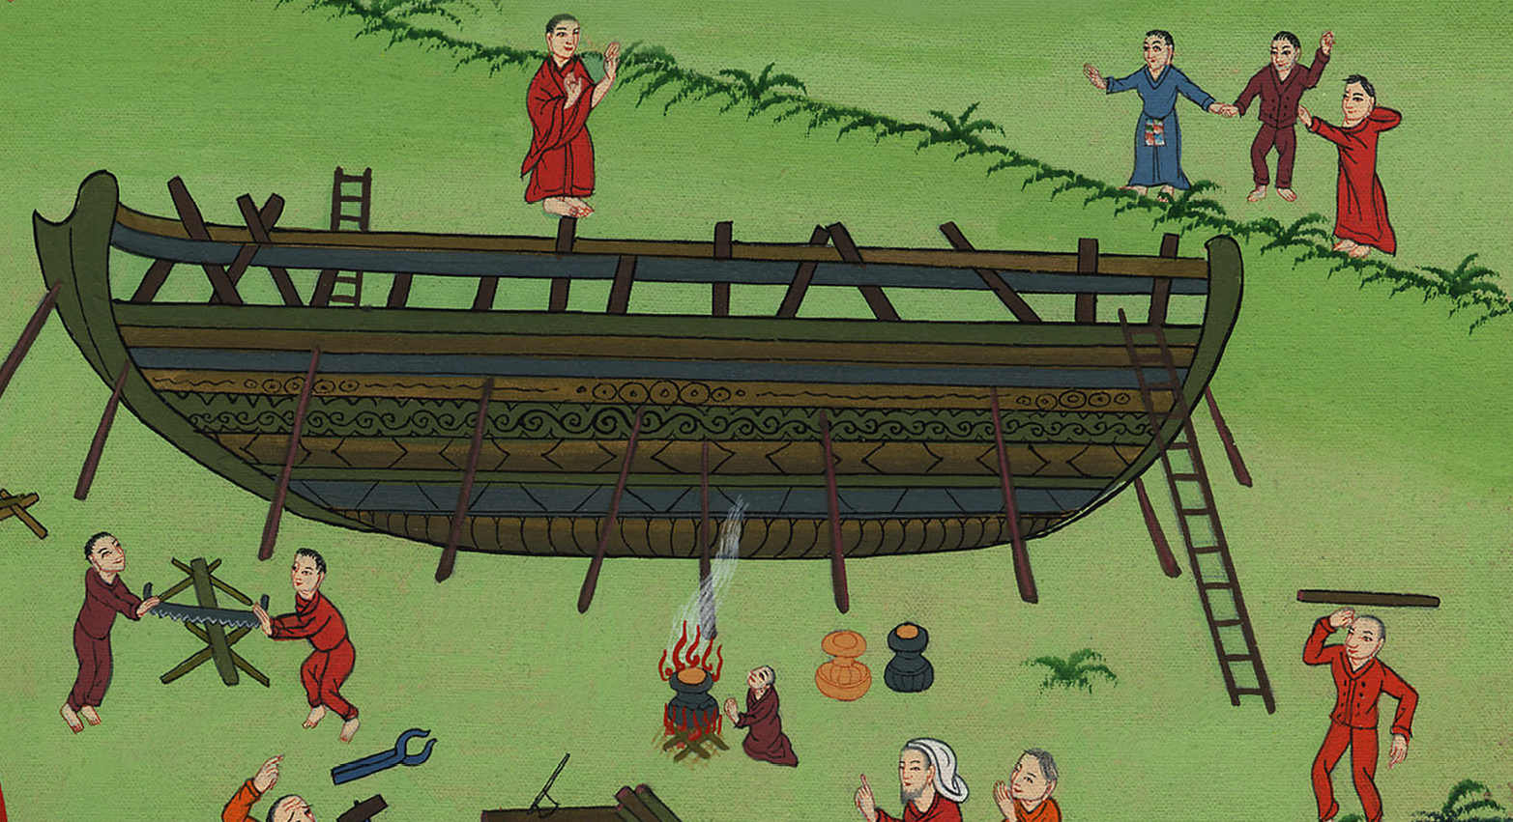
नूह का जहाज़ को बनाना –
उत्पत्ति 6:12-22
This work is licensed under a Creative Commons Attribution-ShareAlike 4.0 International License

Slide 3
Noah builds the Ark – Genesis 6:12-22
नूह का जहाज़ को बनाना –उत्पत्ति 6:12-22

Slide 4
नूह का जहाज़ को बनाना –
उत्पत्ति 6:12-22

Slide 5
12And God looked upon the earth and saw that it was corrupt; for all living creatures on the earth had corrupted their ways.
12 और परमेश्वर ने पृथ्वी पर जो दृष्टि की तो क्या देखा कि वह बिगड़ी हुई है; क्योंकि सब प्राणियों ने पृथ्वी पर अपना-अपना चाल-चलन बिगाड़ लिया था।

Slide 6
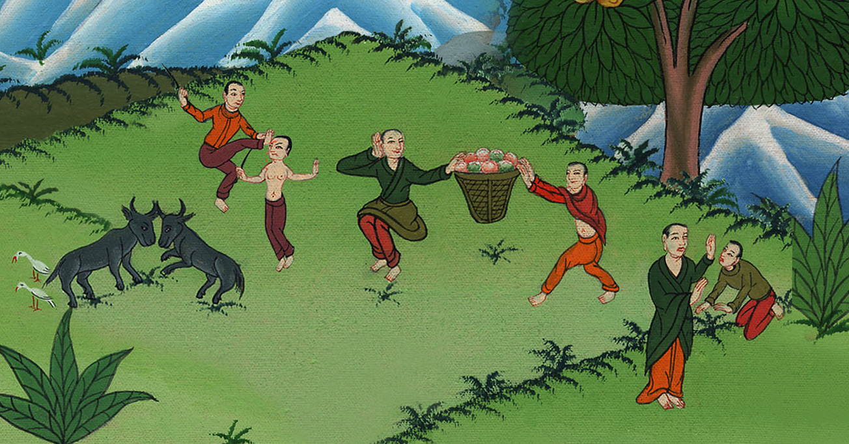
उत्पत्ति 6:12
Notes:
.

Slide 7
13God said to Noah, “I will bring an end to all flesh, for the earth is filled with violence through them. Behold, I will destroy them and the earth.
1313 तब परमेश्वर ने नूह से कहा, “सब प्राणियों के अन्त करने का प्रश्न मेरे सामने आ गया है; क्योंकि उनके कारण पृथ्वी उपद्रव से भर गई है, इसलिए मैं उनको पृथ्वी समेत नाश कर डालूँगा।

Slide 8
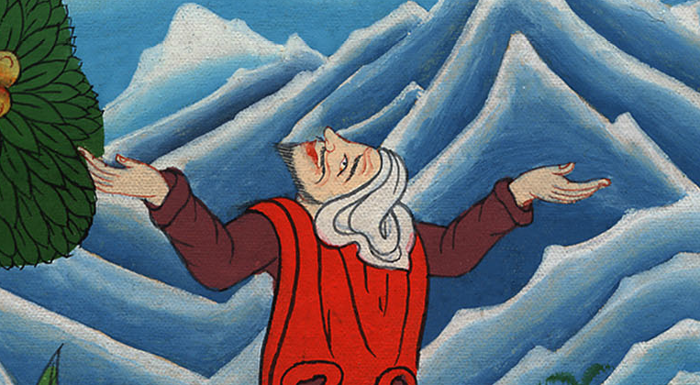
उत्पत्ति 6:13

Slide 9
14Make a ship of gopher wood. You shall make rooms in the ship, and shall seal it inside and outside with pitch.
14इसलिये नोहा से याहवेह ने कहा कि तुम अपने लिए गोपेर पेड़ की लकड़ी का एक बड़ा जहाज़ बनाना; जहाज़ में कई अलग-अलग भाग बनाना, और भीतर बाहर उस पर राल लगाना.

Slide 10
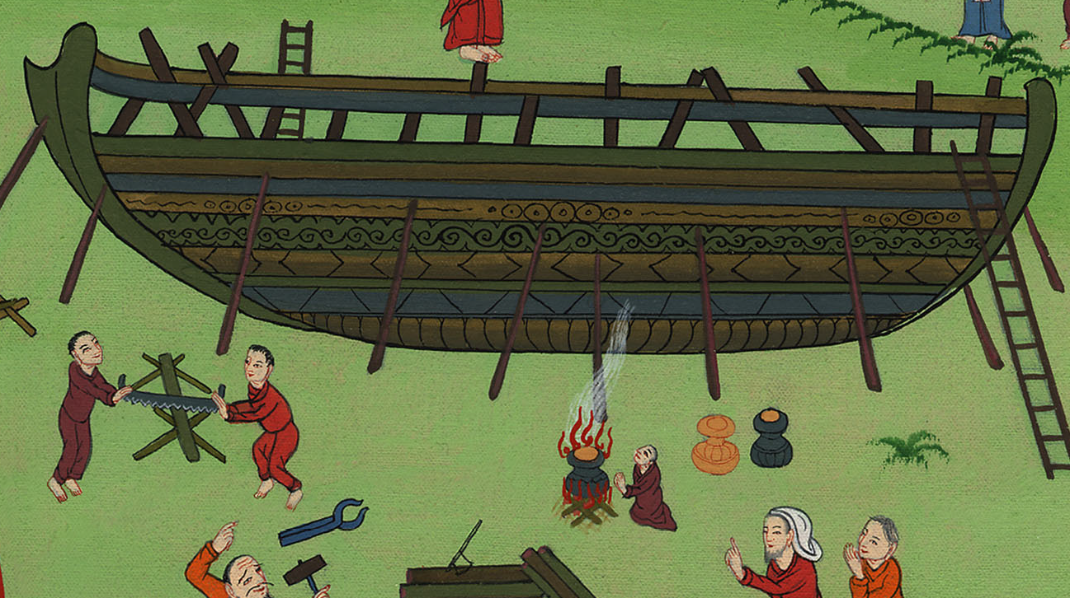
उत्पत्ति 6:14

Slide 11
15Here is how I want you to build it. The ark has to be 450 feet long. It has to be 75 feet wide and 45 feet high. (nirv)
5जहाज़ की लंबाई 135 मीटर, चौड़ाई 23 मीटर तथा ऊंचाई 14 मीटर रखना.

Slide 12
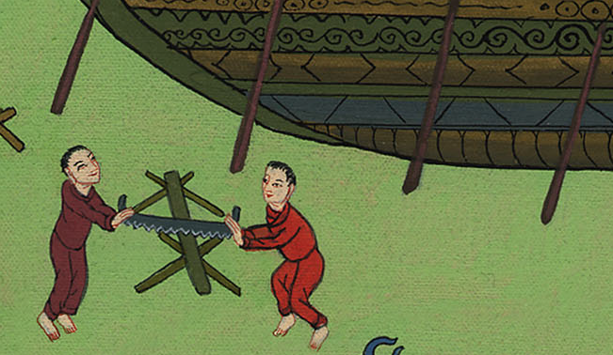
उत्पत्ति 6:15

Slide 13
16You shall make a roof in the ship, and you shall finish it to a cubit upward. You shall set the door of the ship in its side. You shall make it with lower, second, and third levels.
16इसके लिए एक छत बनाना. जहाज़ में एक खिड़की बनाना, जो ऊपर की ओर छत से आधा मीटर नीचे होगी, जहाज़ के एक तरफ दरवाजा रखना. जहाज़ में पहली, दूसरी तथा तीसरी मंजिलें बनाना.

Slide 14
उत्पत्ति 6:16

Slide 15
17I, even I, will bring the flood of waters on this earth, to destroy all flesh having the breath of life from under the sky. Everything that is in the earth will die.
17क्योंकि मैं पृथ्वी को जलप्रलय से नाश कर दूंगा और कोई न बचेगा; सबको जिनमें जीवन की आत्मा है, आकाश के नीचे से मैं नाश करनेवाला हूं.

Slide 16
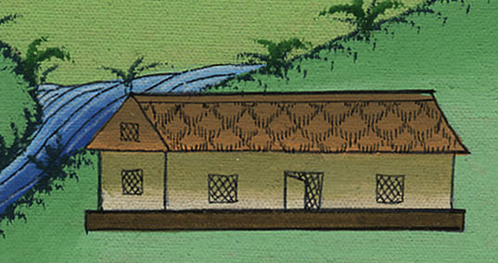
उत्पत्ति 6:17

Slide 17
18But I will establish my covenant with you. You shall come into the ship, you, your sons, your wife, and your sons’ wives with you.
18लेकिन मैं तुम्हारे साथ अपनी वाचा बांधूंगा—जहाज़ में तुम, तुम्हारे पुत्र, तुम्हारी पत्नी तथा तुम्हारी बहुओं सहित प्रवेश करना.

Slide 18
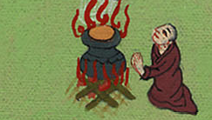
उत्पत्ति 6:18

Slide 19
19Of every living thing of all flesh, you shall bring two of every sort into the ship, to keep them alive with you. They shall be male and female.
19और प्रत्येक जीवित प्राणी के दो-दो अर्थात् नर एवं मादा को जहाज़ में ले जाना, ताकि वे तुम्हारे साथ जीवित रह सकें.

Slide 20
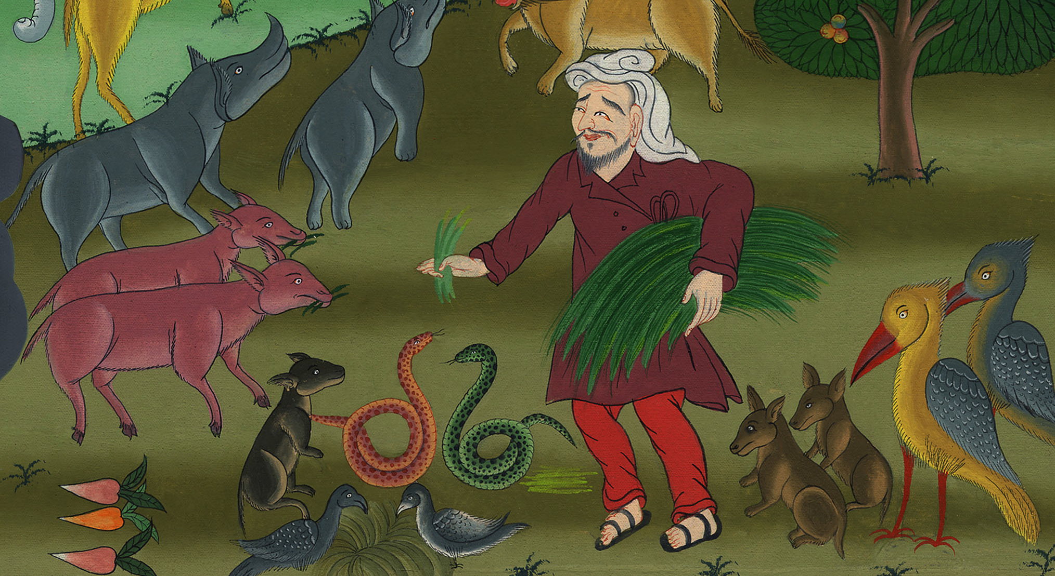
उत्पत्ति 6:19

Slide 21
20Of the birds after their kind, of the livestock after their kind, of every creeping thing of the ground after its kind, two of every sort will come to you, to keep them alive.
20पक्षी भी अपनी-अपनी जाति के, पशु अपनी-अपनी जाति के, भूमि पर रेंगनेवाले जंतु अपनी-अपनी जाति के सभी जातियों के जोड़े जहाज़ में रखना, ताकि वे जीवित रह सकें.

Slide 22
उत्पत्ति 6:19,20
Notes:
19Bring a male and a female of every living thing into the ark. They will be kept alive with you. 20Two of every kind of bird will come to you. Two of every kind of animal will also come to you. And so will two of every kind of creature that moves along the ground. All of them will be kept alive with you.

Slide 23
21Take with you some of all food that is eaten, and gather it to yourself; and it will be for food for you, and for them.”
21और खाने के लिए सब प्रकार का भोजन रखना, जो सबके लिए होगा.”

Slide 24
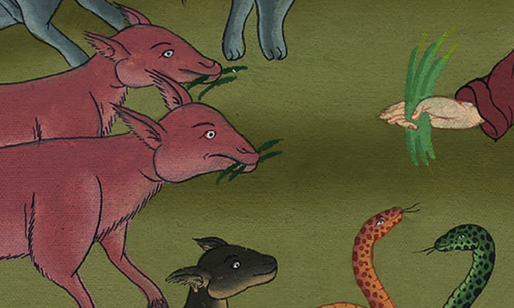
उत्पत्ति 6:21

Slide 25
22Thus Noah did. He did all that God commanded him.
22नोहा ने वैसा ही किया, जैसा परमेश्वर ने उनसे कहा.

Slide 26
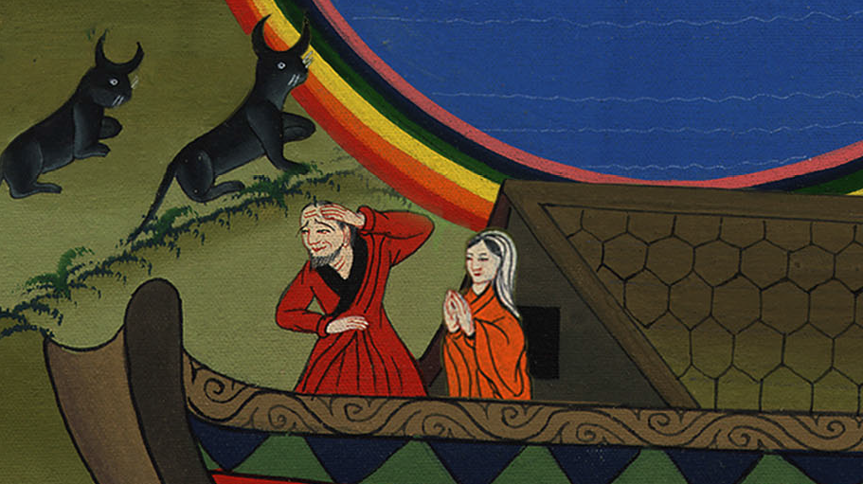
उत्पत्ति 6:22

