Slide 1
05-10
These materials are by the Kongki Ka Project and are made available to you under the terms of the Creative Commons Attribution ShareAlike license 4.0.
You have permission to share and redistribute these materials in any format and to make reasonable revisions and adaptations of this translation, provided that:
You include the above licence and source information.
If you redistribute these materials or create derivatives, you must distribute your contributions under the same license as the original.
The Holy Bible, Berean Standard Bible, BSB is produced in cooperation with Bible Hub, Discovery Bible, OpenBible.com, and the Berean Bible Translation Committee. This text of God's Word has been dedicated to the public domain.
Hindi text is from Free Bibles India. This translation is made available under the terms of a Creative Commons Attribution-ShareAlike 4.0 International License.

Slide 2
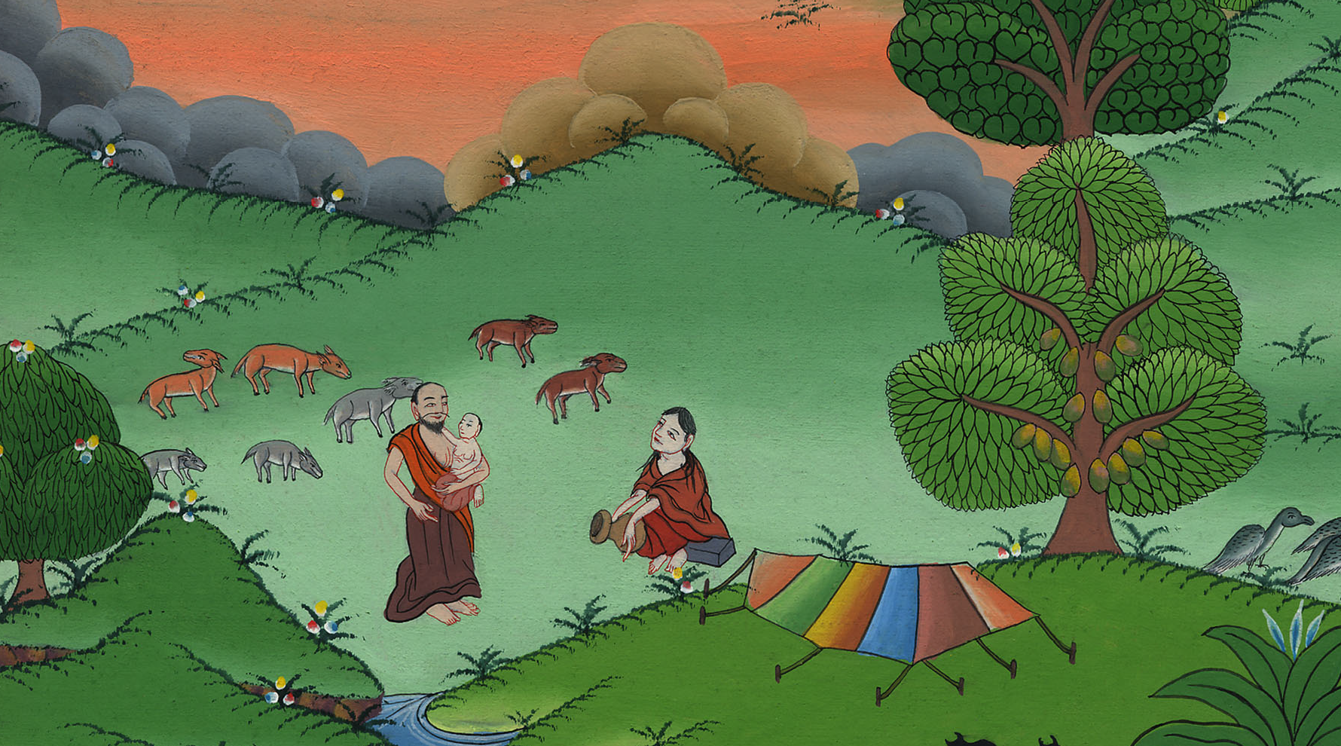
10
इसहाक का जन्म– उत्पत्ति 21:1-8
This work is licensed under a Creative Commons Attribution-ShareAlike 4.0 International License

Slide 3
The Birth of Isaac – Genesis 21:1-8
इसहाक का जन्म– उत्पत्ति 21:1-8

Slide 4
इसहाक का जन्म– उत्पत्ति 21:1-8
Notes:
10 Isaac Born – Gen 21:1-8 (Left 3rd) ཨི་སཱག་སྐྱེས་པ།
Introduction:
After the destruction of Sodom, Abraham decides to move to a new place. He leads his growing clan to the Negev region, near the dessert.

Slide 5
After the destruction of Sodom, Abraham decides to move to a new place. He leads his growing clan to the Negev region, near the dessert.
सदोम के विनाश के बाद, इब्राहीम एक नई जगह पर जाने का फैसला करता है। वह अपने बढ़ते कबीले को डेज़र्ट के पास नेगेव क्षेत्र में ले जाता है।

Slide 6
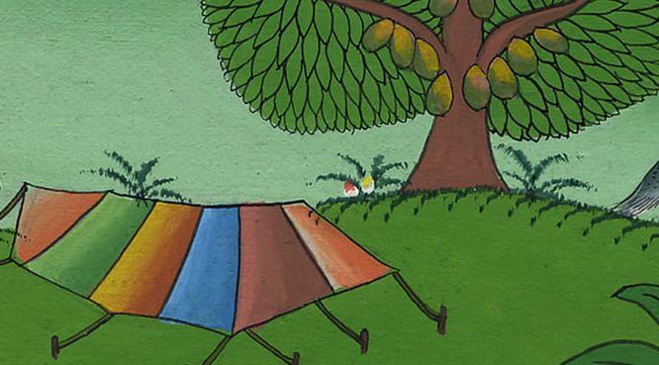

Slide 7
1Now the Lord attended to Sarah as He had said, and the Lord did for Sarah what He had promised.
1यहोवा ने जैसा कहा था वैसा ही सारा की सुधि लेकर उसके साथ अपने वचन के अनुसार कियाa।

Slide 8
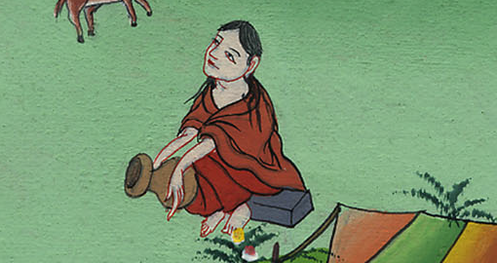
उत्पत्ति 21:1
Notes:
The Lord was gracious to Sarah, just as he had said he would be. The Lord did for Sarah what he had promised to do.
1དཀོན་མཆོག་གིས་དམ་བཅའ་གནང་བ་བཞིན་ས་རཱ་ལ་བྱིན་རླབས་གནང་ཞིང་།

Slide 9
2So Sarah conceived and bore a son to Abraham in his old age, at the very time God had promised.
2 सारा अब्राहम से गर्भवती होकर उसके बुढ़ापे में उसी नियुक्त समय पर जो परमेश्वर ने उससे ठहराया था, एक पुत्र उत्पन्न हुआ।

Slide 10
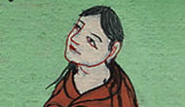
उत्पत्ति 21:2
Notes:
² Sarah became pregnant. She had a son by Abraham when he was old. The child was born at the exact time God had promised.
2ས་རཱ་མངལ་དང་ལྡན་པར་འགྱུར་ནས། ཨབ་ར་ཧམ་རྒས་པའི་ཚེ་མོ་ལ་བུ་ཞིག་སྐྱེས་སོ། བུ་དེ་ནི་དཀོན་མཆོག་གིས་སྐྱེས་ཡོང་གསུངས་པའི་དུས་ཚོད་དེ་རང་ལ་སྐྱེས་སོ།

Slide 11
3And Abraham gave the name Isaac to the son Sarah bore to him.
3 अब्राहम ने अपने पुत्र का नाम जो सारा से उत्पन्न हुआ था इसहाक रखा।

Slide 12
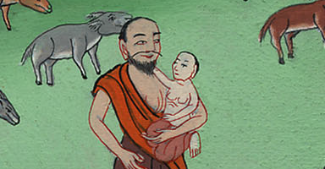
उत्पत्ति 21:3
Notes:
³ Abraham gave the name Isaac to the son Sarah had by him.
3ཨབ་ར་ཧམ་གྱིས་བུ་དེའི་མིང་ཨི་སཱག་ཞེས་བཏགས་སོ།

Slide 13
4When his son Isaac was eight days old, Abraham circumcised him, as God had commanded him.
4 और जब उसका पुत्र इसहाक आठ दिन का हुआ, तब उसने परमेश्वर की आज्ञा के अनुसार उसका खतना किया।

Slide 14
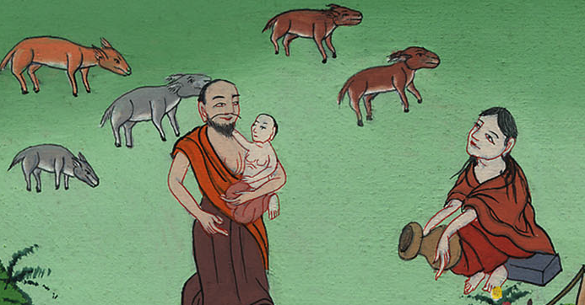
उत्पत्ति 21:4
Notes:
⁴ When his son Isaac was eight days old, Abraham circumcised him. He did it exactly as God had commanded him.
4དཀོན་མཆོག་གིས་བཀའ་གནང་བ་བཞིན་ཨི་སཱག་སྐྱེས་ནས་ཉི་མ་བརྒྱད་ལོན་པའི་རྗེས་སུ་ཨབ་ར་ཧམ་གྱིས་ཁོའི་མདུན་ལྤགས་བཅད་དོ།

Slide 15
5Abraham was a hundred years old when his son Isaac was born to him.
5 जब अब्राहम का पुत्र इसहाक उत्पन्न हुआ तब वह एक सौ वर्ष का था।

Slide 16
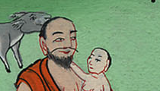
उत्पत्ति 21:5
Notes:
⁵ Abraham was 100 years old when his son Isaac was born to him.
5ཨི་སཱག་སྐྱེས་པའི་ཚེ་ཨབ་ར་ཧམ་ལོ་ ༡༠༠ ལོན་ཡོད་པ་དང་།

Slide 17
6Then Sarah said, “God has made me laugh, and everyone who hears of this will laugh with me.”
6 और सारा ने कहा, “परमेश्वर ने मुझे प्रफुल्लित किया है; इसलिए सब सुननेवाले भी मेरे साथ प्रफुल्लित होंगे।”

Slide 18
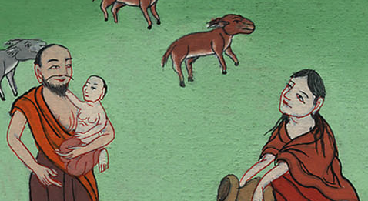
उत्पत्ति 21:6
Notes:
⁶ Sarah said, “God has given laughter to me. Everyone who hears about this will laugh with me.”
6ས་རཱས། ཕྲུ་གུ་འདི་སྐྱེས་པའི་སྒོ་ནས་དཀོན་མཆོག་གིས་ང་ལ་དགའ་བ་དང་། གད་མོ་གནང་བས། བྱ་བ་དེའི་སྐོར་ཐོས་མཁན་རྣམས་ཀྱིས་ཀྱང་ང་དང་མཉམ་དུ་གད་མོ་བགད་ཡོང།

