Slide 1
06-1
These materials are by the Kongki Ka Project and are made available to you under the terms of the Creative Commons Attribution ShareAlike license 4.0.
You have permission to share and redistribute these materials in any format and to make reasonable revisions and adaptations of this translation, provided that:
You include the above licence and source information.
If you redistribute these materials or create derivatives, you must distribute your contributions under the same license as the original.
The Holy Bible, Berean Standard Bible, BSB is produced in cooperation with Bible Hub, Discovery Bible, OpenBible.com, and the Berean Bible Translation Committee. This text of God's Word has been dedicated to the public domain.
Hindi text is from Free Bibles India. This translation is made available under the terms of a Creative Commons Attribution-ShareAlike 4.0 International License.

Slide 2
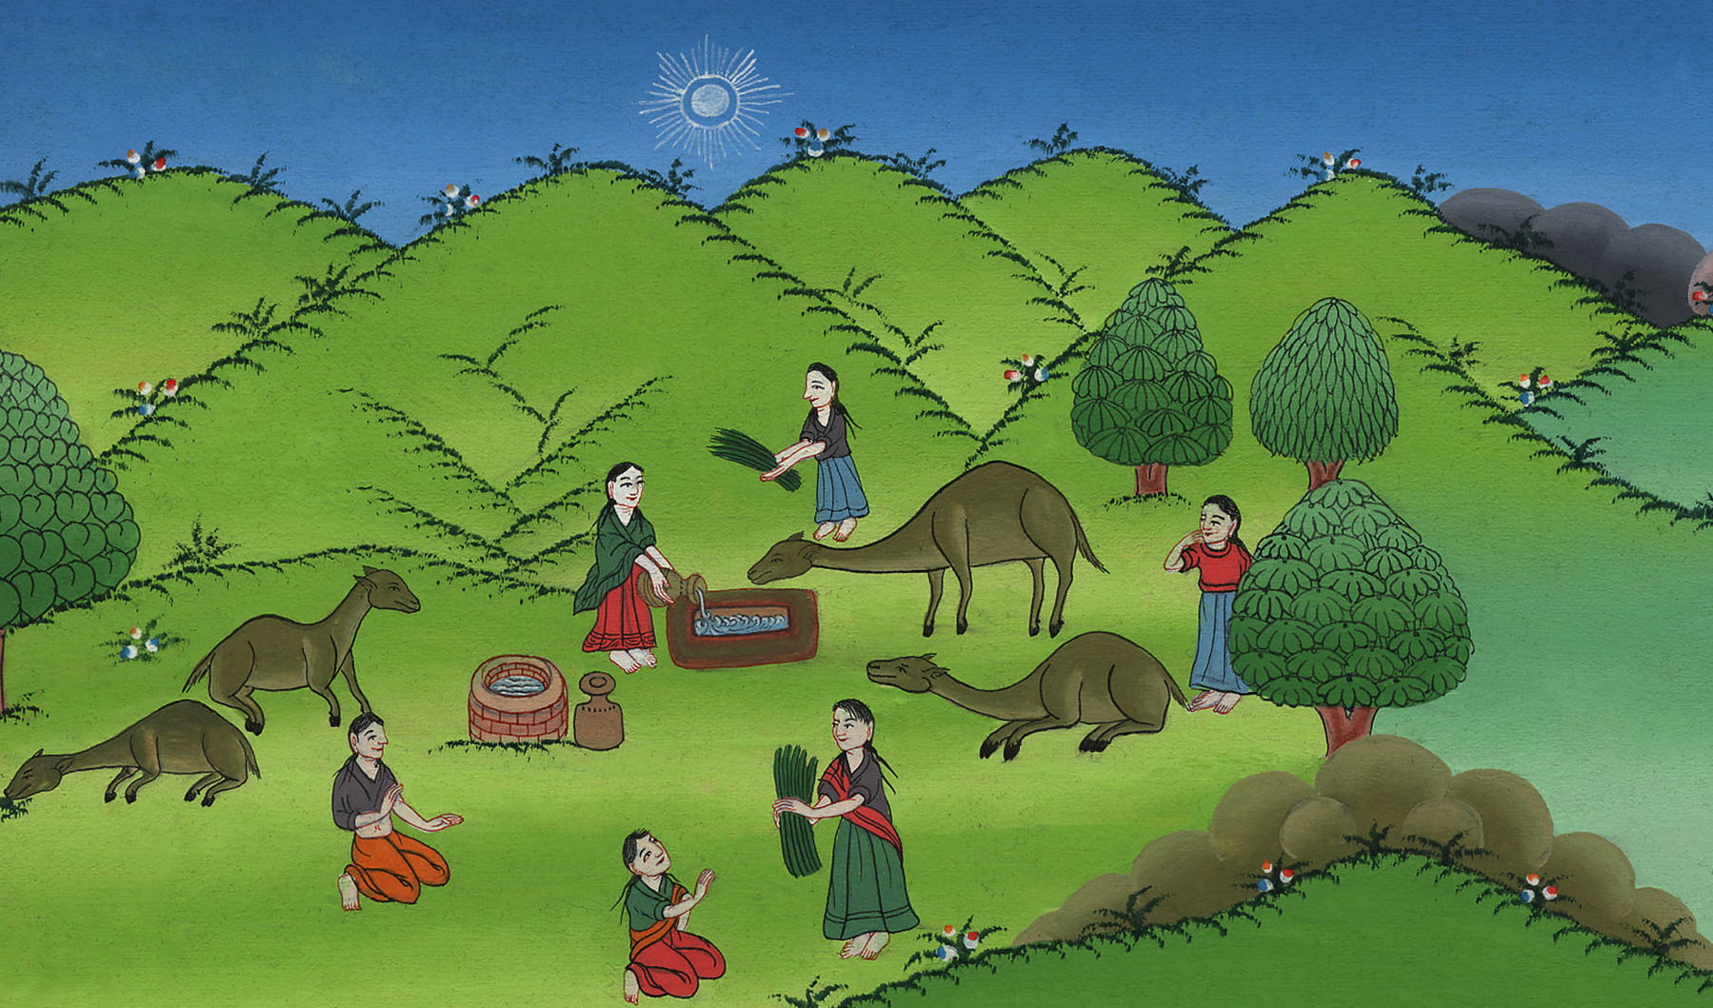
इसहाक के लिए पत्नी ढूँढना - उत्पत्ति 24:1-61
This work is licensed under a Creative Commons Attribution-ShareAlike 4.0 International License
Notes:
Checked

Slide 3
A wife for Isaac – Genesis 24:1-61
इसहाक के लिए पत्नी ढूँढना - उत्पत्ति 24:1-61

Slide 4
इसहाक के लिए पत्नी ढूँढना - उत्पत्ति 24:1-61
Notes:
Abraham sends his servant to find a wife for Isaac – Gen 24:1-61

Slide 5
1By now Abraham was old and well along in years, and the Lord had blessed him in every way.
1अब्राहम अब वृद्ध हो गया था और उसकी आयु बहुत थी और यहोवा ने सब बातों में उसको आशीष दी थी।

Slide 6
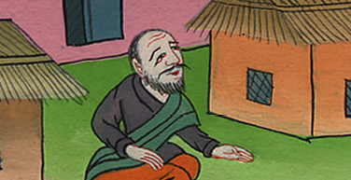
उत्पत्ति 24:1
Notes:
24:1 By that time Abraham was very old. The Lord had blessed Abraham in every way

Slide 7
2So Abraham instructed the chief servant of his household, who managed all he owned, “Place your hand under my thigh,
2 अब्राहम ने अपने उस दास से, जो उसके घर में पुरनिया और उसकी सारी सम्पत्ति पर अधिकारी थाa, कहा, “अपना हाथ मेरी जाँघ के नीचे रख;

Slide 8
उत्पत्ति 24:2
Notes:
. ² The best servant in his house was in charge of everything Abraham had. Abraham said to him, “

Slide 9
3and I will have you swear by the Lord, the God of heaven and the God of earth, that you will not take a wife for my son from the daughters of the Canaanites among whom I am dwelling,
3 और मुझसे आकाश और पृथ्वी के परमेश्वर यहोवा की इस विषय में शपथ खाb, कि तू मेरे पुत्र के लिये कनानियों की लड़कियों में से, जिनके बीच मैं रहता हूँ, किसी को न लाएगा।

Slide 10
उत्पत्ति 24:3
Notes:
³ The Lord is the God of heaven and the God of earth. I want you to make a promise to me in his name. I’m living among the people of Canaan. But I want you to promise me that you won’t get a wife for my son from their daughters.

Slide 11
4but will go to my country and my kindred to take a wife for my son Isaac.”
4 परन्तु तू मेरे देश में मेरे ही कुटुम्बियों के पास जाकर मेरे पुत्र इसहाक के लिये एक पत्नी ले आएगा।”

Slide 12
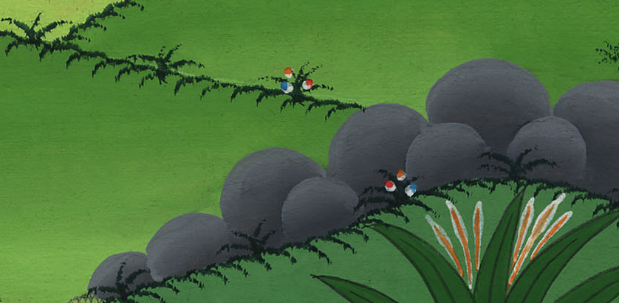
उत्पत्ति 24:4
Notes:
⁴ Instead, promise me that you will go to my country and to my own relatives. Get a wife for my son Isaac from there.”

Slide 13
10Then the servant took ten of his master’s camels and departed with all manner of good things from his master in hand. And he set out for Nahor’s hometown in Aram-naharaim.
10 तब वह दास अपने स्वामी के ऊँटों में से दस ऊँट छाँटकर उसके सब उत्तम-उत्तम पदार्थों में से कुछ कुछ लेकर चला; और अरम्नहरैम में नाहोर के नगर के पास पहुँचा।

Slide 14
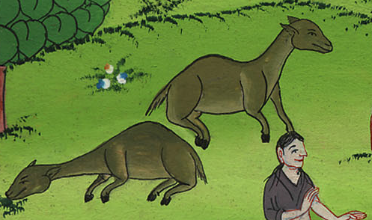
उत्पत्ति 24:10
Notes:
¹⁰ The servant chose ten of his master’s camels and left. He loaded the camels with all kinds of good things from his master. He started out for Aram Naharaim and made his way to the town of Nahor.

Slide 15
11As evening approached, he made the camels kneel down near the well outside the town at the time when the women went out to draw water.
11 और उसने ऊँटों को नगर के बाहर एक कुएँ के पास बैठाया। वह संध्या का समय था, जिस समय स्त्रियाँ जल भरने के लिये निकलती हैं।

Slide 16
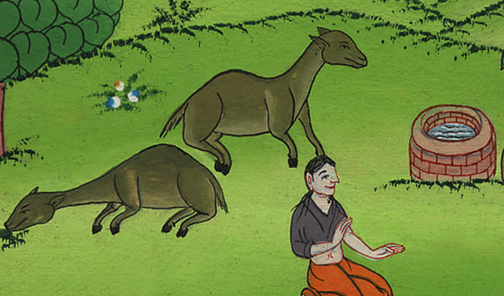
उत्पत्ति 24:11
Notes:
¹¹ He stopped near the well outside the town. There he made the camels get down on their knees. It was almost evening, the time when women go out to get water.

Slide 17
12“O Lord, God of my master Abraham,” he prayed, “please grant me success today, and show kindness to my master Abraham.
12 वह कहने लगा, “हे मेरे स्वामी अब्राहम के परमेश्वर यहोवा, आज मेरे कार्य को सिद्ध कर, और मेरे स्वामी अब्राहम पर करुणा कर।

Slide 18
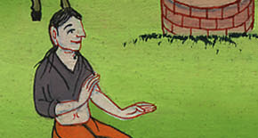
उत्पत्ति 24:12
Notes:
¹² Then he prayed, “Lord, you are the God of my master Abraham. Make me successful today. Be kind to my master Abraham.

Slide 19
13Here I am, standing beside the spring, and the daughters of the townspeople are coming out to draw water.
13 देख, मैं जल के इस सोते के पास खड़ा हूँ; और नगरवासियों की बेटियाँ जल भरने के लिये निकली आती हैं

Slide 20
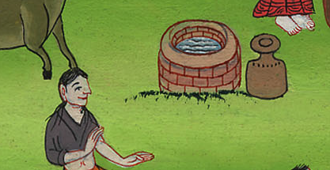
उत्पत्ति 24:13
Notes:
¹³ I’m standing beside this spring. The daughters of the people who live in the town are coming out here to get water.

Slide 21
14Now may it happen that the girl to whom I say, ‘Please let down your jar that I may drink,’ and who responds, ‘Drink, and I will water your camels as well’—let her be the one You have appointed for Your servant Isaac. By this I will know that You have shown kindness to my master.”
14 इसलिए ऐसा होने दे कि जिस कन्या से मैं कहूँ, ‘अपना घड़ा मेरी ओर झुका, कि मैं पीऊँ,’ और वह कहे, ‘ले, पी ले, बाद में मैं तेरे ऊँटों को भी पिलाऊँगी,’ यह वही हो जिसे तूने अपने दास इसहाक के लिये ठहराया हो; इसी रीति मैं जान लूँगा कि तूने मेरे स्वामी पर करुणा की है।”

Slide 22
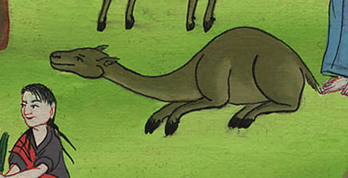
उत्पत्ति 24:14
Notes:
¹⁴ I will speak to a young woman. I’ll say to her, ‘Please lower your jar so I can have a drink.’ Suppose she says, ‘Have a drink of water, and I’ll get some for your camels too.’ Then let her be the one you have chosen for your servant Isaac. That’s how I’ll know you have been kind to my master.”

Slide 23
15Before the servant had finished praying, Rebekah came out with her jar on her shoulder. She was the daughter of Bethuel son of Milcah, the wife of Abraham’s brother Nahor.
15 और ऐसा हुआ कि जब वह कह ही रहा था कि रिबका, जो अब्राहम के भाई नाहोर के जन्माये मिल्का के पुत्र, बतूएल की बेटी थी, वह कंधे पर घड़ा लिये हुए आई।

Slide 24
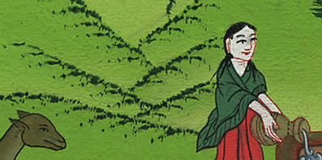
उत्पत्ति 24:15
Notes:
¹⁵ Before he had finished praying, Rebekah came out. She was carrying a jar on her shoulder.

Slide 25
16Now the girl was very beautiful, a virgin who had not had relations with any man. She went down to the spring, filled her jar, and came up again.
16 वह अति सुन्दर, और कुमारी थी, और किसी पुरुष का मुँह न देखा था। वह कुएँ में सोते के पास उतर गई, और अपना घड़ा भरकर फिर ऊपर आई।

Slide 26
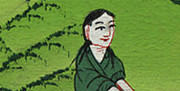
उत्पत्ति 24:16
Notes:
¹⁶ The young woman was very beautiful. No man had ever slept with her. She went down to the spring. She filled her jar and came up again.

Slide 27
17So the servant ran to meet her and said, “Please let me have a little water from your jar.”
17 तब वह दास उससे भेंट करने को दौड़ा, और कहा, “अपने घड़े में से थोड़ा पानी मुझे पिला दे।”

Slide 28
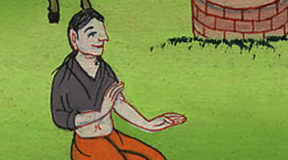
उत्पत्ति 24:17
Notes:
¹⁷ The servant hurried to meet her. He said, “Please give me a little water from your jar.”

Slide 29
18“Drink, my lord,” she replied, and she quickly lowered her jar to her hands and gave him a drink.
18 उसने कहा, “हे मेरे प्रभु, ले, पी ले,” और उसने फुर्ती से घड़ा उतारकर हाथ में लिये-लिये उसको पानी पिला दिया।

Slide 30
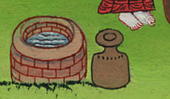
उत्पत्ति 24:18
Notes:
¹⁸ “Have a drink, sir,” she said. She quickly lowered the jar to her hands and gave him a drink.

Slide 31
19After she had given him a drink, she said, “I will also draw water for your camels, until they have had enough to drink.”
19 जब वह उसको पिला चुकी, तब कहा, “मैं तेरे ऊँटों के लिये भी तब तक पानी भर-भर लाऊँगी, जब तक वे पी न चुकें।”

Slide 32
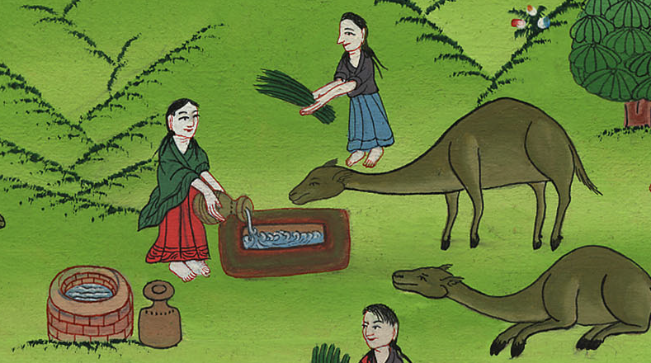
उत्पत्ति 24:19
Notes:
¹⁹ After she had given him a drink, she said, “I’ll get water for your camels too. I’ll keep doing it until they have had enough to drink.”

Slide 33
20And she quickly emptied her jar into the trough and ran back to the well to draw water, until she had drawn water for all his camels.
20 तब वह फुर्ती से अपने घड़े का जल हौद में उण्डेलकर फिर कुएँ पर भरने को दौड़ गई; और उसके सब ऊँटों के लिये पानी भर दिया।

Slide 34
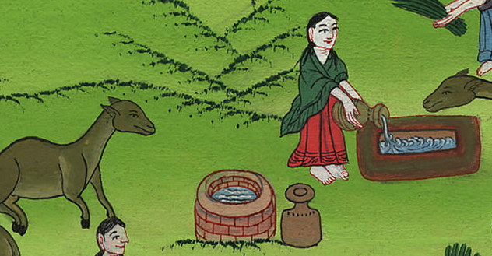
उत्पत्ति 24:20
Notes:
²⁰ So she quickly emptied her jar into the stone tub. Then she ran back to the well to get more water. She got enough for all his camels

Slide 35
22And after the camels had finished drinking, he took out a gold ring weighing a beka, and two gold bracelets for her wrists weighing ten shekels.
22 जब ऊँट पी चुके, तब उस पुरुष ने आधा तोला सोने का एक नत्थ निकालकर उसको दिया, और दस तोले सोने के कंगन उसके हाथों में पहना दिए;

Slide 36
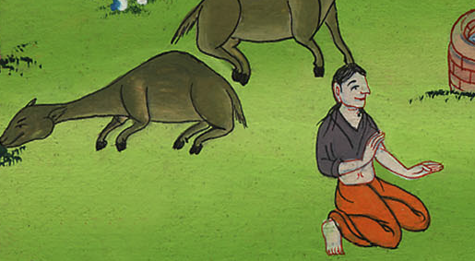
उत्पत्ति 24:22
Notes:
²² The camels finished drinking. Then the man took out a gold nose ring. It weighed about a fifth of an ounce. He also took out two gold bracelets. They weighed about four ounces.

Slide 37
23“Whose daughter are you?” he asked. “Please tell me, is there room in your father’s house for us to spend the night?”
23 और पूछा, “तू किसकी बेटी है? यह मुझ को बता। क्या तेरे पिता के घर में हमारे टिकने के लिये स्थान है?”

Slide 38
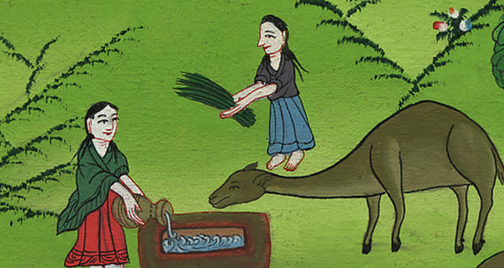
उत्पत्ति 24:23
Notes:
²³ Then he asked, “Whose daughter are you? And please tell me something else. Is there room in your father’s house for us? Can we spend the night there?”

Slide 39
24She replied, “I am the daughter of Bethuel, the son that Milcah bore to Nahor.”
24 उसने उत्तर दिया, “मैं तो नाहोर के जन्माए मिल्का के पुत्र बतूएल की बेटी हूँ।”

Slide 40
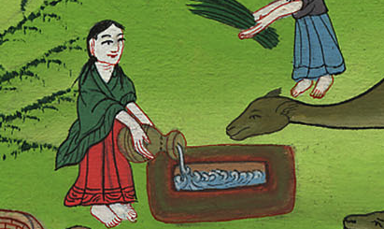
उत्पत्ति 24:24
Notes:
²⁴ She answered, “I’m the daughter of Bethuel. He’s the son Milkah had by Nahor.”

Slide 41
25Then she added, “We have plenty of straw and feed, as well as a place for you to spend the night.”
25 फिर उसने उससे कहा, “हमारे यहाँ पुआल और चारा बहुत है, और टिकने के लिये स्थान भी है।”

Slide 42
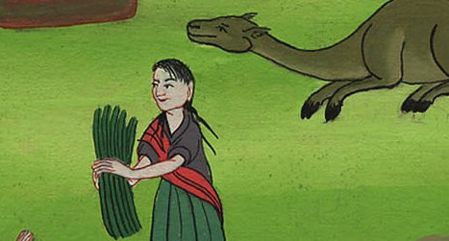
उत्पत्ति 24:25
Notes:
²⁵ She continued, “We have plenty of straw and feed for your camels. We also have room for you to spend the night.”

Slide 43
26Then the man bowed down and worshiped the Lord, 27saying, “Blessed be the Lord, the God of my master Abraham, who has not withheld His kindness and faithfulness from my master. As for me, the Lord has led me on the journey to the house of my master’s relatives.”
26 तब उस पुरुष ने सिर झुकाकर यहोवा को दण्डवत् करके कहाc, 27 “धन्य है मेरे स्वामी अब्राहम का परमेश्वर यहोवा, जिसने अपनी करुणा और सच्चाई को मेरे स्वामी पर से हटा नहीं लिया: यहोवा ने मुझ को ठीक मार्ग पर चलाकर मेरे स्वामी के भाई-बन्धुओं के घर पर पहुँचा दिया है।”

Slide 44
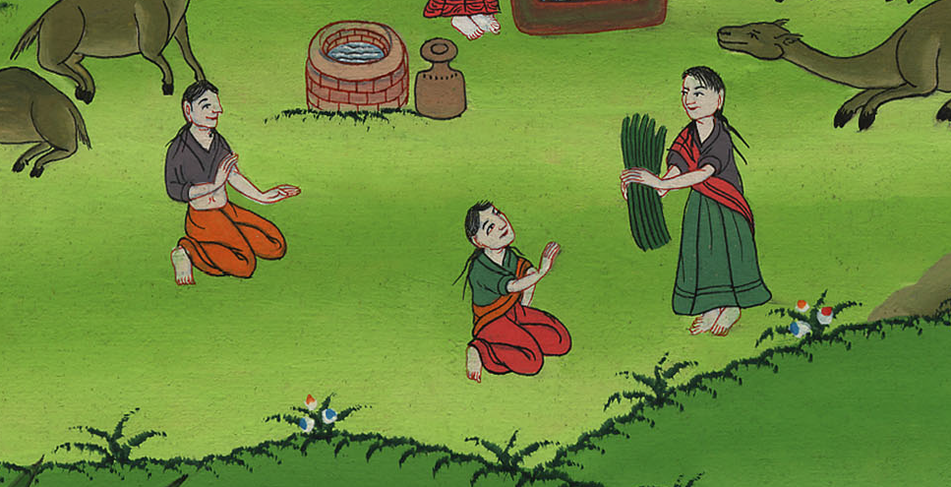
उत्पत्ति 24:26,27
Notes:
²⁶ Then the man bowed down and worshiped the Lord. ²⁷ He said, “I praise the Lord, the God of my master Abraham. The Lord hasn’t stopped being kind and faithful to my master. The Lord has led me on this journey. He has brought me to the house of my master’s relatives.”

Slide 45
28The girl ran and told her mother’s household about these things.
28 तब उस कन्या ने दौड़कर अपनी माता को इस घटना का सारा हाल बता दिया।

Slide 46
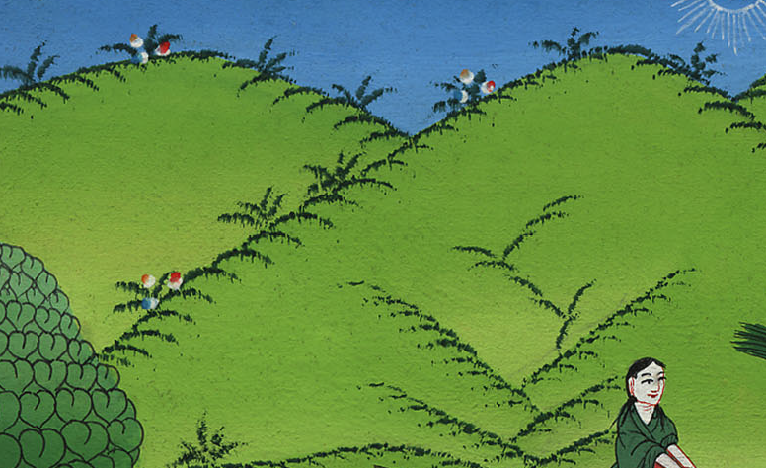
उत्पत्ति 24:28
Notes:
²⁸ The young woman ran home. She told her mother’s family what had happened.

Slide 47
(The servant went to Rebekha’s house and met her family. He told them everything.)
(नौकर रिबखा के घर गया और उसके परिवार से मिला। उसने उन्हें सब कुछ बताया।)

Slide 48
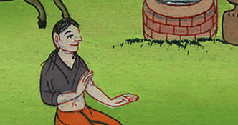
Notes:
The servant went to Rebekha’s house and met her family. He told them everything.

Slide 49
59So they sent their sister Rebekah on her way, along with her nurse and Abraham’s servant and his men.
59 तब उन्होंने अपनी बहन रिबका, और उसकी दाई और अब्राहम के दास, और उसके साथी सभी को विदा किया।

Slide 50
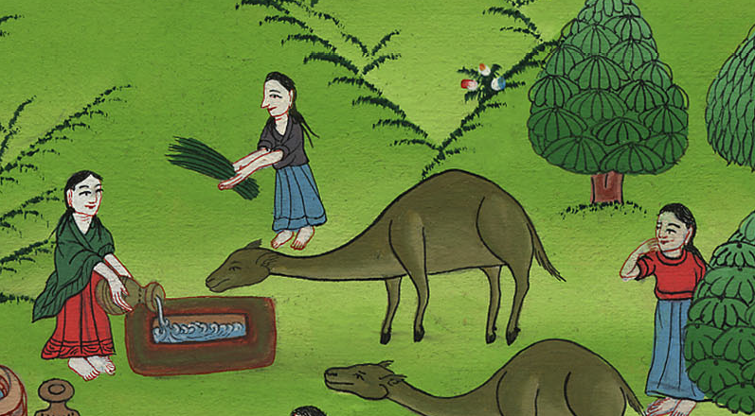
उत्पत्ति 24:59
Notes:
⁵⁹ So they sent their sister Rebekah on her way with Abraham’s servant and his men. They also sent Rebekah’s servant with her.

Slide 51
60And they blessed Rebekah and said to her,
“Our sister, may you become the mother
of thousands upon thousands.
May your offspring possess
the gates of their enemies.”
61Then Rebekah and her servant girls got ready, mounted the camels, and followed the man. So the servant took Rebekah and left.
60 और उन्होंने रिबका को आशीर्वाद देकर कहा, “हे हमारी बहन, तू हजारों लाखों की आदिमाता हो, और तेरा वंश अपने बैरियों के नगरों का अधिकारी हो।” 61 तब रिबका अपनी सहेलियों समेत चली; और ऊँट पर चढ़कर उस पुरुष के पीछे हो ली। इस प्रकार वह दास रिबका को साथ लेकर चल दिया।

Slide 52
བཀོད་པ 24:61
उत्पत्ति 24:60,61
Notes:
⁶¹ Then Rebekah and her female servants got ready. They got on their camels to go back with the man. So Abraham’s servant took Rebekah and left.

