Slide 1
14-1
These materials are by the Kongki Ka Project and are made available to you under the terms of the Creative Commons Attribution ShareAlike license 4.0.
You have permission to share and redistribute these materials in any format and to make reasonable revisions and adaptations of this translation, provided that:
You include the above licence and source information.
If you redistribute these materials or create derivatives, you must distribute your contributions under the same license as the original.
The Holy Bible, Berean Standard Bible, BSB is produced in cooperation with Bible Hub, Discovery Bible, OpenBible.com, and the Berean Bible Translation Committee. This text of God's Word has been dedicated to the public domain.
Hindi text is from Free Bibles India. This translation is made available under the terms of a Creative Commons Attribution-ShareAlike 4.0 International License.
Notes:
Ch
14 Ruth
1. Naomi’s son’s die - Ruth 1:1-5 (Left Top)
2. Ruth stays with Naomi – Ruth 1:6-22 (Right Top)
3. Ruth gleaning in the field of Boaz – Ruth 2:1-16 (Right Center)
4. Naomi advises Ruth – Ruth 2:17-23 (Right Bottom)
5. Ruth goes to Boaz – Ruth 3:1-18 (Left Bottom)
6. Boaz arranges marriage with Ruth – Ruth 4:1-12 (Left Center)
7. Naomi receives her grandson – Ruth 4:13-22 (Center)

Slide 2
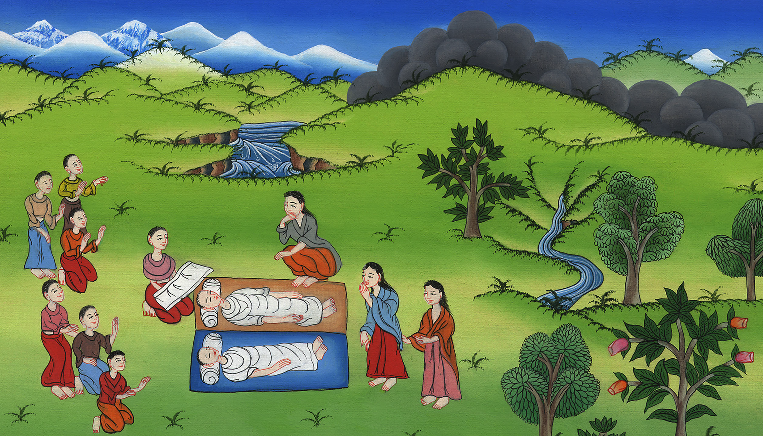
नाओमी के बेटे मर गए - रूत 1:1-5
This work is licensed under a Creative Commons Attribution-ShareAlike 4.0 International License

Slide 3
Naomi’s sons die – Ruth 1:1-5
नाओमी के बेटे मर गए - रूत 1:1-5

Slide 4
नाओमी के बेटे मर गए - रूत 1:1-5

Slide 5
1In the days when the judges ruled, there was a famine in the land. And a certain man from Bethlehem in Judah, with his wife and two sons, went to reside in the land of Moab.
1 जिन दिनों में न्यायी लोग राज्य करते थेa उन दिनों में देश में अकाल पड़ा, तब यहूदा के बैतलहम का एक पुरुष अपनी स्त्री और दोनों पुत्रों को संग लेकर मोआब के देश में परदेशी होकर रहने के लिए चला।

Slide 6
रूत 1:1

Slide 7
2The man’s name was Elimelech, his wife’s name was Naomi, and the names of his two sons were Mahlon and Chilion.
2 उस पुरुष का नाम एलीमेलेक, और उसकी पत्नी का नाम नाओमी, और उसके दो बेटों के नाम महलोन और किल्योन थे;
Notes:
check

Slide 8
रूत 1:2

Slide 9
…They were Ephrathites from Bethlehem in Judah, and they entered the land of Moab and settled there.
…ये एप्राती अर्थात् यहूदा के बैतलहम के रहनेवाले थे। वे मोआब के देश में आकर वहाँ रहे।
Notes:
check

Slide 10
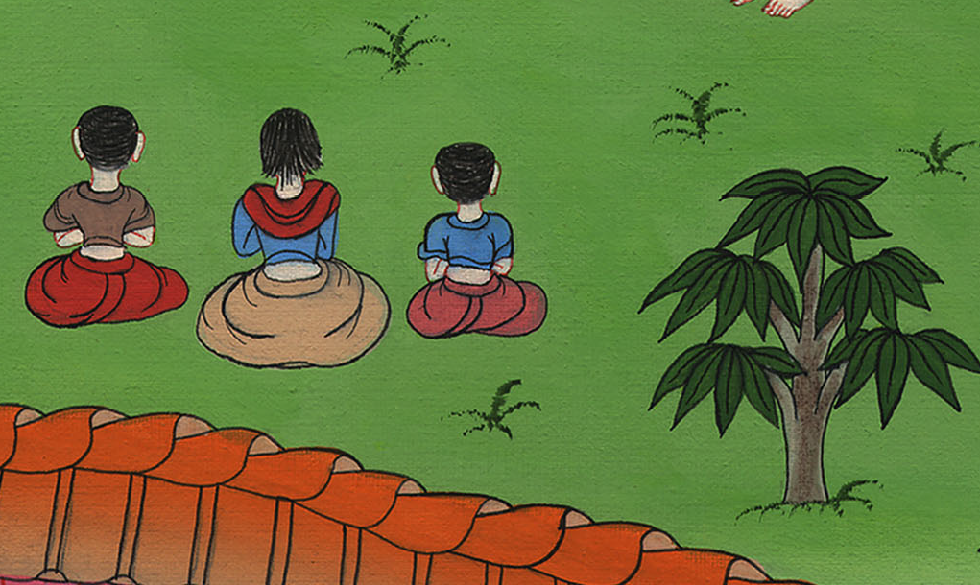
रूत 1:2

Slide 11
3Then Naomi’s husband Elimelech died, and she was left with her two sons,
3 और नाओमी का पति एलीमेलेक मर गया, और नाओमी और उसके दोनों पुत्र रह गए।

Slide 12
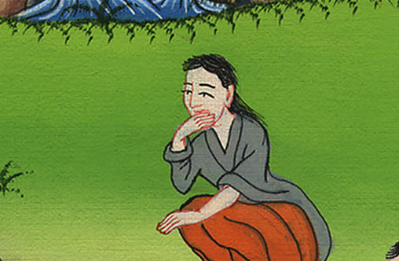
रूत 1:3

Slide 13
4who took Moabite women as their wives, one named Orpah and the other named Ruth.
And after they had lived in Moab about ten years,
4 और उन्होंने एक-एक मोआबिन स्त्री ब्याह लीb; एक स्त्री का नाम ओर्पा और दूसरी का नाम रूत था। फिर वे वहाँ कोई दस वर्ष रहे।

Slide 14
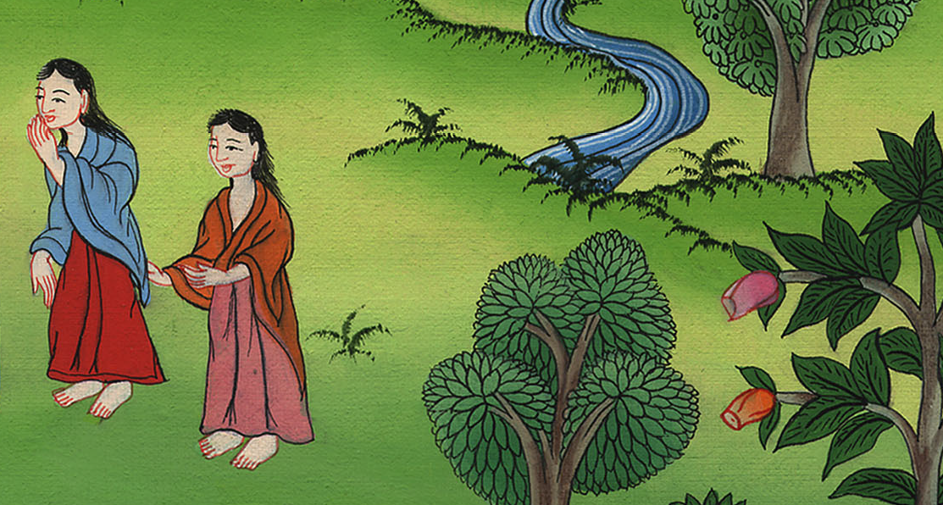
रूत 1:4

Slide 15
5both Mahlon and Chilion also died, and Naomi was left without her two sons and without her husband.
5 जब महलोन और किल्योन दोनों मर गए, तब नाओमी अपने दोनों पुत्रों और पति से वंचित हो गई।

Slide 16
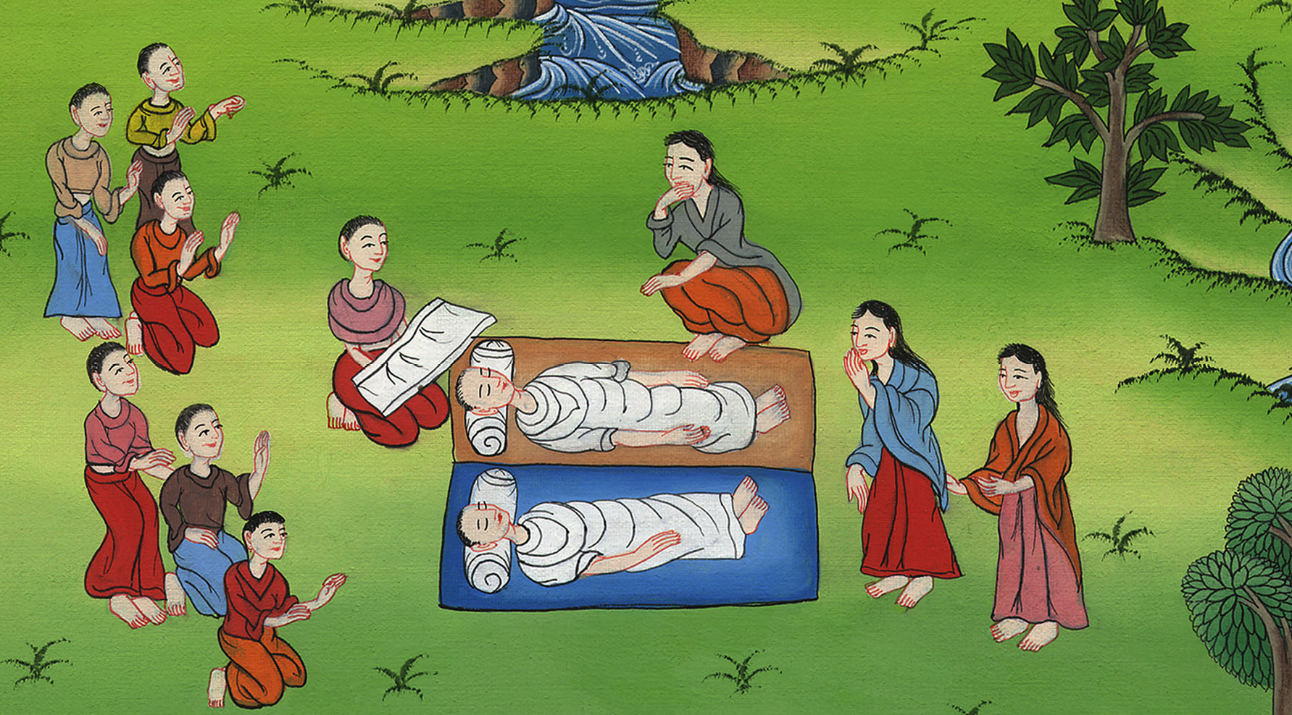
रूत 1:5

