Slide 1
14-4
These materials are by the Kongki Ka Project and are made available to you under the terms of the Creative Commons Attribution ShareAlike license 4.0.
You have permission to share and redistribute these materials in any format and to make reasonable revisions and adaptations of this translation, provided that:
You include the above licence and source information.
If you redistribute these materials or create derivatives, you must distribute your contributions under the same license as the original.
The Holy Bible, Berean Standard Bible, BSB is produced in cooperation with Bible Hub, Discovery Bible, OpenBible.com, and the Berean Bible Translation Committee. This text of God's Word has been dedicated to the public domain.
Hindi text is from Free Bibles India. This translation is made available under the terms of a Creative Commons Attribution-ShareAlike 4.0 International License.
Notes:
Ch
14 Ruth
1. Naomi’s son’s die - Ruth 1:1-5 (Left Top)
2. Ruth stays with Naomi – Ruth 1:6-22 (Right Top)
3. Ruth gleaning in the field of Boaz – Ruth 2:1-16 (Right Center)
4. Naomi advises Ruth – Ruth 2:17-23 (Right Bottom)
5. Ruth goes to Boaz – Ruth 3:1-18 (Left Bottom)
6. Boaz arranges marriage with Ruth – Ruth 4:1-12 (Left Center)
7. Naomi receives her grandson – Ruth 4:13-22 (Center)

Slide 2
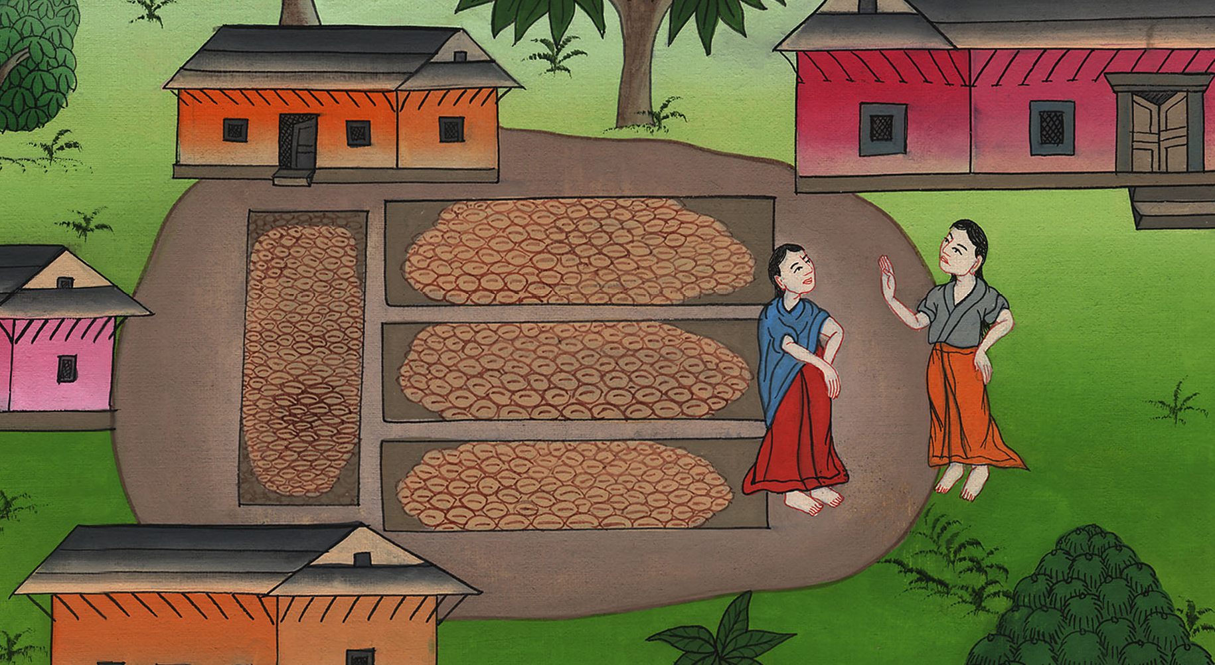
नाओमी रूथ को सलाह देती है - रूत 2:17-23
This work is licensed under a Creative Commons Attribution-ShareAlike 4.0 International License

Slide 3
Naomi advises Ruth – Ruth 2:17-23
नाओमी रूथ को सलाह देती है - रूत 2:17-23

Slide 4
नाओमी रूथ को सलाह देती है - रूत 2:17-23

Slide 5
17So she gleaned in the field until evening; and she beat out that which she had gleaned, and it was about an ephah of barley.
17 अतः वह साँझ तक खेत में बीनती रही; तब जो कुछ बीन चुकी उसे फटकाc, और वह कोई एपा भर जौ निकला।

Slide 6
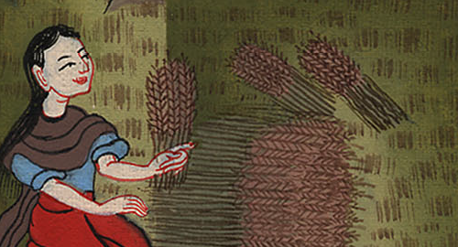
रूत 2:17

Slide 7
18She picked up the grain and went into the town, where her mother-in-law saw what she had gleaned. And she brought out what she had saved from her meal and gave it to Naomi.
18 तब वह उसे उठाकर नगर में गई, और उसकी सास ने उसका बीना हुआ देखा, और जो कुछ उसने तृप्त होकर बचाया था उसको उसने निकालकर अपनी सास को दिया।

Slide 8
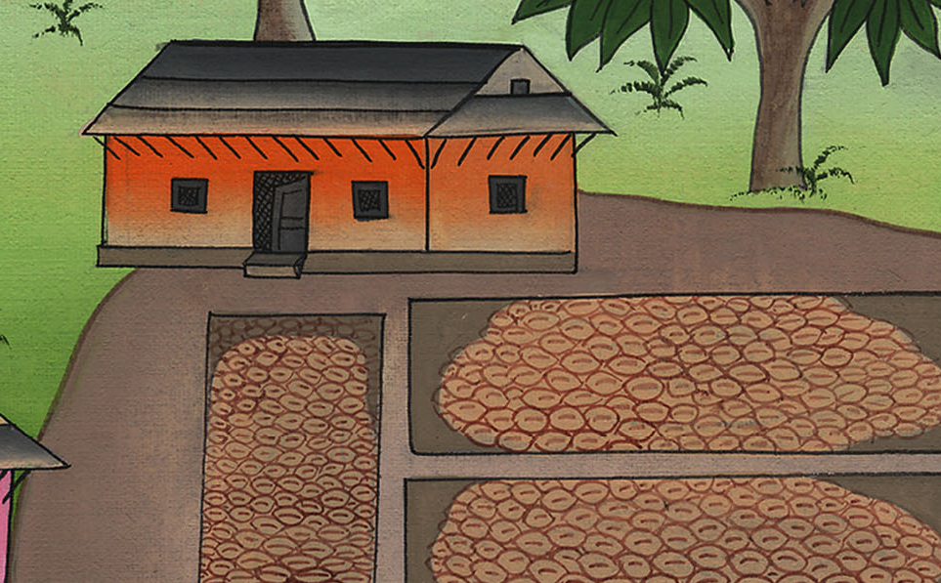
रूत 2:18

Slide 9
19Then her mother-in-law asked her, “Where did you glean today, and where did you work? Blessed be the man who noticed you.”
19 उसकी सास ने उससे पूछा, “आज तू कहाँ बीनती, और कहाँ काम करती थी? धन्य वह हो जिसने तेरी सुधि ली है।”

Slide 10
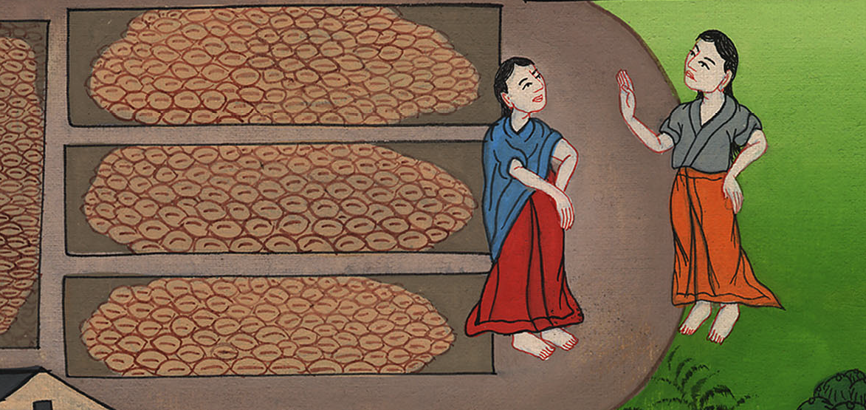
रूत 2:19

Slide 11
…So she told her mother-in-law where she had worked. “The name of the man I worked with today is Boaz,” she said.
…तब उसने अपनी सास को बता दिया, कि मैंने किसके पास काम किया, और कहा, “जिस पुरुष के पास मैंने आज काम किया उसका नाम बोअज है।”

Slide 12
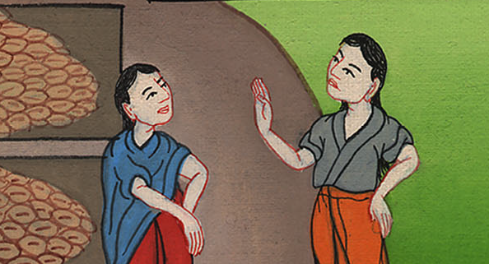
रूत 2:19

Slide 13
20Then Naomi said to her daughter-in-law, “May he be blessed by the Lord, who has not withdrawn His kindness from the living or the dead.” Naomi continued, “The man is a close relative. He is one of our kinsman-redeemers.”
20 नाओमी ने अपनी बहू से कहा, “वह यहोवा की ओर से आशीष पाए, क्योंकि उसने न तो जीवित पर से और न मरे हुओं पर से अपनी करुणा हटाई!” फिर नाओमी ने उससे कहा, “वह पुरुष तो हमारा एक कुटुम्बी है, वरन् उनमें से है जिनको हमारी भूमि छुड़ाने का अधिकार है।”

Slide 14
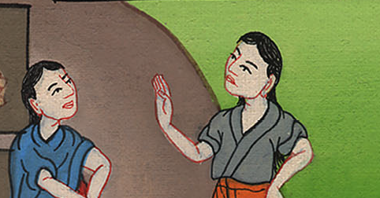
रूत 2:20

Slide 15
21Then Ruth the Moabitess said, “He also told me, ‘Stay with my young men until they have finished gathering all my harvest.’”
21 फिर रूत मोआबिन बोली, “उसने मुझसे यह भी कहा, ‘जब तक मेरे सेवक मेरी सारी कटनी पूरी न कर चुकें तब तक उन्हीं के संग-संग लगी रह।’”

Slide 16
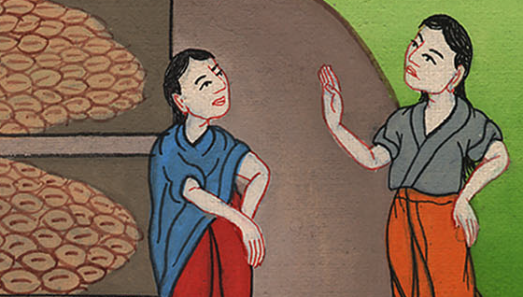
रूत 2:21

Slide 17
22And Naomi said to her daughter-in-law Ruth, “My daughter, it is good for you to work with his young women, so that nothing will happen to you in another field.”
22 नाओमी ने अपनी बहू रूत से कहा, “मेरी बेटी यह अच्छा भी है, कि तू उसी की दासियों के साथ-साथ जाया करे, और वे तुझको दूसरे के खेत में न मिलें।”

Slide 18
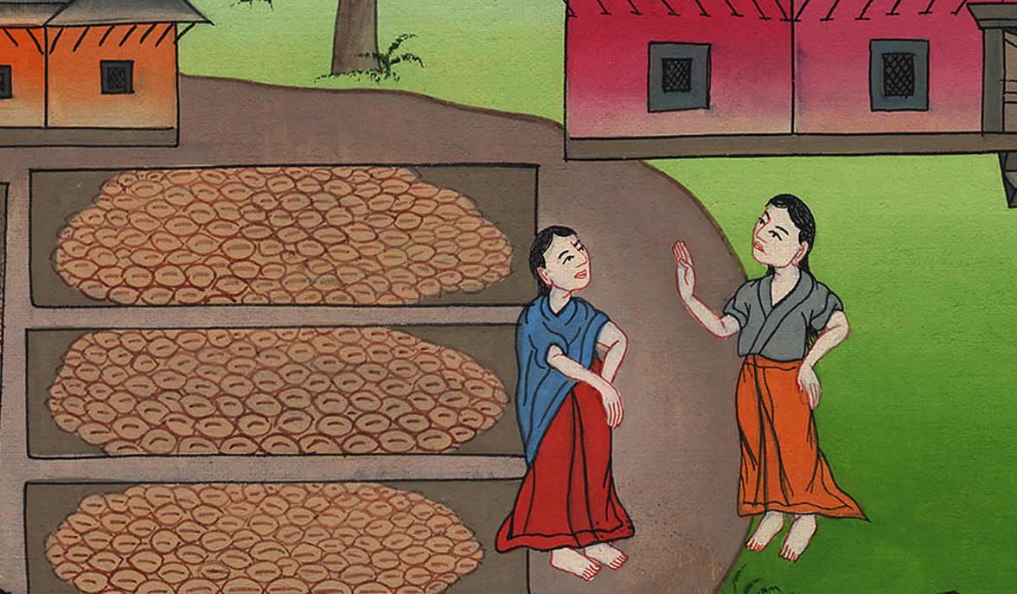
रूत 2:22

Slide 19
23So Ruth stayed close to the servant girls of Boaz to glean grain until the barley and wheat harvests were finished. And she lived with her mother-in-law.
23 इसलिए रूत जौ और गेहूँ दोनों की कटनी के अन्त तक बीनने के लिये बोअज की दासियों के साथ-साथ लगी रही; और अपनी सास के यहाँ रहती थी।

Slide 20
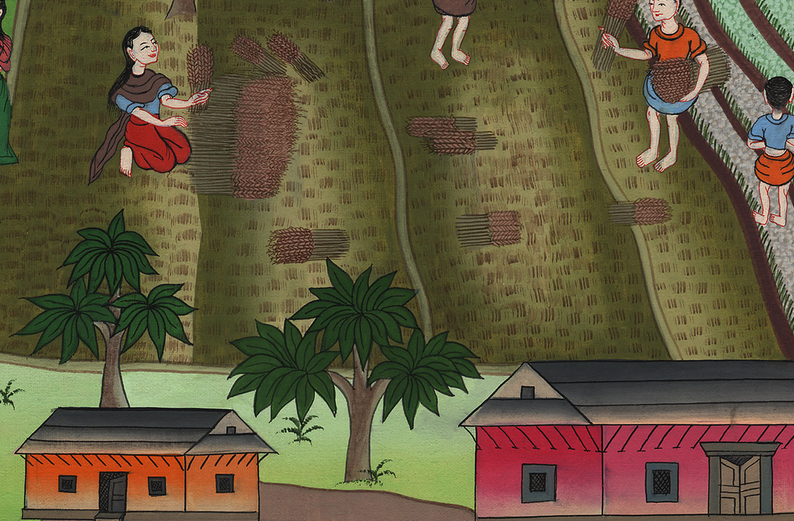
रूत 2:23

