Slide 1
14-7
These materials are by the Kongki Ka Project and are made available to you under the terms of the Creative Commons Attribution ShareAlike license 4.0.
You have permission to share and redistribute these materials in any format and to make reasonable revisions and adaptations of this translation, provided that:
You include the above licence and source information.
If you redistribute these materials or create derivatives, you must distribute your contributions under the same license as the original.
The Holy Bible, Berean Standard Bible, BSB is produced in cooperation with Bible Hub, Discovery Bible, OpenBible.com, and the Berean Bible Translation Committee. This text of God's Word has been dedicated to the public domain.
Hindi text is from Free Bibles India. This translation is made available under the terms of a Creative Commons Attribution-ShareAlike 4.0 International License.
Notes:
Ch
14 Ruth
1. Naomi’s son’s die - Ruth 1:1-5 (Left Top)
2. Ruth stays with Naomi – Ruth 1:6-22 (Right Top)
3. Ruth gleaning in the field of Boaz – Ruth 2:1-16 (Right Center)
4. Naomi advises Ruth – Ruth 2:17-23 (Right Bottom)
5. Ruth goes to Boaz – Ruth 3:1-18 (Left Bottom)
6. Boaz arranges marriage with Ruth – Ruth 4:1-12 (Left Center)
7. Naomi receives her grandson – Ruth 4:13-22 (Center)

Slide 2
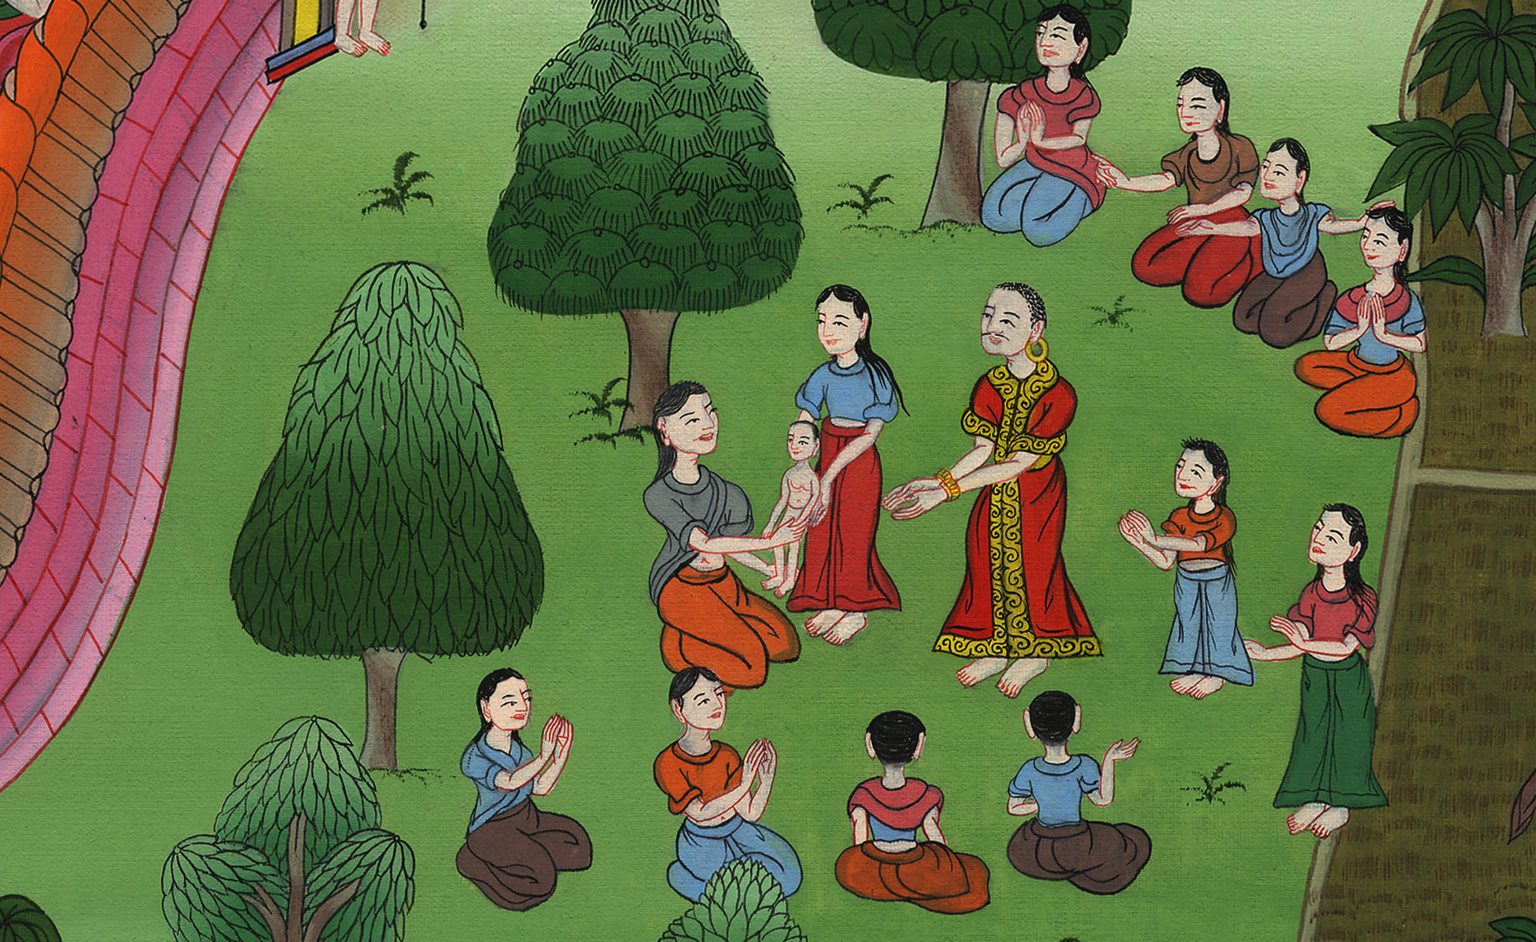
नाओमी को उसका पोता मिला - रूत 4:13-22
This work is licensed under a Creative Commons Attribution-ShareAlike 4.0 International License

Slide 3
Naomi receives her grandson – Ruth 4:13-22
नाओमी को उसका पोता मिला - रूत 4:13-22

Slide 4
नाओमी को उसका पोता मिला - रूत 4:13-22

Slide 5
13So Boaz took Ruth, and she became his wife. And when he had relations with her, the Lord enabled her to conceive, and she gave birth to a son.
13 तब बोअज ने रूत को ब्याह लिया, और वह उसकी पत्नी हो गई; और जब वह उसके पास गया तब यहोवा की दया से उसको गर्भ रहा, और उसके एक बेटा उत्पन्न हुआ।

Slide 6
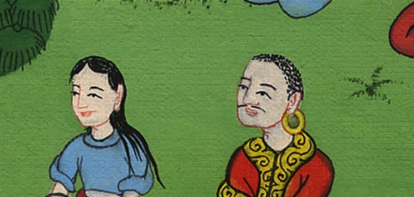
रूत 4:13

Slide 7
14Then the women said to Naomi, “Blessed be the Lord, who has not left you this day without a kinsman-redeemer. May his name become famous in Israel.
14 तब स्त्रियों ने नाओमी से कहा, “यहोवा धन्य है, जिसने तुझे आज छुड़ानेवाले कुटुम्बी के बिना नहीं छोड़ा; इस्राएल में इसका बड़ा नाम हो।

Slide 8
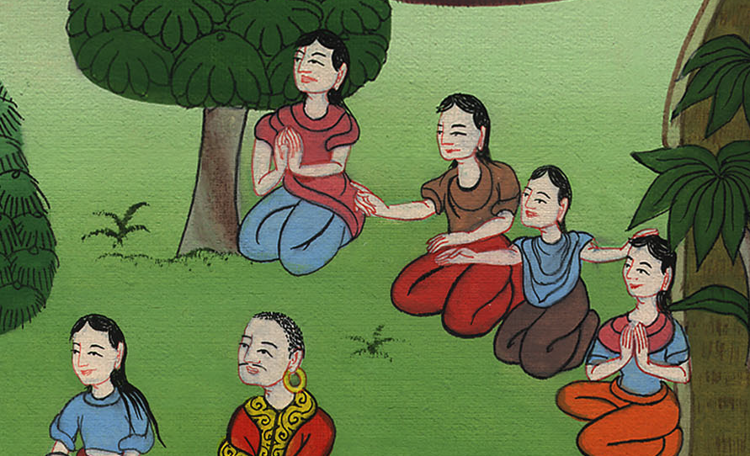
रूत 4:14

Slide 9
15He will renew your life and sustain you in your old age. For your daughter-in-law, who loves you and is better to you than seven sons, has given him birth.”
15 और यह तेरे जी में जी ले आनेवाला और तेरा बुढ़ापे में पालनेवाला हो, क्योंकि तेरी बहू जो तुझ से प्रेम रखती और सात बेटों से भी तेरे लिये श्रेष्ठ है उसी का यह बेटा है।”

Slide 10
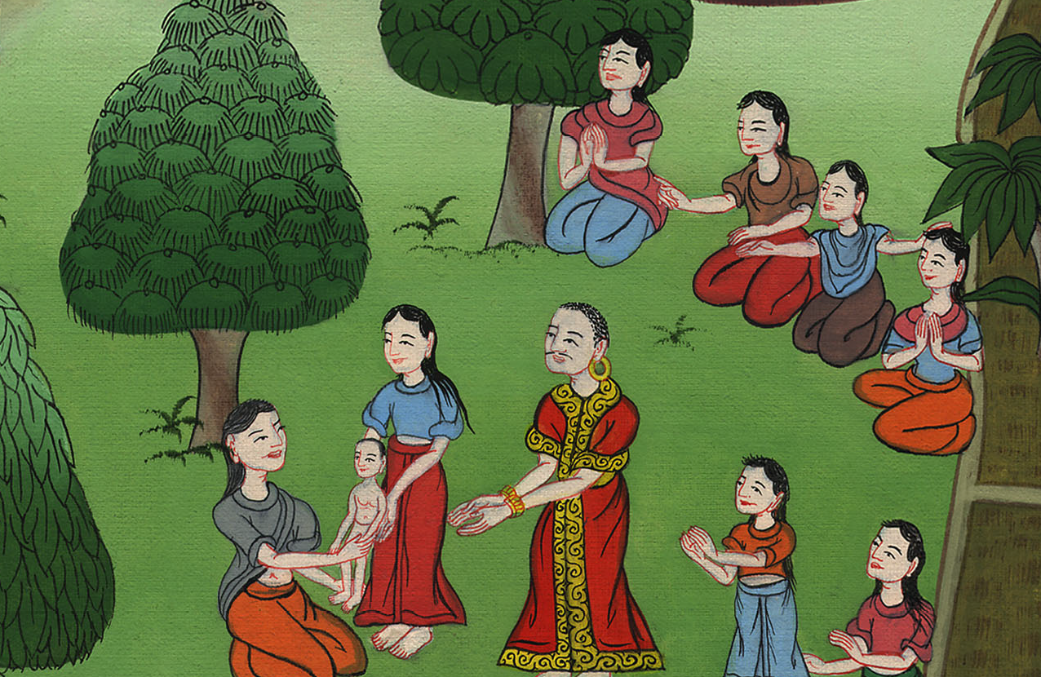
रूत 4:15

Slide 11
16And Naomi took the child, placed him on her lap, and became a nurse to him.
16 फिर नाओमी उस बच्चे को अपनी गोद में रखकर उसकी दाई का काम करने लगी।

Slide 12
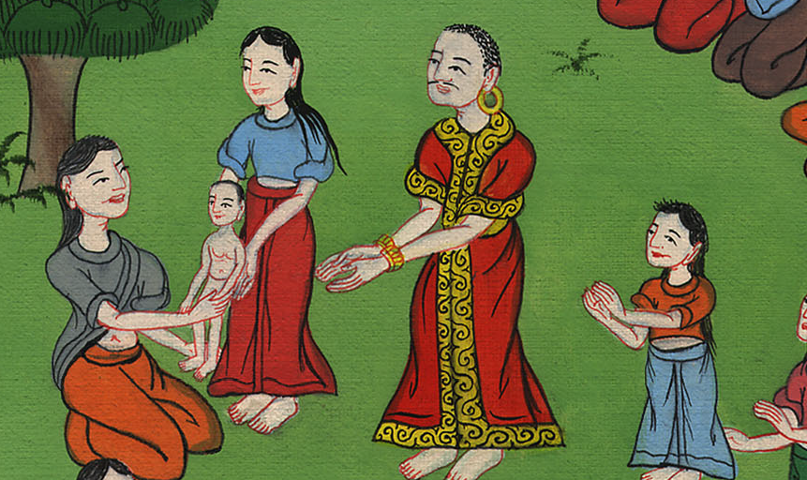
रूत 4:16

Slide 13
17The neighbor women said, “A son has been born to Naomi,” and they named him Obed. He became the father of Jesse, the father of David.
17 और उसकी पड़ोसिनों ने यह कहकर, कि “नाओमी के एक बेटा उत्पन्न हुआ है”, लड़के का नाम ओबेदd रखा। यिशै का पिता और दाऊद का दादा वही हुआ।

Slide 14
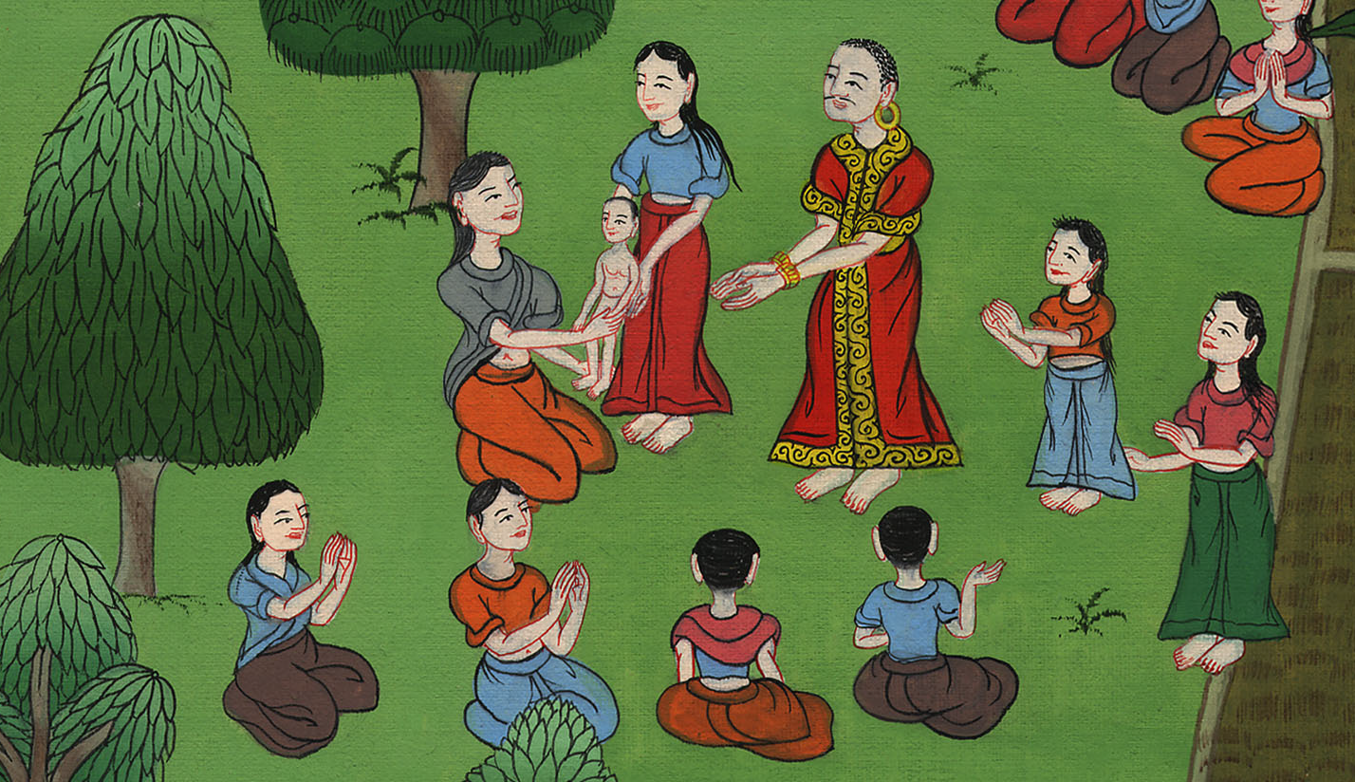
रूत 4:17

