Slide 1
21-1
These materials are by the Kongki Ka Project and are made available to you under the terms of the Creative Commons Attribution ShareAlike license 4.0.
You have permission to share and redistribute these materials in any format and to make reasonable revisions and adaptations of this translation, provided that:
You include the above licence and source information.
If you redistribute these materials or create derivatives, you must distribute your contributions under the same license as the original.
The Holy Bible, Berean Standard Bible, BSB is produced in cooperation with Bible Hub, Discovery Bible, OpenBible.com, and the Berean Bible Translation Committee. This text of God's Word has been dedicated to the public domain.
Hindi text is from Free Bibles India. This translation is made available under the terms of a Creative Commons Attribution-ShareAlike 4.0 International License.
Notes:
21 Elijah
1. Elijah comes to Ahab - 1 Kings 16:28 – 17:1 (Left Top)
2. Ravens feed Elijah – 1 Kings 17:2-7 (Center Top)
3. Elijah and the widow – 1 Kings 17:8-24 (Right Top)
4. Mt. Carmel – 1 Kings 18:17-40 (Right Center)
5. Rain comes – 1 kings 18:41-46 (Right Bottom)
6. Elisha called – 1 Kings 19:19-21 (Left Bottom)
7. Elijah taken up to Heaven - 2 Kings 2:1-13 (Left Center)

Slide 2
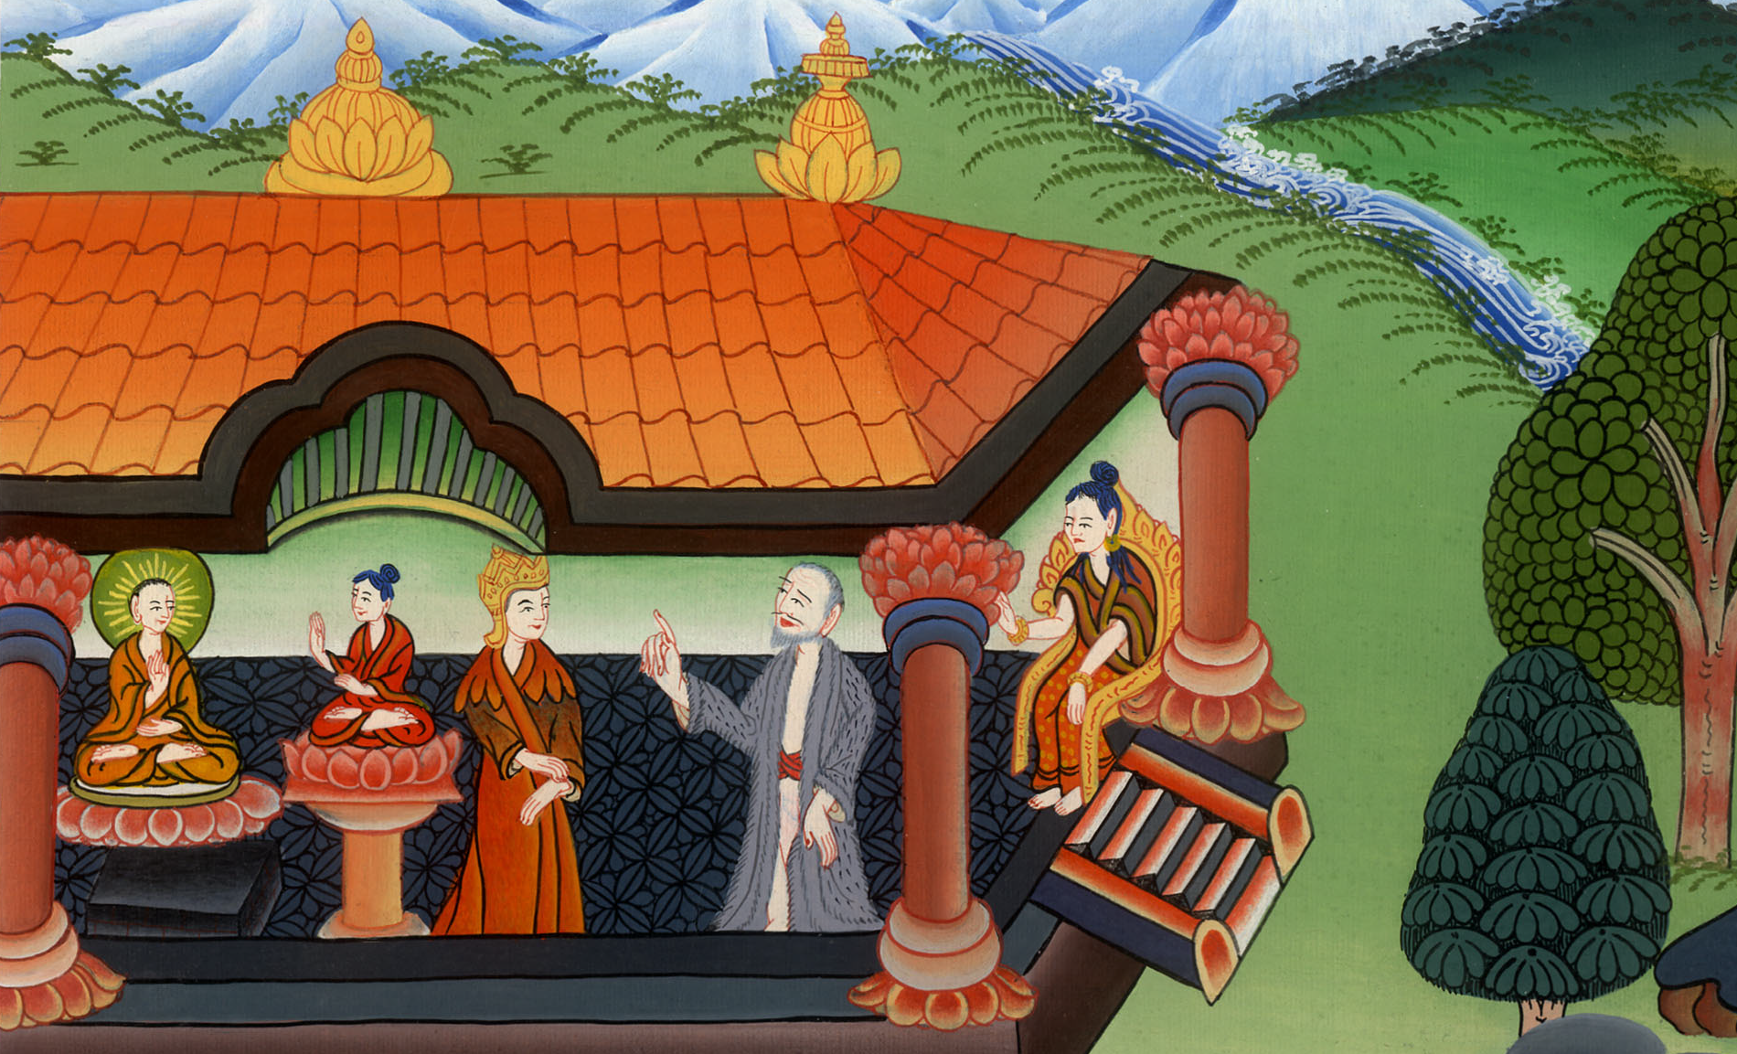
एलिय्याह अहाब के पास आता है - 1 राजा 16:28 - 17:1
This work is licensed under a Creative Commons Attribution-ShareAlike 4.0 International License

Slide 3
Elijah comes to Ahab – 1 Kings 16:28 - 17:1
एलिय्याह अहाब के पास आता है - 1 राजा 16:28 - 17:1

Slide 4
एलिय्याह अहाब के पास आता है - 1 राजा 16:28 - 17:1

Slide 5
( After Solomon died, Ahab was the 8th king of Israel.)
30However, Ahab son of Omri did evil in the sight of the Lord, more than all who were before him.
(After Solomon died, Ahab was the 8th king of Israel.)
30 और ओम्री के पुत्र अहाब ने उन सबसे अधिक जो उससे पहले थे, वह कर्म किए जो यहोवा की दृष्टि में बुरे थेc।

Slide 6
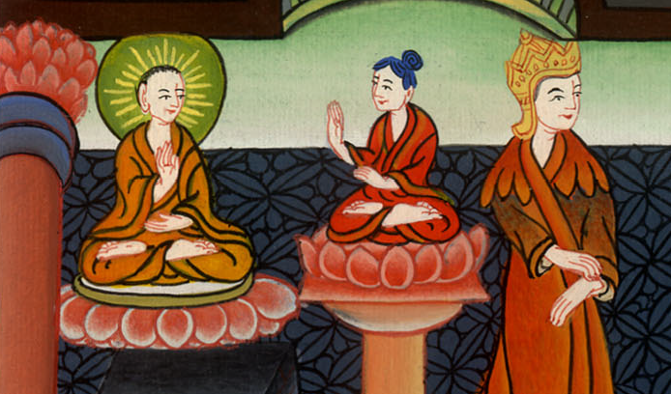
1 राजा 16:30

Slide 7
Ahab served Baal and worshiped him. 32First, Ahab set up an altar for Baal in the temple of Baal that he had built in Samaria.
अहाब ने बाल की सेवा की और उसकी पूजा की।
32 उसने बाल का एक भवन सामरिया में बनाकर उसमें बाल की एक वेदी बनाई।

Slide 8
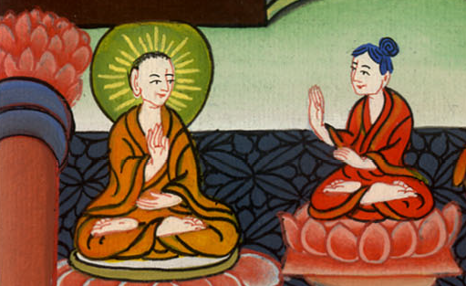
1 राजा 16:32

Slide 9
33Then he set up an Asherah pole. Thus Ahab did more to provoke the Lord, the God of Israel, to anger than all the kings of Israel before him.
33 और अहाब ने एक अशेरा भी बनाया, वरन् उसने उन सब इस्राएली राजाओं से बढ़कर जो उससे पहले थे इस्राएल के परमेश्वर यहोवा को क्रोध दिलाने के काम किए।

Slide 10
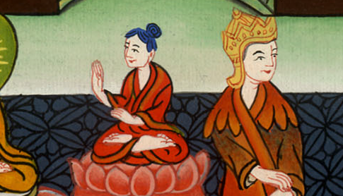
1 राजा 16:33

Slide 11
17:1Now Elijah the Tishbite, who was among the settlers of Gilead, said to Ahab, “As surely as the Lord lives—the God of Israel before whom I stand—
17:1 तिशबी एलिय्याहa जो गिलाद का निवासी था उसने अहाब से कहा, “इस्राएल का परमेश्वर यहोवा जिसके सम्मुख मैं उपस्थित रहता हूँ,

Slide 12
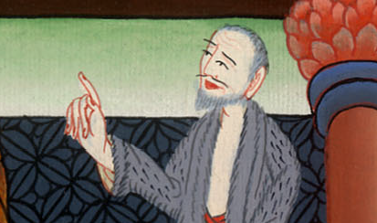
1 राजा 17:1

Slide 13
…there will be neither dew nor rain in these years except at my word!”
…उसके जीवन की शपथ इन वर्षों में मेरे बिना कहे, न तो मेंह बरसेगा, और न ओस पड़ेगी।”

Slide 14
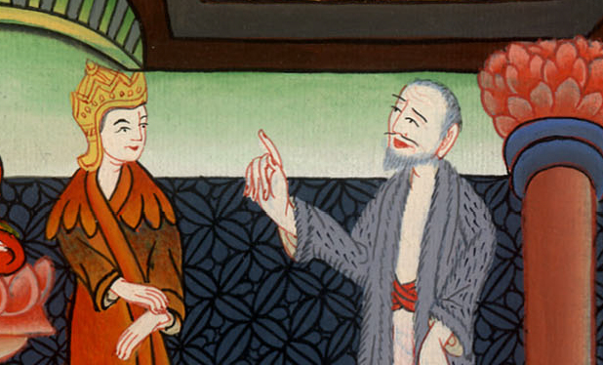
1 राजा 17:1

