Slide 1
21-5
These materials are by the Kongki Ka Project and are made available to you under the terms of the Creative Commons Attribution ShareAlike license 4.0.
You have permission to share and redistribute these materials in any format and to make reasonable revisions and adaptations of this translation, provided that:
You include the above licence and source information.
If you redistribute these materials or create derivatives, you must distribute your contributions under the same license as the original.
The Holy Bible, Berean Standard Bible, BSB is produced in cooperation with Bible Hub, Discovery Bible, OpenBible.com, and the Berean Bible Translation Committee. This text of God's Word has been dedicated to the public domain.
Hindi text is from Free Bibles India. This translation is made available under the terms of a Creative Commons Attribution-ShareAlike 4.0 International License.
Notes:
ch21 Elijah
1. Elijah comes to Ahab - 1 Kings 16:28 – 17:1 (Left Top)
2. Ravens feed Elijah – 1 Kings 17:2-7 (Center Top)
3. Elijah and the widow – 1 Kings 17:8-24 (Right Top)
4. Mt. Carmel – 1 Kings 18:17-40 (Right Center)
5. Rain comes – 1 kings 18:41-46 (Right Bottom)
6. Elisha called – 1 Kings 19:19-21 (Left Bottom)
7. Elijah taken up to Heaven - 2 Kings 2:1-13 (Left Center)

Slide 2
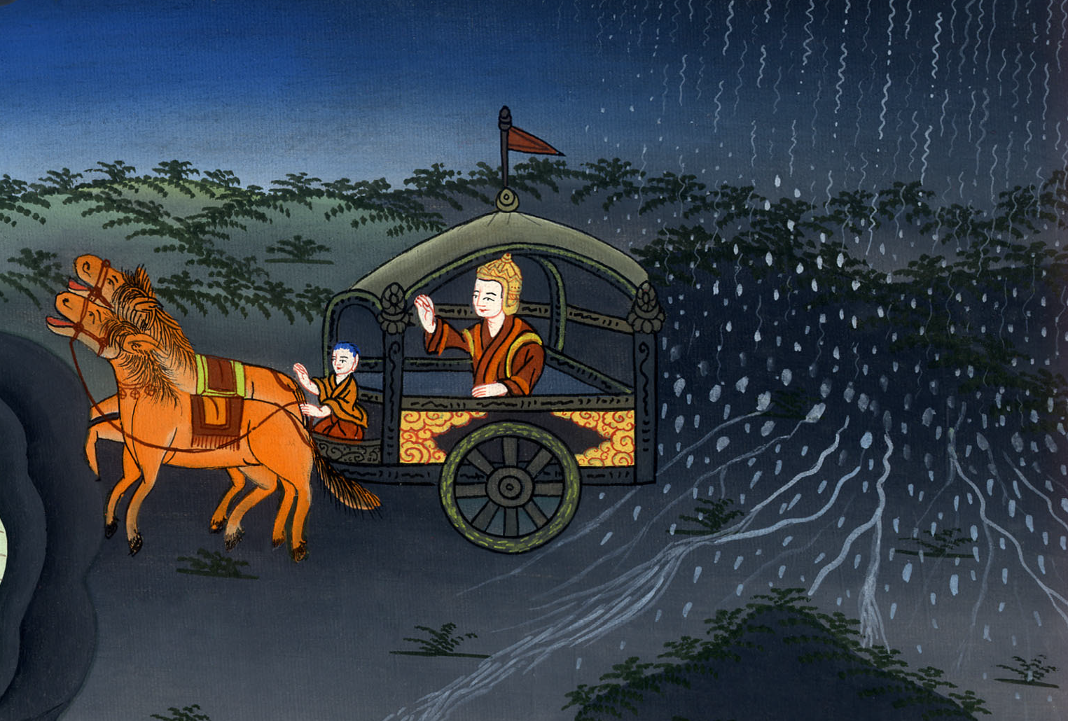
बारिश आती है - 1 राजा 18:41-46
This work is licensed under a Creative Commons Attribution-ShareAlike 4.0 International License

Slide 3
Rain comes –
1 Kings 18:41-46
बारिश आती है -
1 राजा 18:41-46

Slide 4
बारिश आती है - 1 राजा 18:41-46

Slide 5
41And Elijah said to Ahab, “Go up, eat and drink, for there is the sound of a heavy rain.”
41 फिर एलिय्याह ने अहाब से कहा, “उठकर खा पी, क्योंकि भारी वर्षा की सनसनाहटc सुन पड़ती है।”

Slide 6
1 राजा 18:41

Slide 7
42So Ahab went up to eat and drink. But Elijah climbed to the summit of Carmel, bent down on the ground, and put his face between his knees.
42 तब अहाब खाने-पीने चला गया, और एलिय्याह कर्मेल की चोटी पर चढ़ गया, और भूमि पर गिरकर अपना मुँह घुटनों के बीच किया,

Slide 8
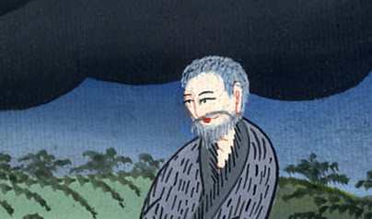
1 राजा 18:42

Slide 9
43“Go and look toward the sea,” he said to his servant.
So the servant went and looked, and he said, “There is nothing there.”
Seven times Elijah said, “Go back.”
43 और उसने अपने सेवक से कहा, “चढ़कर समुद्र की ओर दृष्टि करके देख,” तब उसने चढ़कर देखा और लौटकर कहा, “कुछ नहीं दिखता।” एलिय्याह ने कहा, “फिर सात बार जा।”

Slide 10
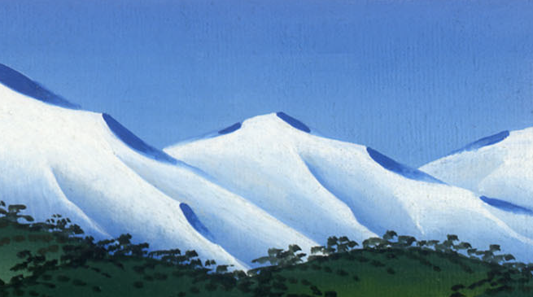
1 राजा 18:43

Slide 11
44On the seventh time the servant reported, “There is a cloud as small as a man’s hand rising from the sea.”
And Elijah replied, “Go and tell Ahab, ‘Prepare your chariot and go down before the rain stops you.’”
44 सातवीं बार उसने कहा, “देख समुद्र में से मनुष्य का हाथ सा एक छोटा बादल उठ रहा है।” एलिय्याह ने कहा, “अहाब के पास जाकर कह, ‘रथ जुतवाकर नीचे जा, कहीं ऐसा न हो कि तू वर्षा के कारण रुक जाए।’”

Slide 12
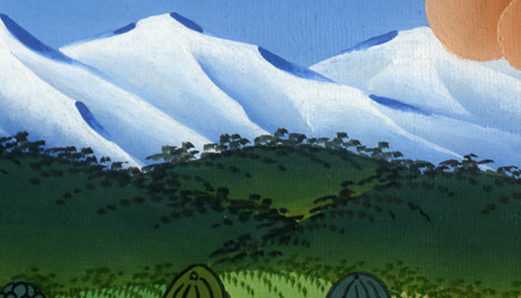
1 राजा 18:44

Slide 13
45Meanwhile, the sky grew dark with clouds and wind, and a heavy rain began to fall. So Ahab rode away and went to Jezreel.
45 थोड़ी ही देर में आकाश वायु से उड़ाई हुई घटाओं, और आँधी से काला हो गया और भारी वर्षा होने लगी; और अहाब सवार होकर यिज्रेल को चला।

Slide 14
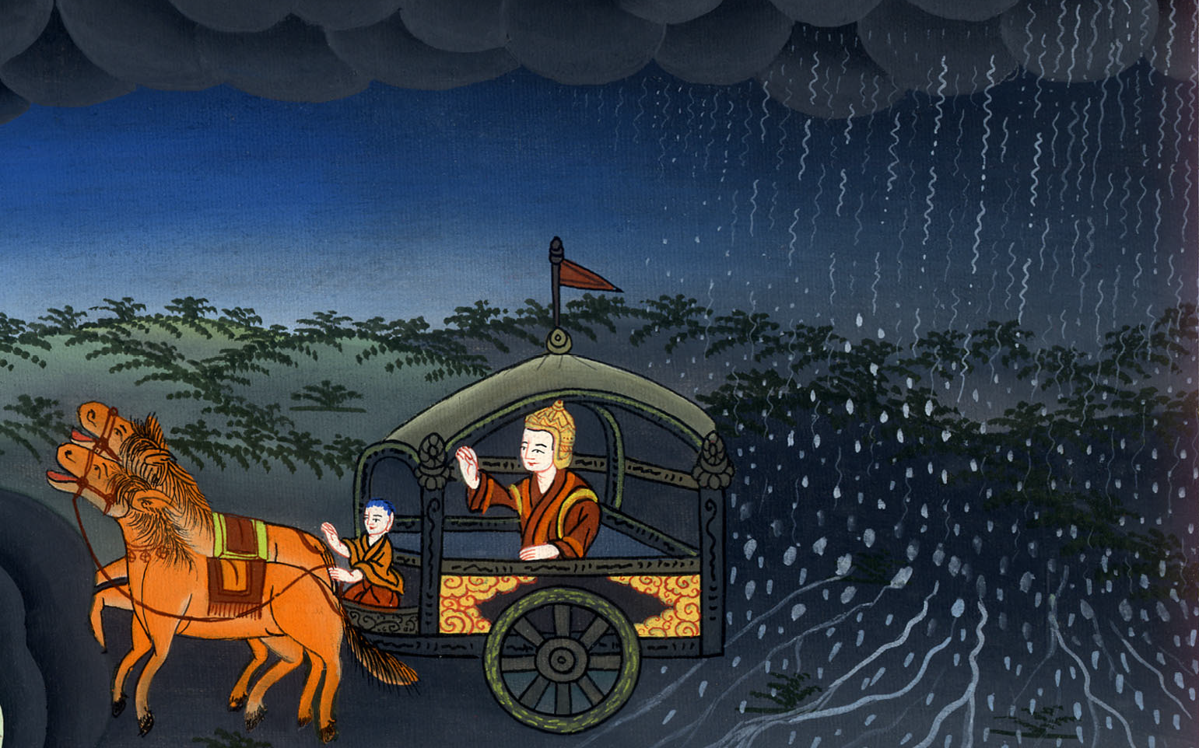
1 राजा 18:45

Slide 15
46And the hand of the Lord came upon Elijah, and he tucked his cloak into his belt and ran ahead of Ahab all the way to Jezreel.
46 तब यहोवा की शक्ति एलिय्याह पर ऐसी हुई; कि वह कमर बाँधकर अहाब के आगे-आगे यिज्रेल तक दौड़ता चला गया।

Slide 16
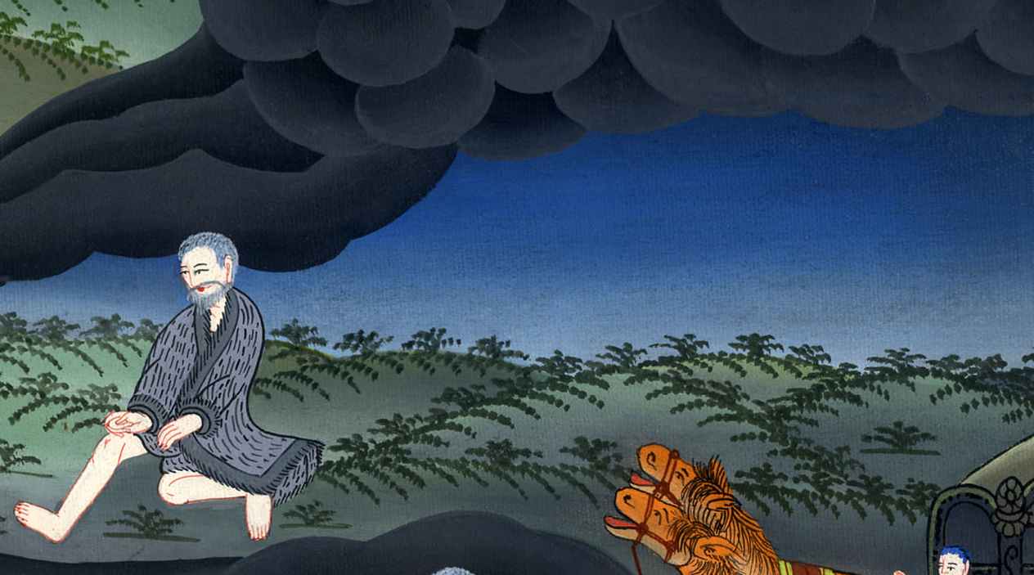
1 राजा 18:46

