Slide 1
30-5
These materials are by the Kongki Ka Project and are made available to you under the terms of the Creative Commons Attribution ShareAlike license 4.0.
You have permission to share and redistribute these materials in any format and to make reasonable revisions and adaptations of this translation, provided that:
You include the above licence and source information.
If you redistribute these materials or create derivatives, you must distribute your contributions under the same license as the original.
The Holy Bible, Berean Standard Bible, BSB is produced in cooperation with Bible Hub, Discovery Bible, OpenBible.com, and the Berean Bible Translation Committee. This text of God's Word has been dedicated to the public domain.
Hindi text is from Free Bibles India. This translation is made available under the terms of a Creative Commons Attribution-ShareAlike 4.0 International License.
Notes:
30 Jesus’ Birth
1. John the Baptist’s birth foretold - Luke 1:5-25 (Left Top)
2. The Birth of Jesus Foretold - Luke 1:26 – 38 (Right Top)
3. Mary visits Elizabeth - Luke 1:39-56 (Center Top)
4. Birth of John - Luke 1:57-80 (Right Bottom)
5. Joseph’s Dream - Matthew 1:18-25 (Center Bottom)
6. The Trip to Bethlehem - Luke 2:1-5 (Left Bottom)
7. Birth of Jesus - Luke 2:6–7 (Center)
8. The Shepherds and the Angels - Luke 2:8–20 (Right Center)

Slide 2
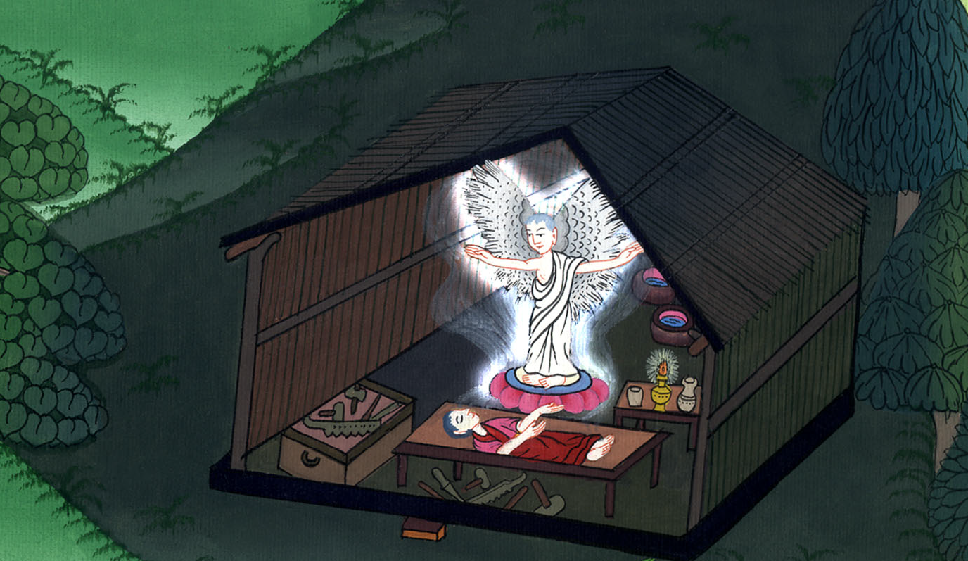
यूसुफ का सपना - मत्ती 1:18-25
This work is licensed under a Creative Commons Attribution-ShareAlike 4.0 International License

Slide 3
Joseph’s Dream - Matthew 1:18-25
यूसुफ का सपना - मत्ती 1:18-25

Slide 4
यूसुफ का सपना - मत्ती 1:18-25

Slide 5
18This is how the birth of Jesus Christ came about: His mother Mary was pledged in marriage to Joseph, but before they came together, she was found to be with child through the Holy Spirit.
18अब यीशु मसीह का जन्म इस प्रकार से हुआ, कि जब उसकी माता मरियम की मंगनी यूसुफ के साथ हो गई, तो उनके इकट्ठे होने के पहले से वह पवित्र आत्मा की ओर से गर्भवती पाई गई।

Slide 6
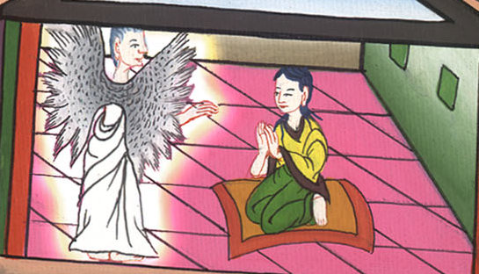
मत्ती 1:18

Slide 7
19Because Joseph her husband was a righteous man and was unwilling to disgrace her publicly, he resolved to divorce her quietly.
19अतः उसके पति यूसुफ ने जो धर्मी था और उसे बदनाम करना नहीं चाहता था, उसे चुपके से त्याग देने की मनसा की।

Slide 8
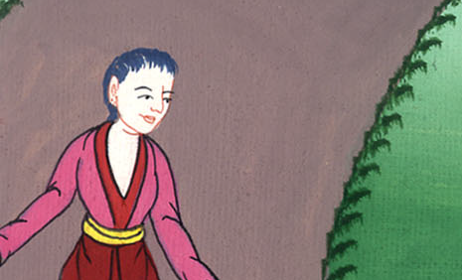
मत्ती 1:19

Slide 9
20But after he had pondered these things, an angel of the Lord appeared to him in a dream and said, “Joseph, son of David, do not be afraid to embrace Mary as your wife, for the One conceived in her is from the Holy Spirit.
20जब वह इन बातों की सोच ही में था तो परमेश्वर का स्वर्गदूत उसे स्वप्न में दिखाई देकर कहने लगा, “हे यूसुफ! दाऊद की सन्तान, तू अपनी पत्नी मरियम को अपने यहाँ ले आने से मत डर, क्योंकि जो उसके गर्भ में है, वह पवित्र आत्मा की ओर से है।

Slide 10
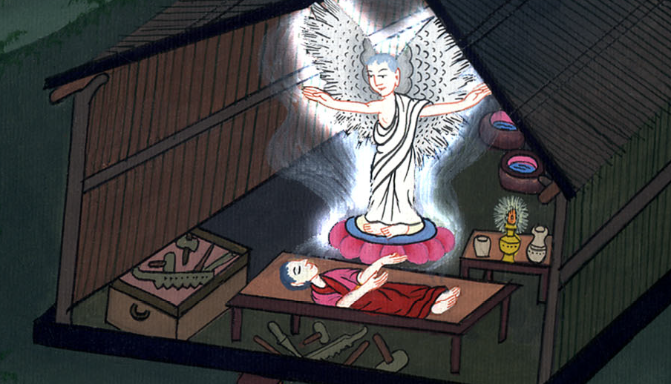
मत्ती 1:20

Slide 11
21She will give birth to a Son, and you are to give Him the name Jesus, because He will save His people from their sins.”
21वह पुत्र जनेगी और तू उसका नाम यीशुe रखना, क्योंकि वह अपने लोगों का उनके पापों से उद्धार करेगा।”

Slide 12
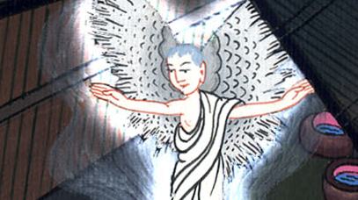
मत्ती 1:21

Slide 13
22All this took place to fulfill what the Lord had said through the prophet:
22यह सब कुछ इसलिए हुआ कि जो वचन प्रभु ने भविष्यद्वक्ता के द्वारा कहा था, वह पूरा हो

Slide 14
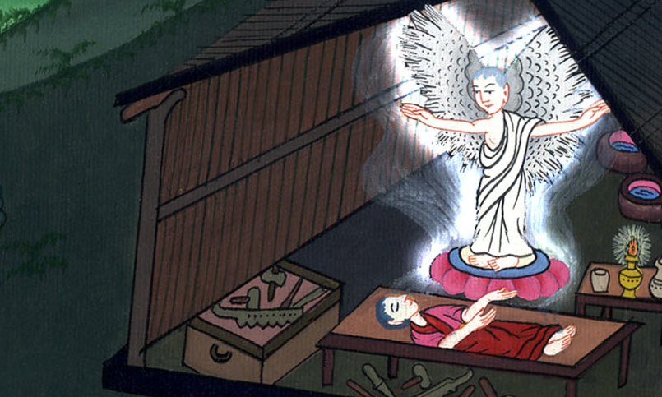
मत्ती 1:22

Slide 15
23“Behold, the virgin will be with child
and will give birth to a son,
and they will call Him Immanuel”
(which means, “God with us”).
23“देखो, एक कुँवारी गर्भवती होगी और एक पुत्र जनेगी, और उसका नाम इम्मानुएल रखा जाएगा,” जिसका अर्थ है - परमेश्वर हमारे साथ।

Slide 16
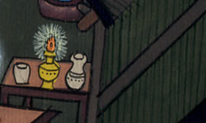
मत्ती 1:23

Slide 17
24When Joseph woke up, he did as the angel of the Lord had commanded him, and embraced Mary as his wife.
24तब यूसुफ नींद से जागकर परमेश्वर के दूत की आज्ञा अनुसार अपनी पत्नी को अपने यहाँ ले आया।

Slide 18
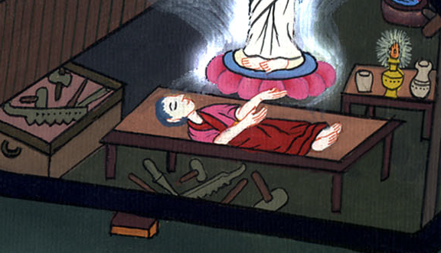
मत्ती 1:24

Slide 19
25But he had no union with her until she gave birth to a Son. And he gave Him the name Jesus.
25और जब तक वह पुत्र न जनी तब तक वह उसके पास न गया: और उसने उसका नाम यीशु रखा।

Slide 20
मत्ती 1:25

