Slide 1
31-4
These materials are by the Kongki Ka Project and are made available to you under the terms of the Creative Commons Attribution ShareAlike license 4.0.
You have permission to share and redistribute these materials in any format and to make reasonable revisions and adaptations of this translation, provided that:
You include the above licence and source information.
If you redistribute these materials or create derivatives, you must distribute your contributions under the same license as the original.
The Holy Bible, Berean Standard Bible, BSB is produced in cooperation with Bible Hub, Discovery Bible, OpenBible.com, and the Berean Bible Translation Committee. This text of God's Word has been dedicated to the public domain.
Hindi text is from Free Bibles India. This translation is made available under the terms of a Creative Commons Attribution-ShareAlike 4.0 International License.
Notes:
Ch
Jesus’ Childhood
1. Simeon and Anna - Luke 2:21-38 (Left Top)
2. The Magi give gifts to Jesus - Matt 2:1-11 (Right Center)
3. Flight to Egypt and return to Nazareth - Matthew 2:12-23 (Left)
4. Childhood in the Temple - 2:40-52 (Right Bottom)

Slide 2
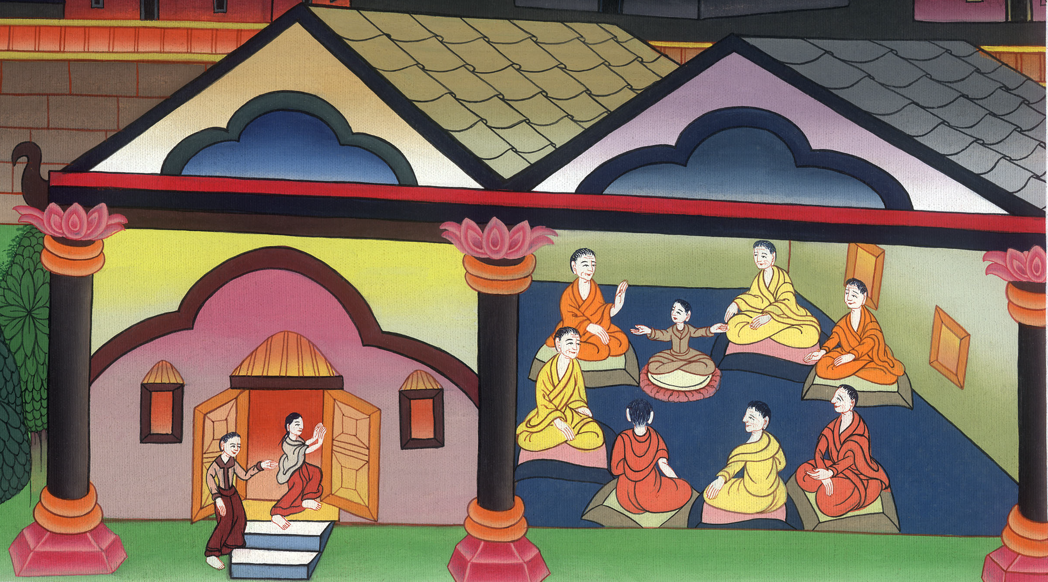
बालक यीशु मंदिर में - लूका 2:39-52
This work is licensed under a Creative Commons Attribution-ShareAlike 4.0 International License

Slide 3
Childhood in the Temple – Luke 2:39-52
बालक यीशु मंदिर में - लूका 2:39-52

Slide 4
बालक यीशु मंदिर में - लूका 2:39-52

Slide 5
39Joseph and Mary … returned into Galilee, to their own city, Nazareth. 40And the Child grew and became strong. He was filled with wisdom, and the grace of God was upon Him.
39 और जब वे प्रभु की व्यवस्था के अनुसार सब कुछ निपटा चुके तो गलील में अपने नगर नासरत को फिर चले गए।
40 और बालक बढ़ता, और बलवन्त होता, और बुद्धि से परिपूर्ण होता गया; और परमेश्वर का अनुग्रह उस पर था।

Slide 6
लूका 2:39,40

Slide 7
41Every year His parents went to Jerusalem for the Feast of the Passover. 42And when He was twelve years old, they went up according to the custom of the Feast.
41उसके माता-पिता प्रतिवर्ष फसह के पर्व में यरूशलेम को जाया करते थे। 42जब वह बारह वर्ष का हुआ, तो वे पर्व की रीति के अनुसार यरूशलेम को गए।

Slide 8
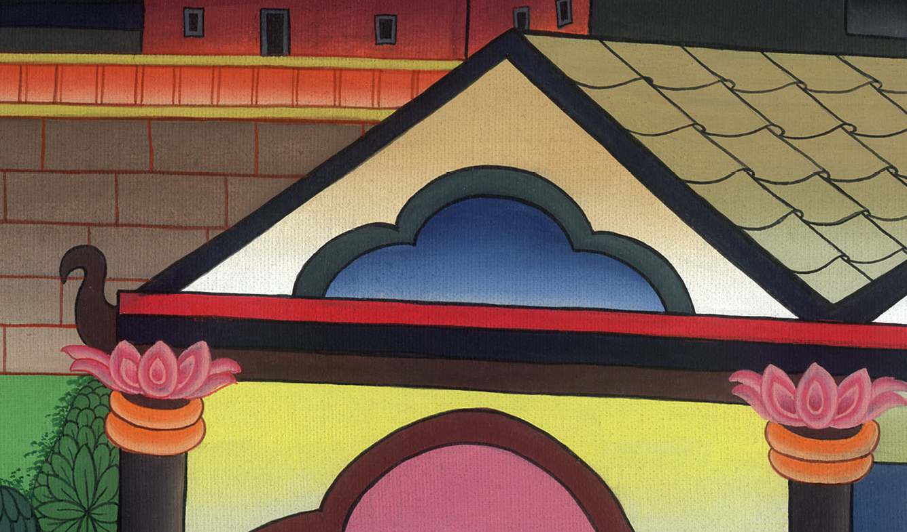
लूका 2:41,42

Slide 9
43When those days were over and they were returning home, the boy Jesus remained behind in Jerusalem, but His parents were unaware He had stayed.
43और जब वे उन दिनों को पूरा करके लौटने लगे, तो वह बालक यीशु यरूशलेम में रह गया; और यह उसके माता-पिता नहीं जानते थे।

Slide 10
लूका 2:43

Slide 11
44Assuming He was in their company, they traveled on for a day before they began to look for Him among their relatives and friends.
45When they could not find Him, they returned to Jerusalem to search for Him.
44वे यह समझकर, कि वह और यात्रियों के साथ होगा, एक दिन का पड़ाव निकल गए: और उसे अपने कुटुम्बियों और जान-पहचानवालों में ढूँढ़ने लगे। 45पर जब नहीं मिला, तो ढूँढ़ते-ढूँढ़ते यरूशलेम को फिर लौट गए।

Slide 12
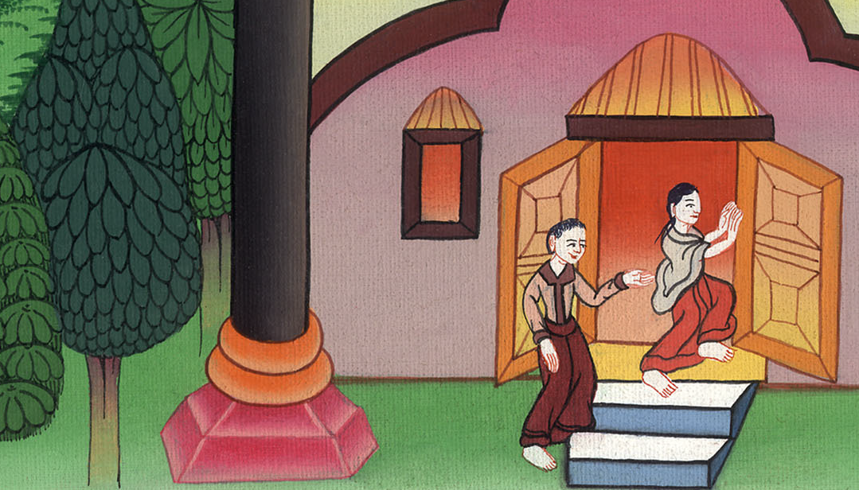
लूका 2:44,45

Slide 13
46Finally, after three days they found Him in the temple courts, sitting among the teachers, listening to them and asking them questions. 47And all who heard Him were astounded at His understanding and His answers.
46और तीन दिन के बाद उन्होंने उसे मन्दिर में उपदेशकों के बीच में बैठे, उनकी सुनते और उनसे प्रश्न करते हुए पाया। 47और जितने उसकी सुन रहे थे, वे सब उसकी समझ और उसके उत्तरों से चकित थे।

Slide 14
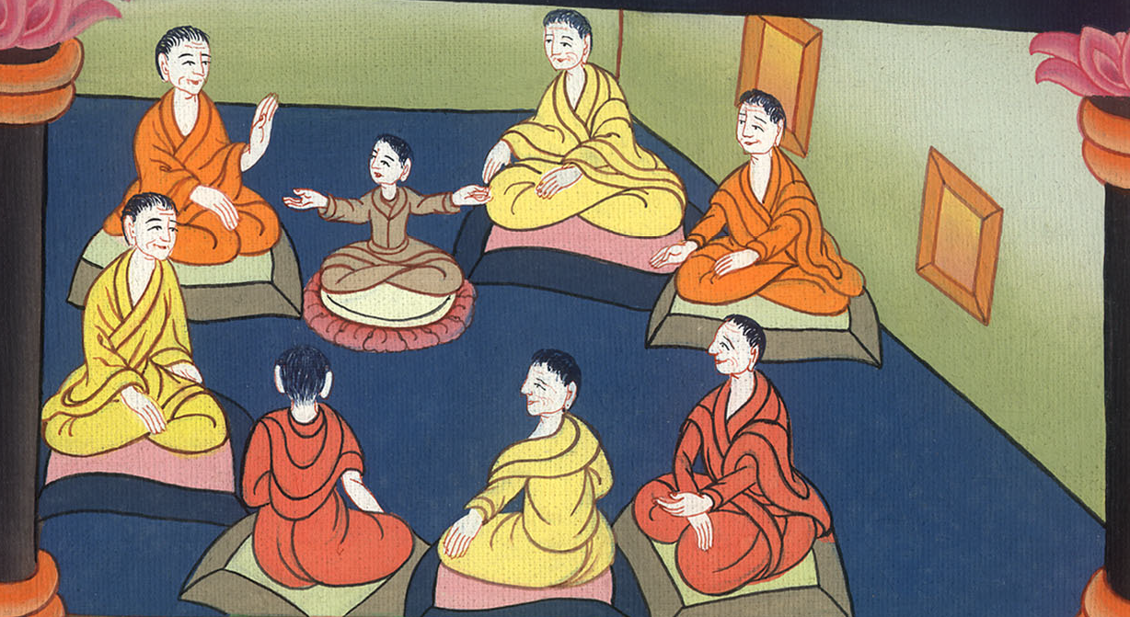
लूका 2:46,47

Slide 15
48When His parents saw Him, they were astonished. “Child, why have You done this to us?” His mother asked. “Your father and I have been anxiously searching for You.”
48तब वे उसे देखकर चकित हुए और उसकी माता ने उससे कहा, “हे पुत्र, तूने हम से क्यों ऐसा व्यवहार किया? देख, तेरा पिता और मैं कुढ़ते हुए तुझे ढूँढ़ते थे।”

Slide 16
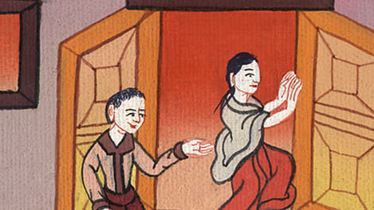
लूका 2:48

Slide 17
49“Why were you looking for Me?” He asked. “Did you not know that I had to be in My Father’s house ?” 50But they did not understand the statement He was making to them.
49उसने उनसे कहा, “तुम मुझे क्यों ढूँढ़ते थे? क्या नहीं जानते थे, किमुझे अपने पिता के भवन मेंcहोना अवश्य है?” 50परन्तु जो बात उसने उनसे कही, उन्होंने उसे नहीं समझा।

Slide 18
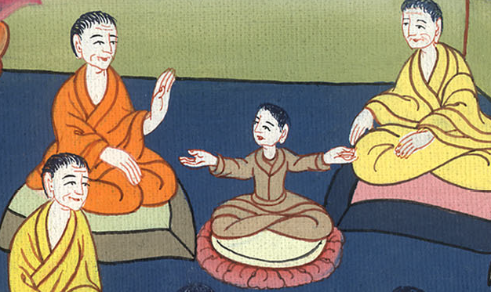
लूका 2:49,50

Slide 19
51Then He went down to Nazareth with them and was obedient to them. But His mother treasured up all these things in her heart.
51तब वह उनके साथ गया, और नासरत में आया, और उनके वश में रहा; और उसकी माता ने ये सब बातें अपने मन में रखीं।

Slide 20
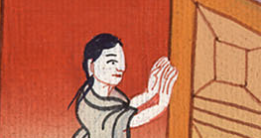
लूका 2:51

Slide 21
52And Jesus grew in wisdom and stature, and in favor with God and man.
52और यीशु बुद्धि और डील-डौल में और परमेश्वर और मनुष्यों के अनुग्रह में बढ़ता गया।

Slide 22
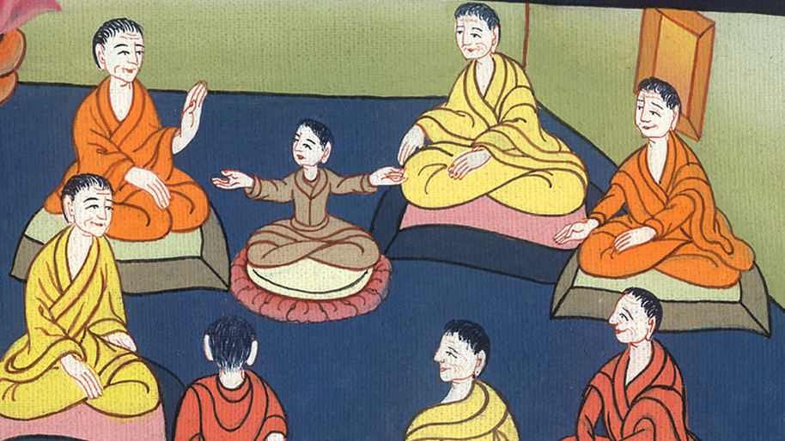
लूका 2:52

