Slide 1
33-3
These materials are by the Kongki Ka Project and are made available to you under the terms of the Creative Commons Attribution ShareAlike license 4.0.
You have permission to share and redistribute these materials in any format and to make reasonable revisions and adaptations of this translation, provided that:
You include the above licence and source information.
If you redistribute these materials or create derivatives, you must distribute your contributions under the same license as the original.
The Holy Bible, Berean Standard Bible, BSB is produced in cooperation with Bible Hub, Discovery Bible, OpenBible.com, and the Berean Bible Translation Committee. This text of God's Word has been dedicated to the public domain.
Hindi text is from Free Bibles India. This translation is made available under the terms of a Creative Commons Attribution-ShareAlike 4.0 International License.
Notes:
Ch
33 Jesus’ early ministry
1. John the Baptist tells about Jesus - John 1:19-42; John’s last witness - John 3:22-36;
and John in Prison - Luke 3:19-20 (Left Top)
2. Philip and Nathanael - John 1:43-51 (Center Top)
3. Wedding at Cana - John 2:1-12 (Right Top)
4. Nicodemus - John 3:1-21 (Right Bottom)
5. Woman at the Well - John 4:1-42 (Center Bottom)
6. Nobleman’s Son - John 4:46-54 (Left Bottom)
7. Sick man at Pool - John 5:1-47 (Left Center)
8. Jesus in Nazareth - Luke 4:16-30 (Right Center)

Slide 2
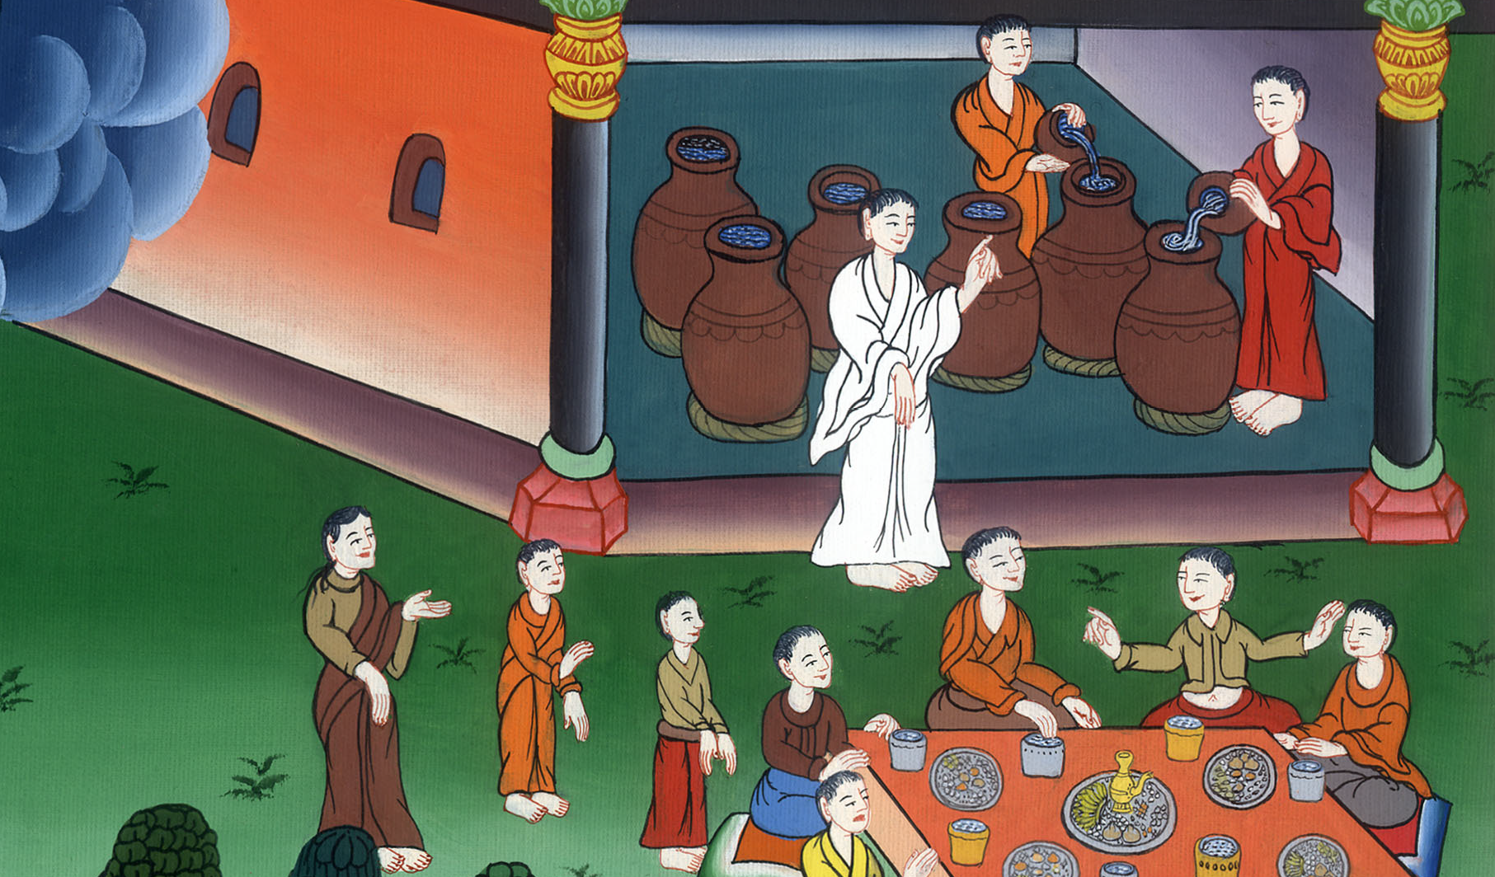
काना नगर में विवाह - यूहन्ना 2:1-12
This work is licensed under a Creative Commons Attribution-ShareAlike 4.0 International License

Slide 3
Wedding at Cana - John 2:1-12
काना में विवाह - यूहन्ना 2:1-12

Slide 4
काना नगर में विवाह - यूहन्ना 2:1-12

Slide 5
1On the third day a wedding took place at Cana in Galilee. Jesus’ mother was there, 2and Jesus and His disciples had also been invited to the wedding. s
1फिर तीसरे दिन गलील के कानाa में किसी का विवाह था, और यीशु की माता भी वहाँ थी। 2 यीशु और उसके चेले भी उस विवाह में निमंत्रित थे।

Slide 6
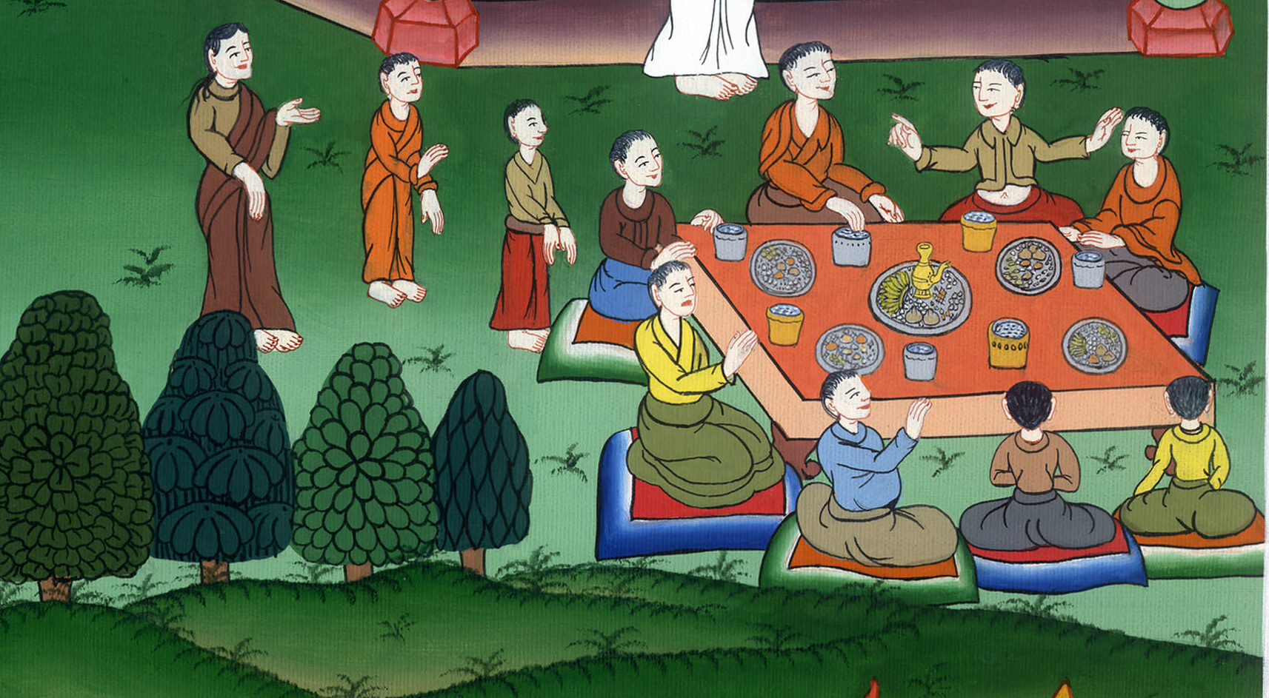
यूहन्ना 2:1,2

Slide 7
3When the wine ran out, Jesus’ mother said to Him, “They have no more wine.”
4“Woman, why does this concern us?” Jesus replied. “My hour has not yet come.”
3 जब दाखरस खत्म हो गया, तो यीशु की माता ने उससे कहा, “उनके पास दाखरस नहीं रहाb।” 4 यीशु ने उससे कहा, “हे महिला मुझे तुझ से क्या काम? अभीमेरा समयcनहीं आया।”

Slide 8
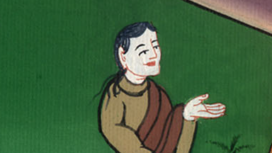
यूहन्ना 2:3,4

Slide 9
5His mother said to the servants, “Do whatever He tells you.”
5 उसकी माता ने सेवकों से कहा, “जो कुछ वह तुम से कहे, वही करना।”

Slide 10
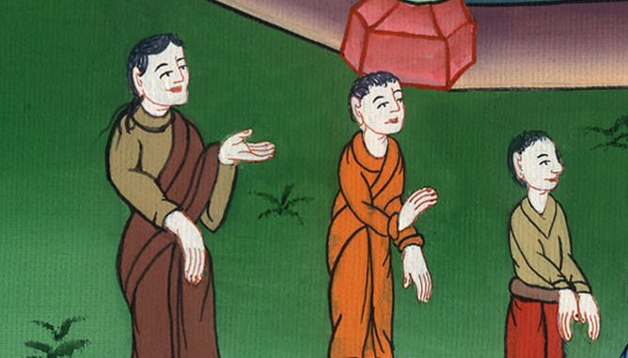
यूहन्ना 2:5

Slide 11
6Now six stone water jars had been set there for the Jewish rites of purification. Each could hold from twenty to thirty gallons.
6वहाँ यहूदियों के शुद्धिकरण के लिए पत्थर के छः मटके रखे थे, जिसमें दो-दो, तीन-तीन मन समाता था।

Slide 12
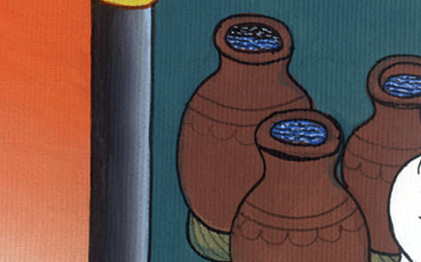
यूहन्ना 2:6

Slide 13
7Jesus told the servants, “Fill the jars with water.”
So they filled them to the brim.
7 यीशु ने उनसे कहा, “मटकों में पानी भर दो।” तब उन्होंने उन्हें मुहाँमुहँ भर दिया।

Slide 14
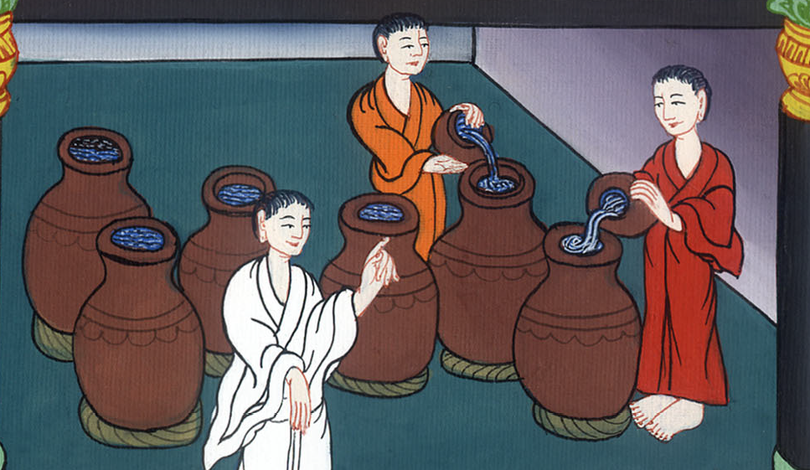
यूहन्ना 2:7

Slide 15
8“Now draw some out,” He said, “and take it to the master of the banquet.”
They did so,
8तब उसने उनसे कहा, “अब निकालकर भोज के प्रधान के पास ले जाओ।” और वे ले गए।

Slide 16
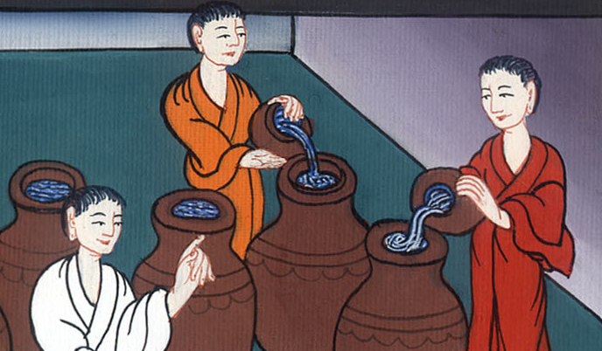
यूहन्ना 2:8

Slide 17
9and the master of the banquet tasted the water that had been turned into wine. He did not know where it was from, but the servants who had drawn the water knew. Then he called the bridegroom aside
9जब भोज के प्रधान ने वह पानी चखा, जो दाखरस बन गया था और नहीं जानता था कि वह कहाँ से आया है; (परन्तु जिन सेवकों ने पानी निकाला था वे जानते थे), तो भोज के प्रधान ने दूल्हे को बुलाकर, उससे कहा

Slide 18
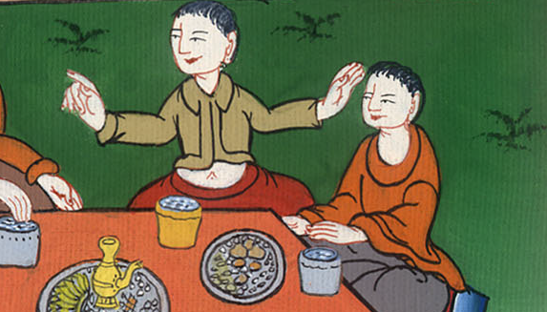
यूहन्ना 2:9

Slide 19
10and said, “Everyone serves the fine wine first, and then the cheap wine after the guests are drunk. But you have saved the fine wine until now!”
10“हर एक मनुष्य पहले अच्छा दाखरस देता है, और जब लोग पीकर छक जाते हैं, तब मध्यम देता है; परन्तु तूने अच्छा दाखरस अब तक रख छोड़ा है।”

Slide 20
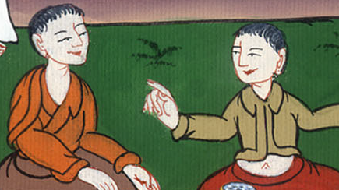
यूहन्ना 2:10

Slide 21
11Jesus performed this, the first of His signs, at Cana in Galilee. He thus revealed His glory, and His disciples believed in Him.
11यीशु ने गलील के काना में अपना यह पहला चिन्ह दिखाकर अपनी महिमा प्रगट की और उसके चेलों ने उस पर विश्वास किया।

Slide 22
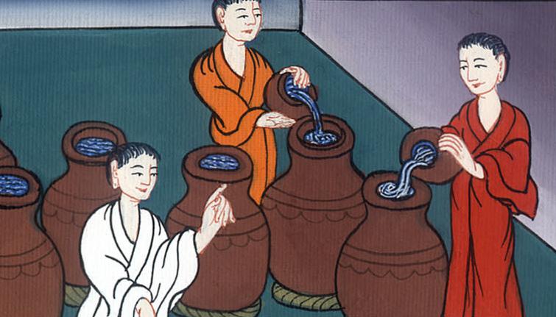
यूहन्ना 2:11

Slide 23
12After this, He went down to Capernaum with His mother and brothers and His disciples, and they stayed there a few days.
12इसके बाद वह और उसकी माता, उसके भाई, उसके चेले, कफरनहूम को गए और वहाँ कुछ दिन रहे।

Slide 24
यूहन्ना 2:12

