Slide 1
33-6
These materials are by the Kongki Ka Project and are made available to you under the terms of the Creative Commons Attribution ShareAlike license 4.0.
You have permission to share and redistribute these materials in any format and to make reasonable revisions and adaptations of this translation, provided that:
You include the above licence and source information.
If you redistribute these materials or create derivatives, you must distribute your contributions under the same license as the original.
The Holy Bible, Berean Standard Bible, BSB is produced in cooperation with Bible Hub, Discovery Bible, OpenBible.com, and the Berean Bible Translation Committee. This text of God's Word has been dedicated to the public domain.
Hindi text is from Free Bibles India. This translation is made available under the terms of a Creative Commons Attribution-ShareAlike 4.0 International License.
Notes:
Ch
33 Jesus’ early ministry
1. John the Baptist tells about Jesus - John 1:19-42; John’s last witness - John 3:22-36;
and John in Prison - Luke 3:19-20 (Left Top)
2. Philip and Nathanael - John 1:43-51 (Center Top)
3. Wedding at Cana - John 2:1-12 (Right Top)
4. Nicodemus - John 3:1-21 (Right Bottom)
5. Woman at the Well - John 4:1-42 (Center Bottom)
6. Nobleman’s Son - John 4:46-54 (Left Bottom)
7. Sick man at Pool - John 5:1-47 (Left Center)
8. Jesus in Nazareth - Luke 4:16-30 (Right Center)

Slide 2
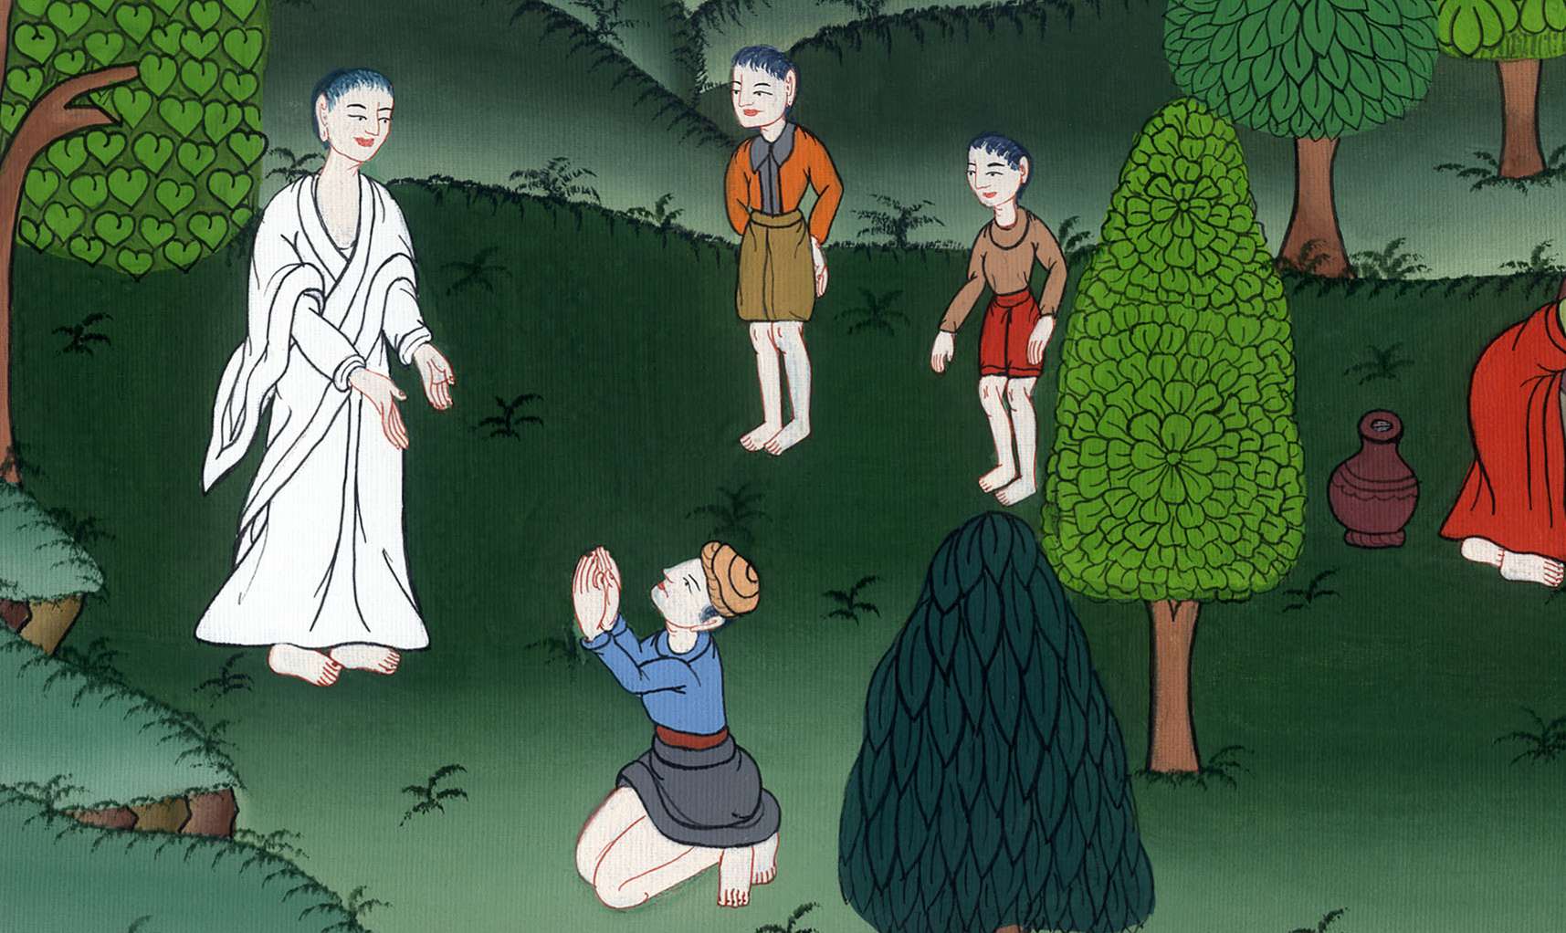
राज कर्मचारी के बेटे को चंगा करना - यूहन्ना 4:46-54
This work is licensed under a Creative Commons Attribution-ShareAlike 4.0 International License

Slide 3
The Nobleman’s Son - John 4:46-54
राज कर्मचारी के बेटे को चंगा करना - यूहन्ना 4:46-54

Slide 4
राज कर्मचारी के बेटे को चंगा करना - यूहन्ना 4:46-54

Slide 5
46So once again He came to Cana in Galilee, where He had turned the water into wine. And there was a royal official whose son lay sick at Capernaum.
46तब वह फिर गलील के काना में आया, जहाँ उसने पानी को दाखरस बनाया था। वहाँ राजा का एक कर्मचारी था जिसका पुत्र कफरनहूम में बीमार था।

Slide 6
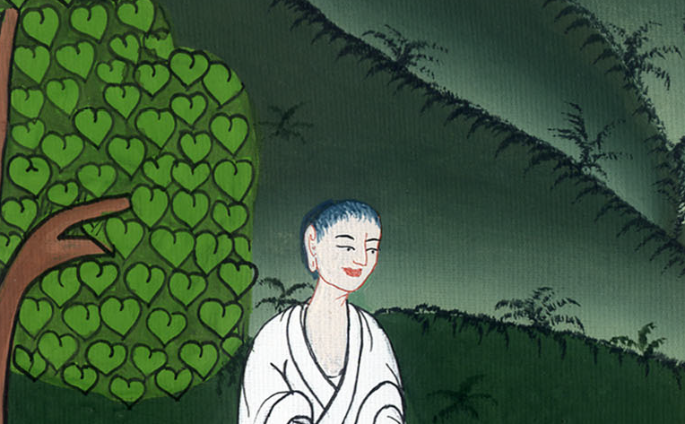
यूहन्ना 4:46

Slide 7
47When he heard that Jesus had come from Judea to Galilee, he went and begged Him to come down and heal his son, who was about to die.
47वह यह सुनकर कि यीशु यहूदिया से गलील में आ गया है, उसके पास गया और उससे विनती करने लगा कि चलकर मेरे पुत्र को चंगा कर दे: क्योंकि वह मरने पर था।

Slide 8
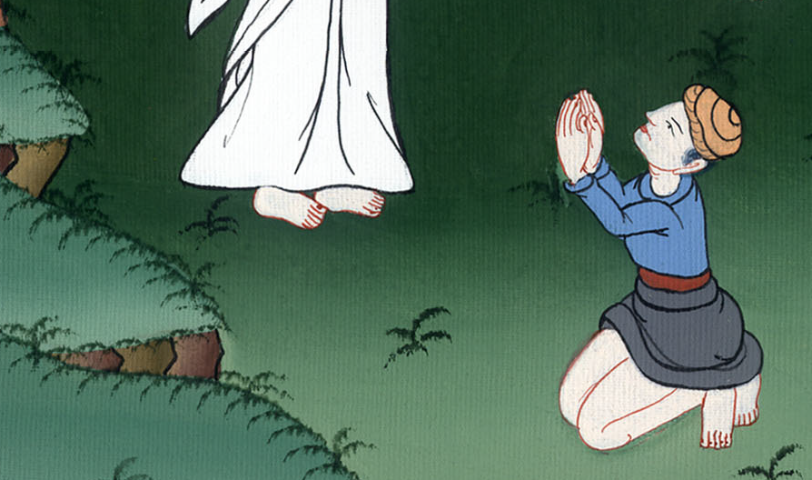
यूहन्ना 4:47

Slide 9
48Jesus said to him, “Unless you people see signs and wonders, you will never believe.”
49“Sir,” the official said, “come down before my child dies.”
48यीशु ने उससे कहा, “जब तक तुम चिन्ह और अद्भुत काम न देखोगे तब तक कदापि विश्वास न करोगे।”
49राजा के कर्मचारी ने उससे कहा, “हे प्रभु, मेरे बालक की मृत्यु होने से पहले चल।”

Slide 10
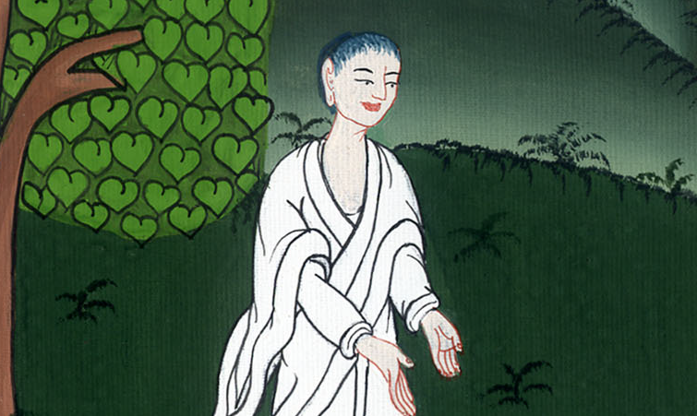
यूहन्ना 4:48,49

Slide 11
50“Go,” said Jesus. “Your son will live.”
The man took Jesus at His word and departed. 51And while he was still on the way, his servants met him with the news that his boy was alive.
50यीशु ने उससे कहा, “जा, तेरा पुत्र जीवित है।” उस मनुष्य ने यीशु की कही हुई बात पर विश्वास किया और चला गया। 51वह मार्ग में जा ही रहा था, कि उसके दास उससे आ मिले और कहने लगे, “तेरा लड़का जीवित है।”

Slide 12
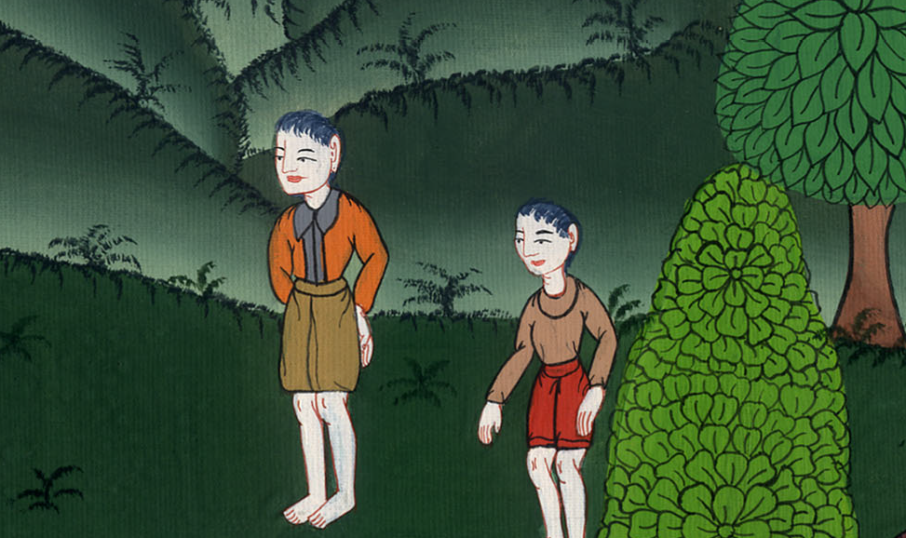
यूहन्ना 4:50,51

Slide 13
52So he inquired as to the hour when his son had recovered, and they told him, “The fever left him yesterday at the seventh hour.
52उसने उनसे पूछा, “किस घड़ी वह अच्छा होने लगा?” उन्होंने उससे कहा, “कल सातवें घण्टे में उसका ज्वर उतर गया।”

Slide 14
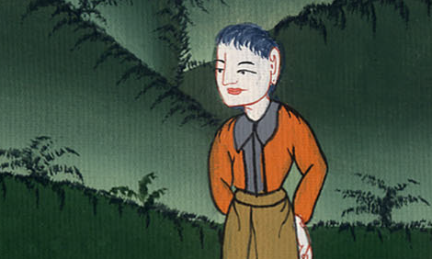
यूहन्ना 4:52

Slide 15
53Then the father realized that this was the very hour in which Jesus had told him, “Your son will live.” And he and all his household believed.
53तब पिता जान गया कि यह उसी घड़ी हुआ जिस घड़ी यीशु ने उससे कहा, “तेरा पुत्र जीवित है,” और उसने और उसके सारे घराने ने विश्वास किया।

Slide 16
यूहन्ना 4:53

