Slide 1
34-3
These materials are by the Kongki Ka Project and are made available to you under the terms of the Creative Commons Attribution ShareAlike license 4.0.
You have permission to share and redistribute these materials in any format and to make reasonable revisions and adaptations of this translation, provided that:
You include the above licence and source information.
If you redistribute these materials or create derivatives, you must distribute your contributions under the same license as the original.
The Holy Bible, Berean Standard Bible, BSB is produced in cooperation with Bible Hub, Discovery Bible, OpenBible.com, and the Berean Bible Translation Committee. This text of God's Word has been dedicated to the public domain.
Hindi text is from Free Bibles India. This translation is made available under the terms of a Creative Commons Attribution-ShareAlike 4.0 International License.
Notes:
Ch
34 Calling the Disciples…
1. Simon, Andrew, James and John - Luke 5:1-11 (Left Top)
2. Capernaum - Mark 1:21-34 (Right Top)
3. Cure Paralyzed Man - Luke 5:17-26 (Right Center)
4. Call of Matthew - Matt 9:9-13 (Right Bottom)
5. Sabbath - Matt 12:1-14; Mark 2:23-28 (Left Bottom)
6. Appointment of the 12 apostles and Sermon on the Mount - Luke 6:12-17; Matt
5:1-7:29 (Left Center)

Slide 2
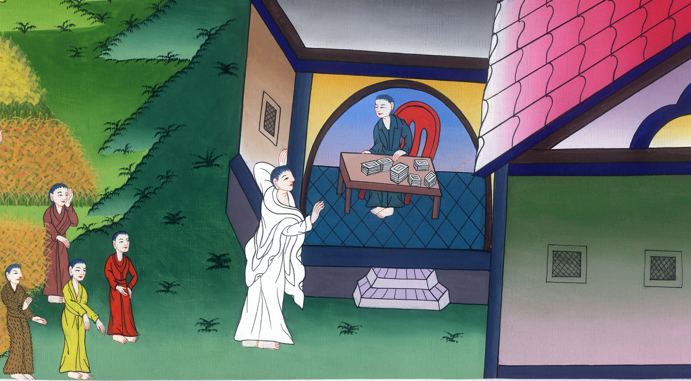
मत्ती की बुलाहट
- मत्ती 9:9-13
This work is licensed under a Creative Commons Attribution-ShareAlike 4.0 International License

Slide 3
Call of Matthew - Matthew 9:9-13
मत्ती की बुलाहट - मत्ती 9:9-13

Slide 4
मत्ती की बुलाहट
- मत्ती 9:9-13

Slide 5
9As Jesus went on from there, He saw a man named Matthew sitting at the tax booth. “Follow Me,” He told him, and Matthew got up and followed Him.
9वहाँ से आगे बढ़कर यीशु ने मत्तीb नामक एक मनुष्य को चुंगी की चौकी पर बैठे देखा, और उससे कहा, “मेरे पीछे हो ले।” वह उठकर उसके पीछे हो लिया।

Slide 6
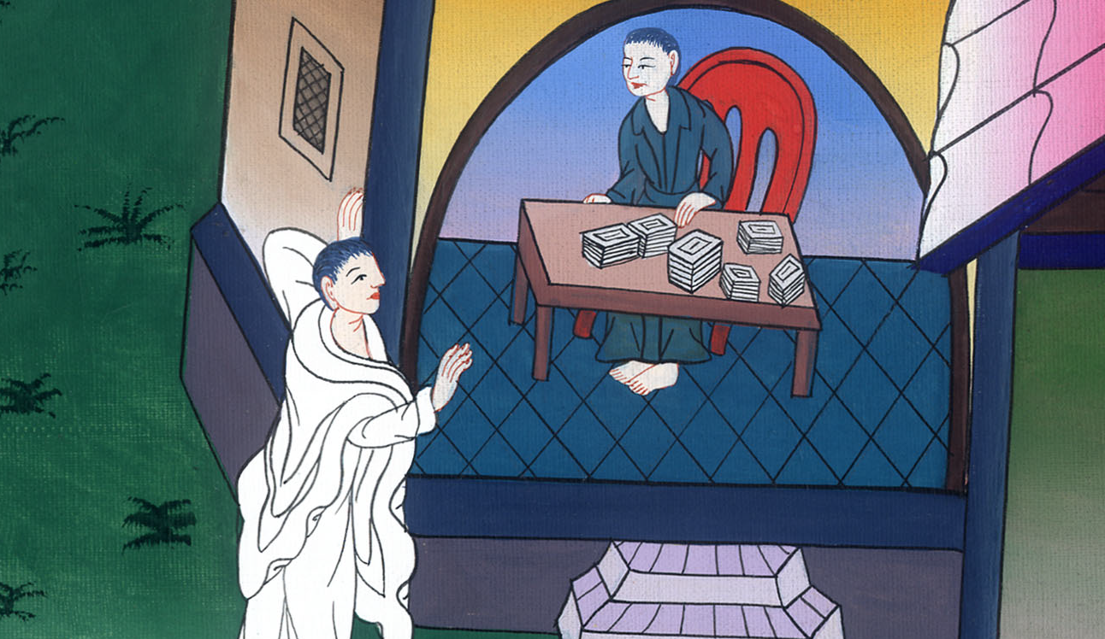
मत्ती 9:9

Slide 7
10Later, as Jesus was dining at Matthew’s house, many tax collectors and sinners came and ate with Him and His disciples.
10और जब वह घर में भोजन करने के लिये बैठा तो बहुत सारे चुंगी लेनेवाले और पापी आकर यीशु और उसके चेलों के साथ खाने बैठे।

Slide 8
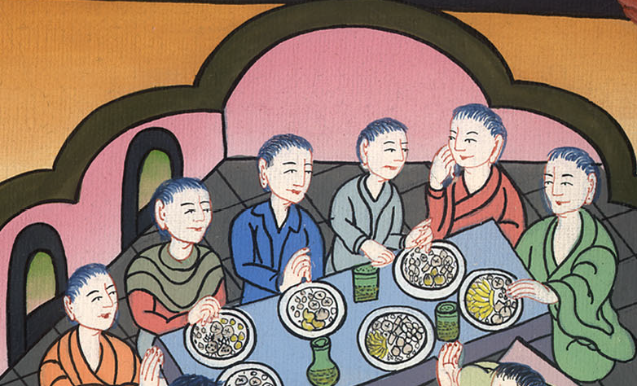
मत्ती 9:10

Slide 9
11When the Pharisees saw this, they asked His disciples, “Why does your Teacher eat with tax collectors and sinners?”
11यह देखकर फरीसियों ने उसके चेलों से कहा, “तुम्हारा गुरु चुंगी लेनेवालों और पापियों के साथ क्यों खाता है?”

Slide 10
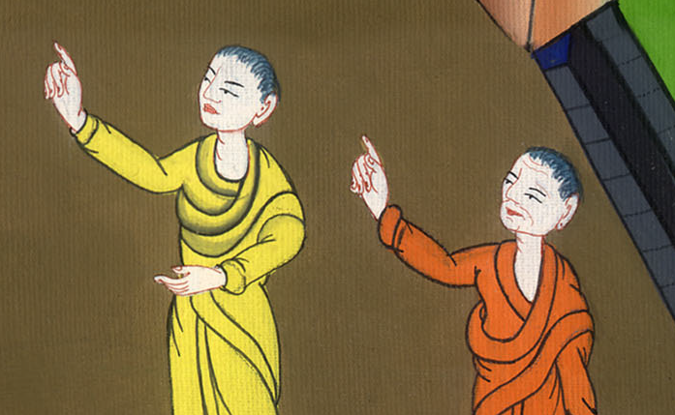
मत्ती 9:11

Slide 11
12On hearing this, Jesus said, “It is not the healthy who need a doctor, but the sick.
12यह सुनकर यीशु ने उनसे कहा, “वैद्य भले चंगों को नहीं परन्तु बीमारों के लिए आवश्यक है।

Slide 12
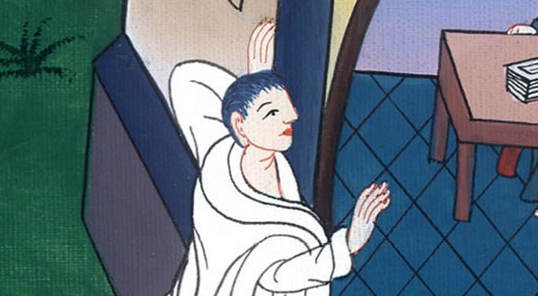
मत्ती 9:12

Slide 13
13But go and learn what this means: ‘I desire mercy, not sacrifice.’ For I have not come to call the righteous, but sinners.”
13इसलिए तुम जाकर इसका अर्थ सीख लो, कि मैं बलिदान नहीं परन्तु दया चाहता हूँ; क्योंकि मैं धर्मियों को नहीं परन्तु पापियों को बुलाने आया हूँ।”

Slide 14
मत्ती 9:13

