Slide 1
35-1
These materials are by the Kongki Ka Project and are made available to you under the terms of the Creative Commons Attribution ShareAlike license 4.0.
You have permission to share and redistribute these materials in any format and to make reasonable revisions and adaptations of this translation, provided that:
You include the above licence and source information.
If you redistribute these materials or create derivatives, you must distribute your contributions under the same license as the original.
The Holy Bible, Berean Standard Bible, BSB is produced in cooperation with Bible Hub, Discovery Bible, OpenBible.com, and the Berean Bible Translation Committee. This text of God's Word has been dedicated to the public domain.
Hindi text is from Free Bibles India. This translation is made available under the terms of a Creative Commons Attribution-ShareAlike 4.0 International License.
Notes:
Ch
35 Cure Leper…
1. Cure Leper - Mark 1:40-45 (Left Top)
2. The Centurion’s Faith - Luke 7:1-10; Matt 8:5-13 (Right Top)
3. The Widow’s Son - Luke 7:11-17 (Right Center)
4. Woman washes Jesus’ Feet - Luke 7:36-50 (Right Bottom)
5. Jesus’ relatives - Mark 3:20-35 (Left Bottom)
6. Calming the Storm - Matt 8:18-27 (left Center)

Slide 2
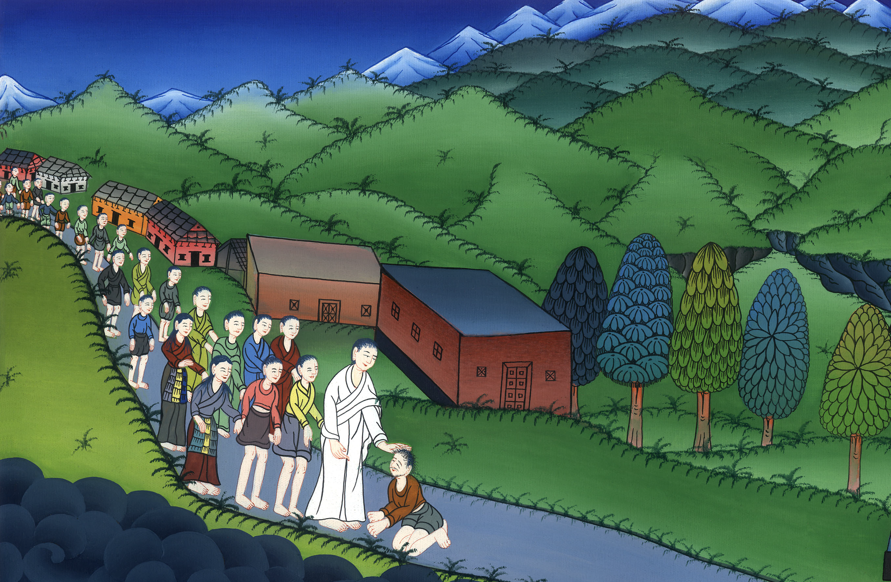
यीशु ने एक कोढ़ी को ठीक किया - मरकुस 1:40-45
This work is licensed under a Creative Commons Attribution-ShareAlike 4.0 International License

Slide 3
Jesus Cure a Leper - Mark 1:40-45
यीशु ने एक कोढ़ी को ठीक किया - मरकुस 1:40-45

Slide 4
यीशु ने एक कोढ़ी को ठीक किया - मरकुस 1:40-45

Slide 5
40Then a leper came to Jesus, begging on his knees: “If You are willing, You can make me clean.”
40एक कोढ़ रोगी उनके पास आया. उसने मसीह येशु के सामने घुटने टेक उनसे विनती की, “आप चाहें तो मुझे शुद्ध कर सकते हैं.”

Slide 6
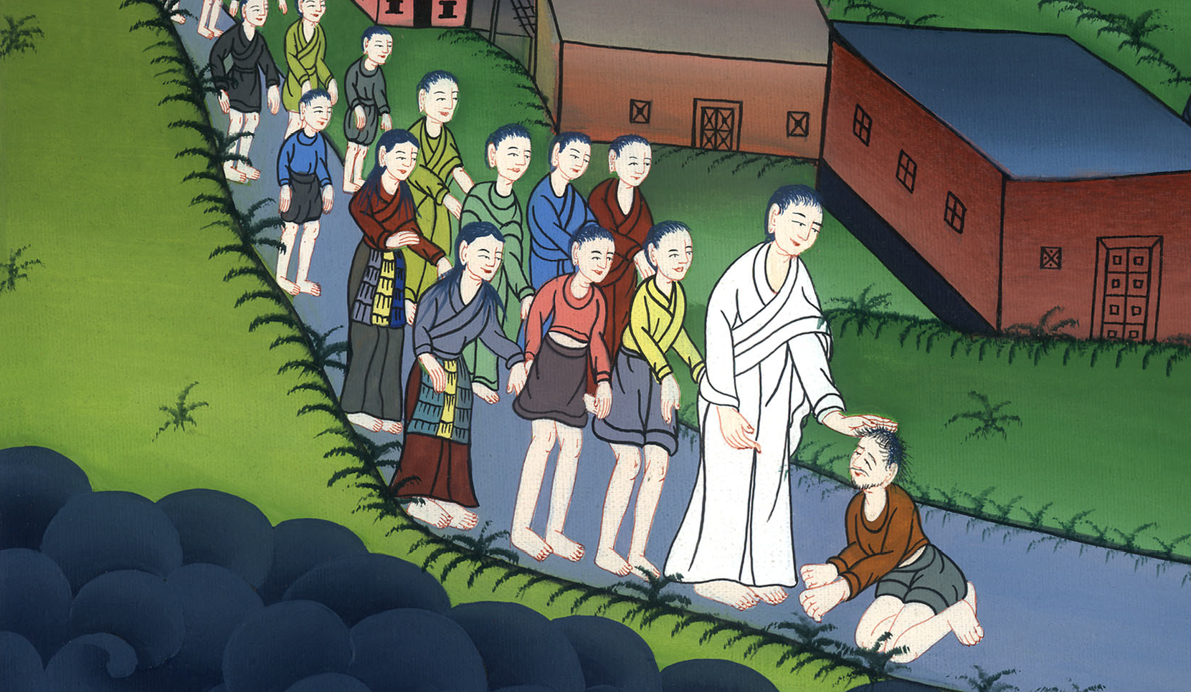
मरकुस 1:40

Slide 7
41Moved with compassion, Jesus reached out His hand and touched the man. “I am willing,” He said. “Be clean!” 42And immediately the leprosy left him, and the man was cleansed.
41उसने उस पर तरस खाकर हाथ बढ़ाया, और उसे छूकर कहा, “मैं चाहता हूँ, तू शुद्ध हो जा।” 42और तुरन्त उसका कोढ़ जाता रहा, और वह शुद्ध हो गया।

Slide 8
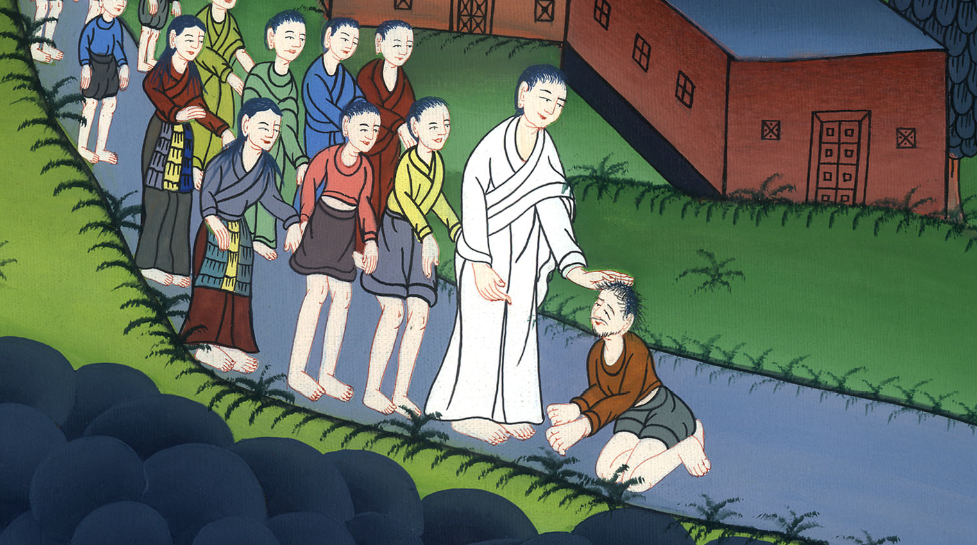
मरकुस 1:41,42

Slide 9
43Jesus promptly sent him away with a stern warning: 44“See that you don’t tell anyone.
43तब उसने उसे कड़ी चेतावनी देकर तुरन्त विदा किया, 44और उससे कहा, “देख, किसी से कुछ मत कहना,

Slide 10
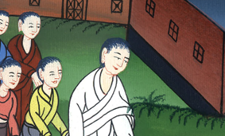
मरकुस 1:43,44

Slide 11
…But go, show yourself to the priest and present the offering Moses prescribed for your cleansing, as a testimony to them.”
…परन्तु जाकर अपने आपको याजक को दिखा, और अपने शुद्ध होने के विषय में जो कुछ मूसा ने ठहराया है उसे भेंट चढ़ा, कि उन पर गवाही हो।”

Slide 12
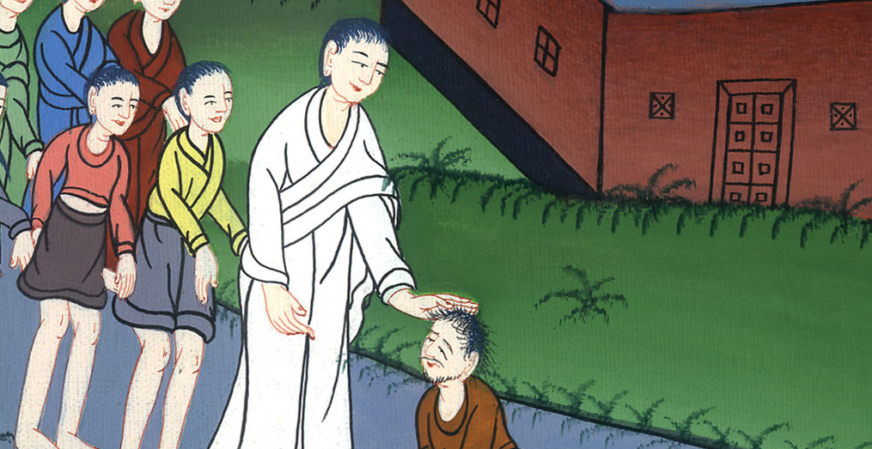
मरकुस 1:44

Slide 13
5But the man went out and openly began to proclaim and spread the news.
45परन्तु वह बाहर जाकर इस बात को बहुत प्रचार करने और यहाँ तक फैलाने लगा,

Slide 14
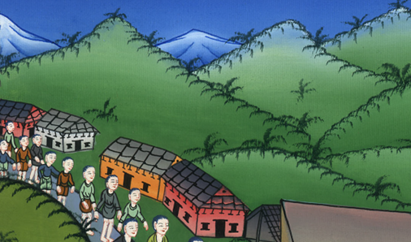
मरकुस 1:45

Slide 15
…Consequently, Jesus could no longer enter a town in plain view, but He stayed out in solitary places. Yet people came to Him from every quarter.
…कि यीशु फिर खुल्लमखुल्ला नगर में न जा सका, परन्तु बाहर जंगली स्थानों में रहा; और चारों ओर से लोग उसके पास आते रहे।

Slide 16
मरकुस 1:45

