Slide 1
35-3
These materials are by the Kongki Ka Project and are made available to you under the terms of the Creative Commons Attribution ShareAlike license 4.0.
You have permission to share and redistribute these materials in any format and to make reasonable revisions and adaptations of this translation, provided that:
You include the above licence and source information.
If you redistribute these materials or create derivatives, you must distribute your contributions under the same license as the original.
The Holy Bible, Berean Standard Bible, BSB is produced in cooperation with Bible Hub, Discovery Bible, OpenBible.com, and the Berean Bible Translation Committee. This text of God's Word has been dedicated to the public domain.
Hindi text is from Free Bibles India. This translation is made available under the terms of a Creative Commons Attribution-ShareAlike 4.0 International License.
Notes:
Ch
35 Cure Leper…
1. Cure Leper - Mark 1:40-45 (Left Top)
2. The Centurion’s Faith - Luke 7:1-10; Matt 8:5-13 (Right Top)
3. The Widow’s Son - Luke 7:11-17 (Right Center)
4. Woman washes Jesus’ Feet - Luke 7:36-50 (Right Bottom)
5. Jesus’ relatives - Mark 3:20-35 (Left Bottom)
6. Calming the Storm - Matt 8:18-27 (left Center)

Slide 2
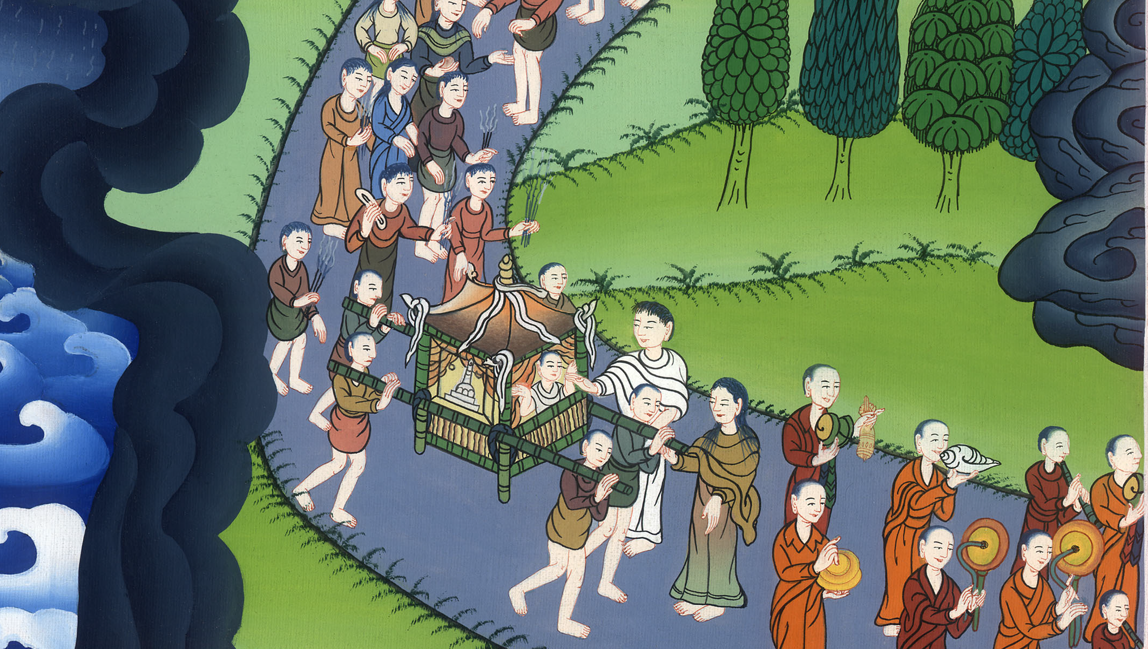
विधवा का बेटा - लूका 7:11-17
This work is licensed under a Creative Commons Attribution-ShareAlike 4.0 International License

Slide 3
The Widow’s Son - Luke 7:11-17
विधवा का बेटा - लूका 7:11-17

Slide 4
विधवा का बेटा - लूका 7:11-17

Slide 5
11Soon afterward, Jesus went to a town called Nain. His disciples went with Him, accompanied by a large crowd.
11थोड़े दिन के बाद वह नाईनa नाम के एक नगर को गया, और उसके चेले, और बड़ी भीड़ उसके साथ जा रही थी।

Slide 6
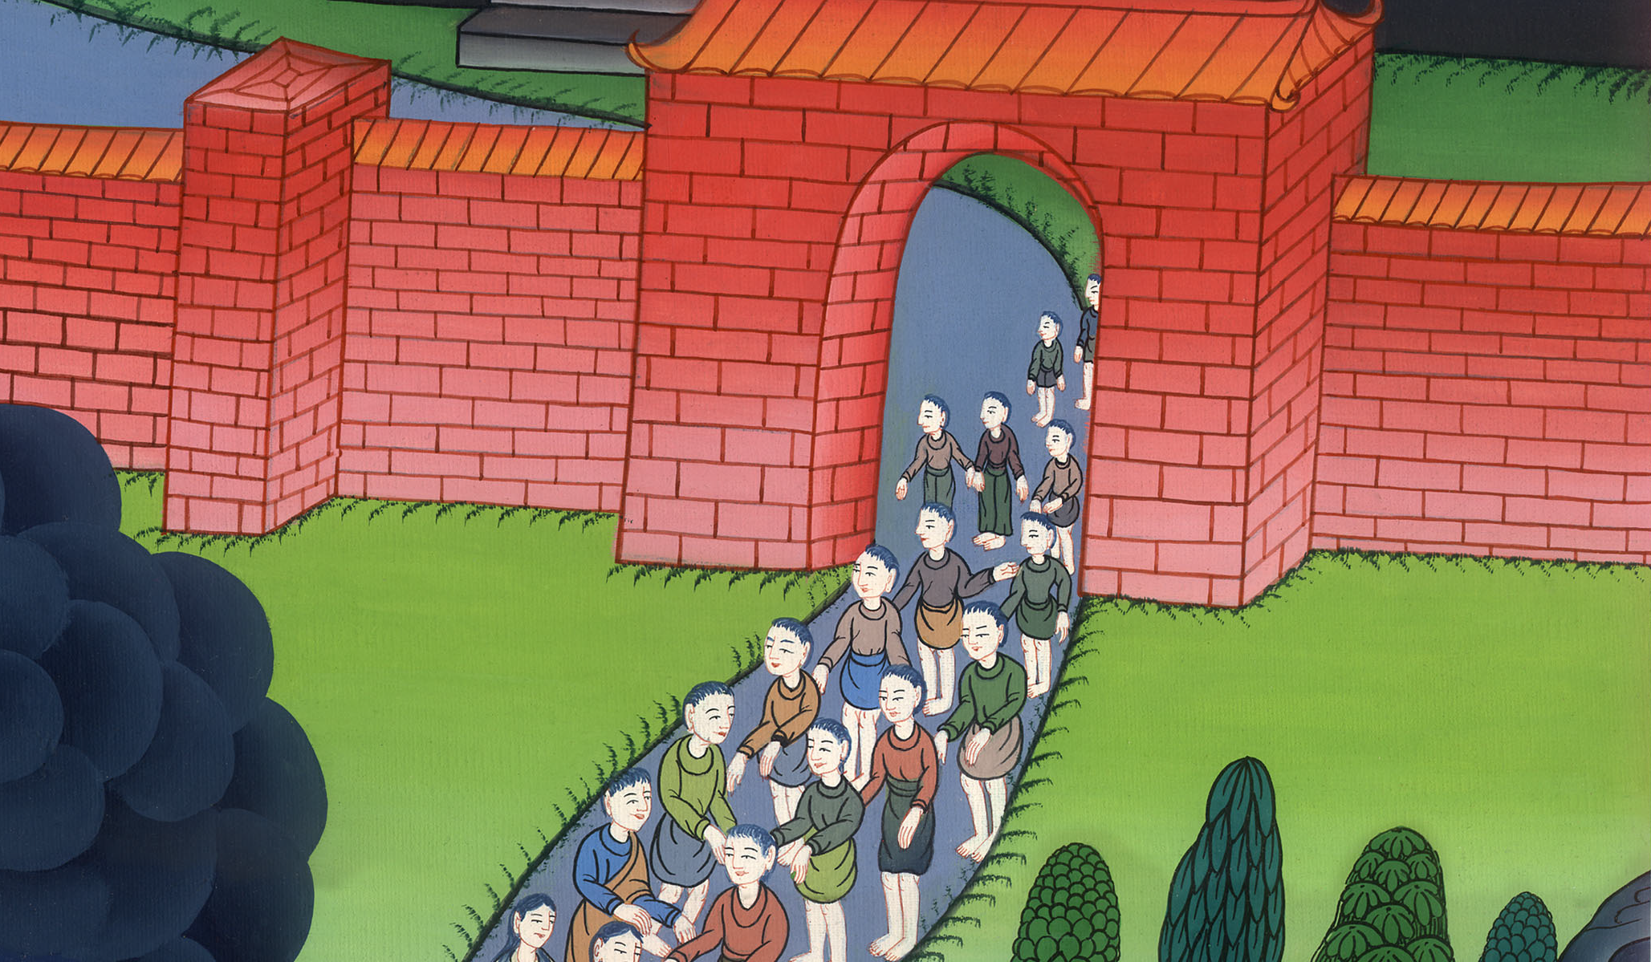
लूका 7:11

Slide 7
12As He approached the town gate, He saw a dead man being carried out, the only son of his mother, and she was a widow. And a large crowd from the town was with her.
12जब वह नगर के फाटक के पास पहुँचा, तो देखो, लोग एक मुर्दे को बाहर लिए जा रहे थे; जो अपनी माँ का एकलौता पुत्र था, और वह विधवा थी: और नगर के बहुत से लोग उसके साथ थे।

Slide 8
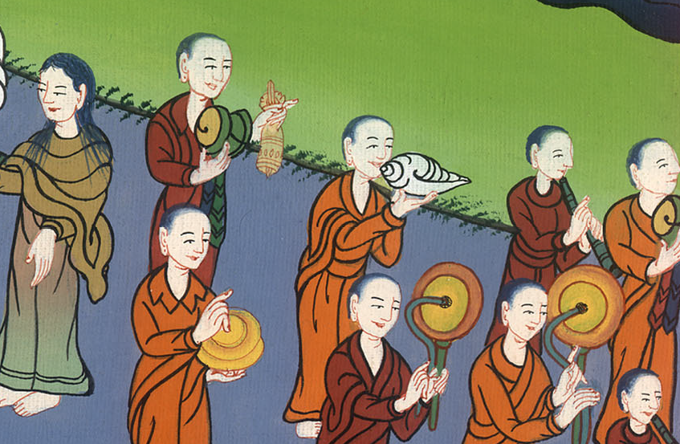
लूका 7:12

Slide 9
13When the Lord saw her, He had compassion on her and said, “Do not weep.”
13उसे देखकर प्रभु को तरस आया, और उसने कहा, “मत रो।”

Slide 10
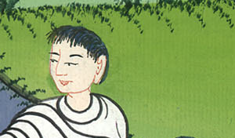
लूका 7:13

Slide 11
14Then He went up and touched the coffin, and those carrying it stood still. “Young man,” He said, “I tell you, get up!”
14तब उसने पास आकर अर्थी को छुआ; और उठानेवाले ठहर गए, तब उसने कहा, “हे जवान, मैं तुझ से कहता हूँ, उठ!”

Slide 12
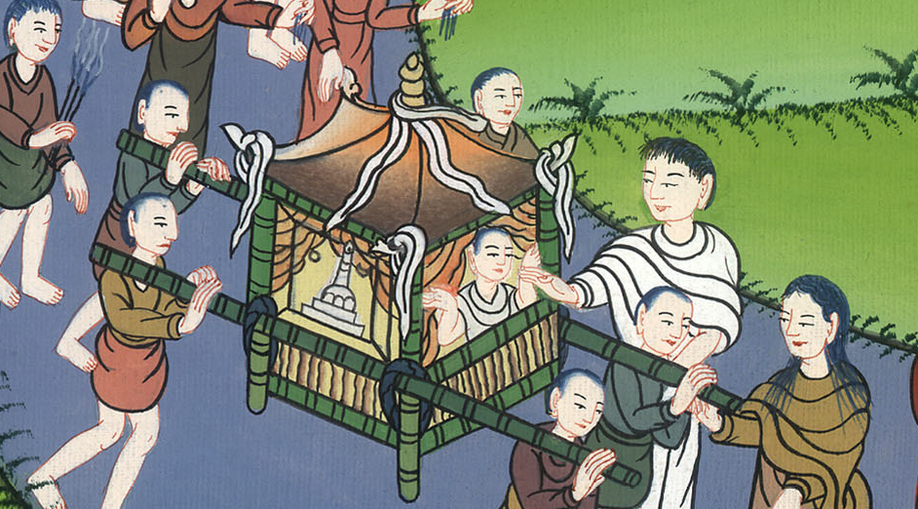
लूका 7:14

Slide 13
15And the dead man sat up and began to speak! Then Jesus gave him back to his mother.
15तब वह मुर्दा उठ बैठा, और बोलने लगा: और उसने उसे उसकी माँ को सौंप दिया।

Slide 14
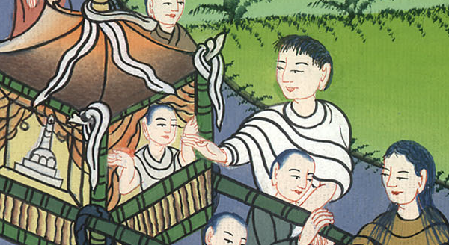
लूका 7:15

Slide 15
16A sense of awe swept over all of them, and they glorified God. “A great prophet has appeared among us!” they said. “God has visited His people!”
16इससे सब पर भय छा गयाb; और वे परमेश्वर की बड़ाई करके कहने लगे, “हमारे बीच में एक बड़ा भविष्यद्वक्ता उठा है, और परमेश्वर ने अपने लोगों पर कृपादृष्टि की है।”

Slide 16
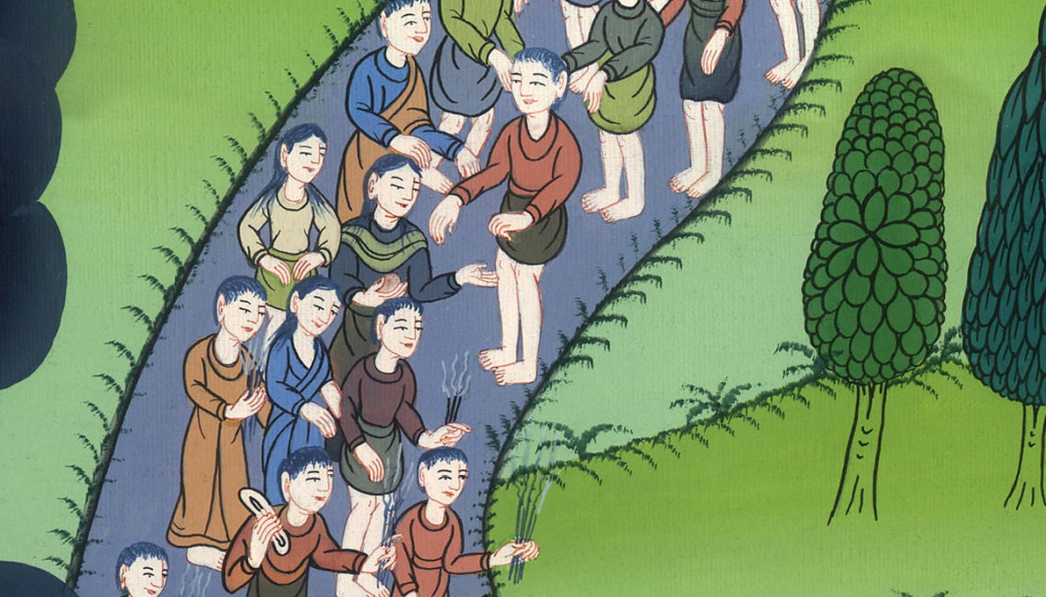
लूका 7:16

Slide 17
17And the news about Jesus spread throughout Judea and all the surrounding region.
17और उसके विषय में यह बात सारे यहूदिया और आस-पास के सारे देश में फैल गई।

Slide 18
लूका 7:17

