Slide 1
36-5
These materials are by the Kongki Ka Project and are made available to you under the terms of the Creative Commons Attribution ShareAlike license 4.0.
You have permission to share and redistribute these materials in any format and to make reasonable revisions and adaptations of this translation, provided that:
You include the above licence and source information.
If you redistribute these materials or create derivatives, you must distribute your contributions under the same license as the original.
The Holy Bible, Berean Standard Bible, BSB is produced in cooperation with Bible Hub, Discovery Bible, OpenBible.com, and the Berean Bible Translation Committee. This text of God's Word has been dedicated to the public domain.
Hindi text is from Free Bibles India. This translation is made available under the terms of a Creative Commons Attribution-ShareAlike 4.0 International License.
Notes:
Ch
36 Legion
1. Legion - Matt 8:28-34; Mark 5:1-20; Luke 8:26-39 (Left Center)
2. Woman touching Jesus’ cloak & Jairus’ daughter - Matthew 9:18-26; Mark 5:21-
43; Luke 8:40-56 (Top)
3. John Beheaded - Matt 14:1-12; Mark 6:14-29; Luke 9:7-9 (Right Bottom)
4. 1st Miracle with loaves - Matt 14:13-21; Mark 6:30-44;luke 9:10-17; John 6:1-15
(Left Bottom)
5. Jesus walks on Water - Matt 14:22-33; Mark 6:45-52; John 6:16-21 (Center)

Slide 2
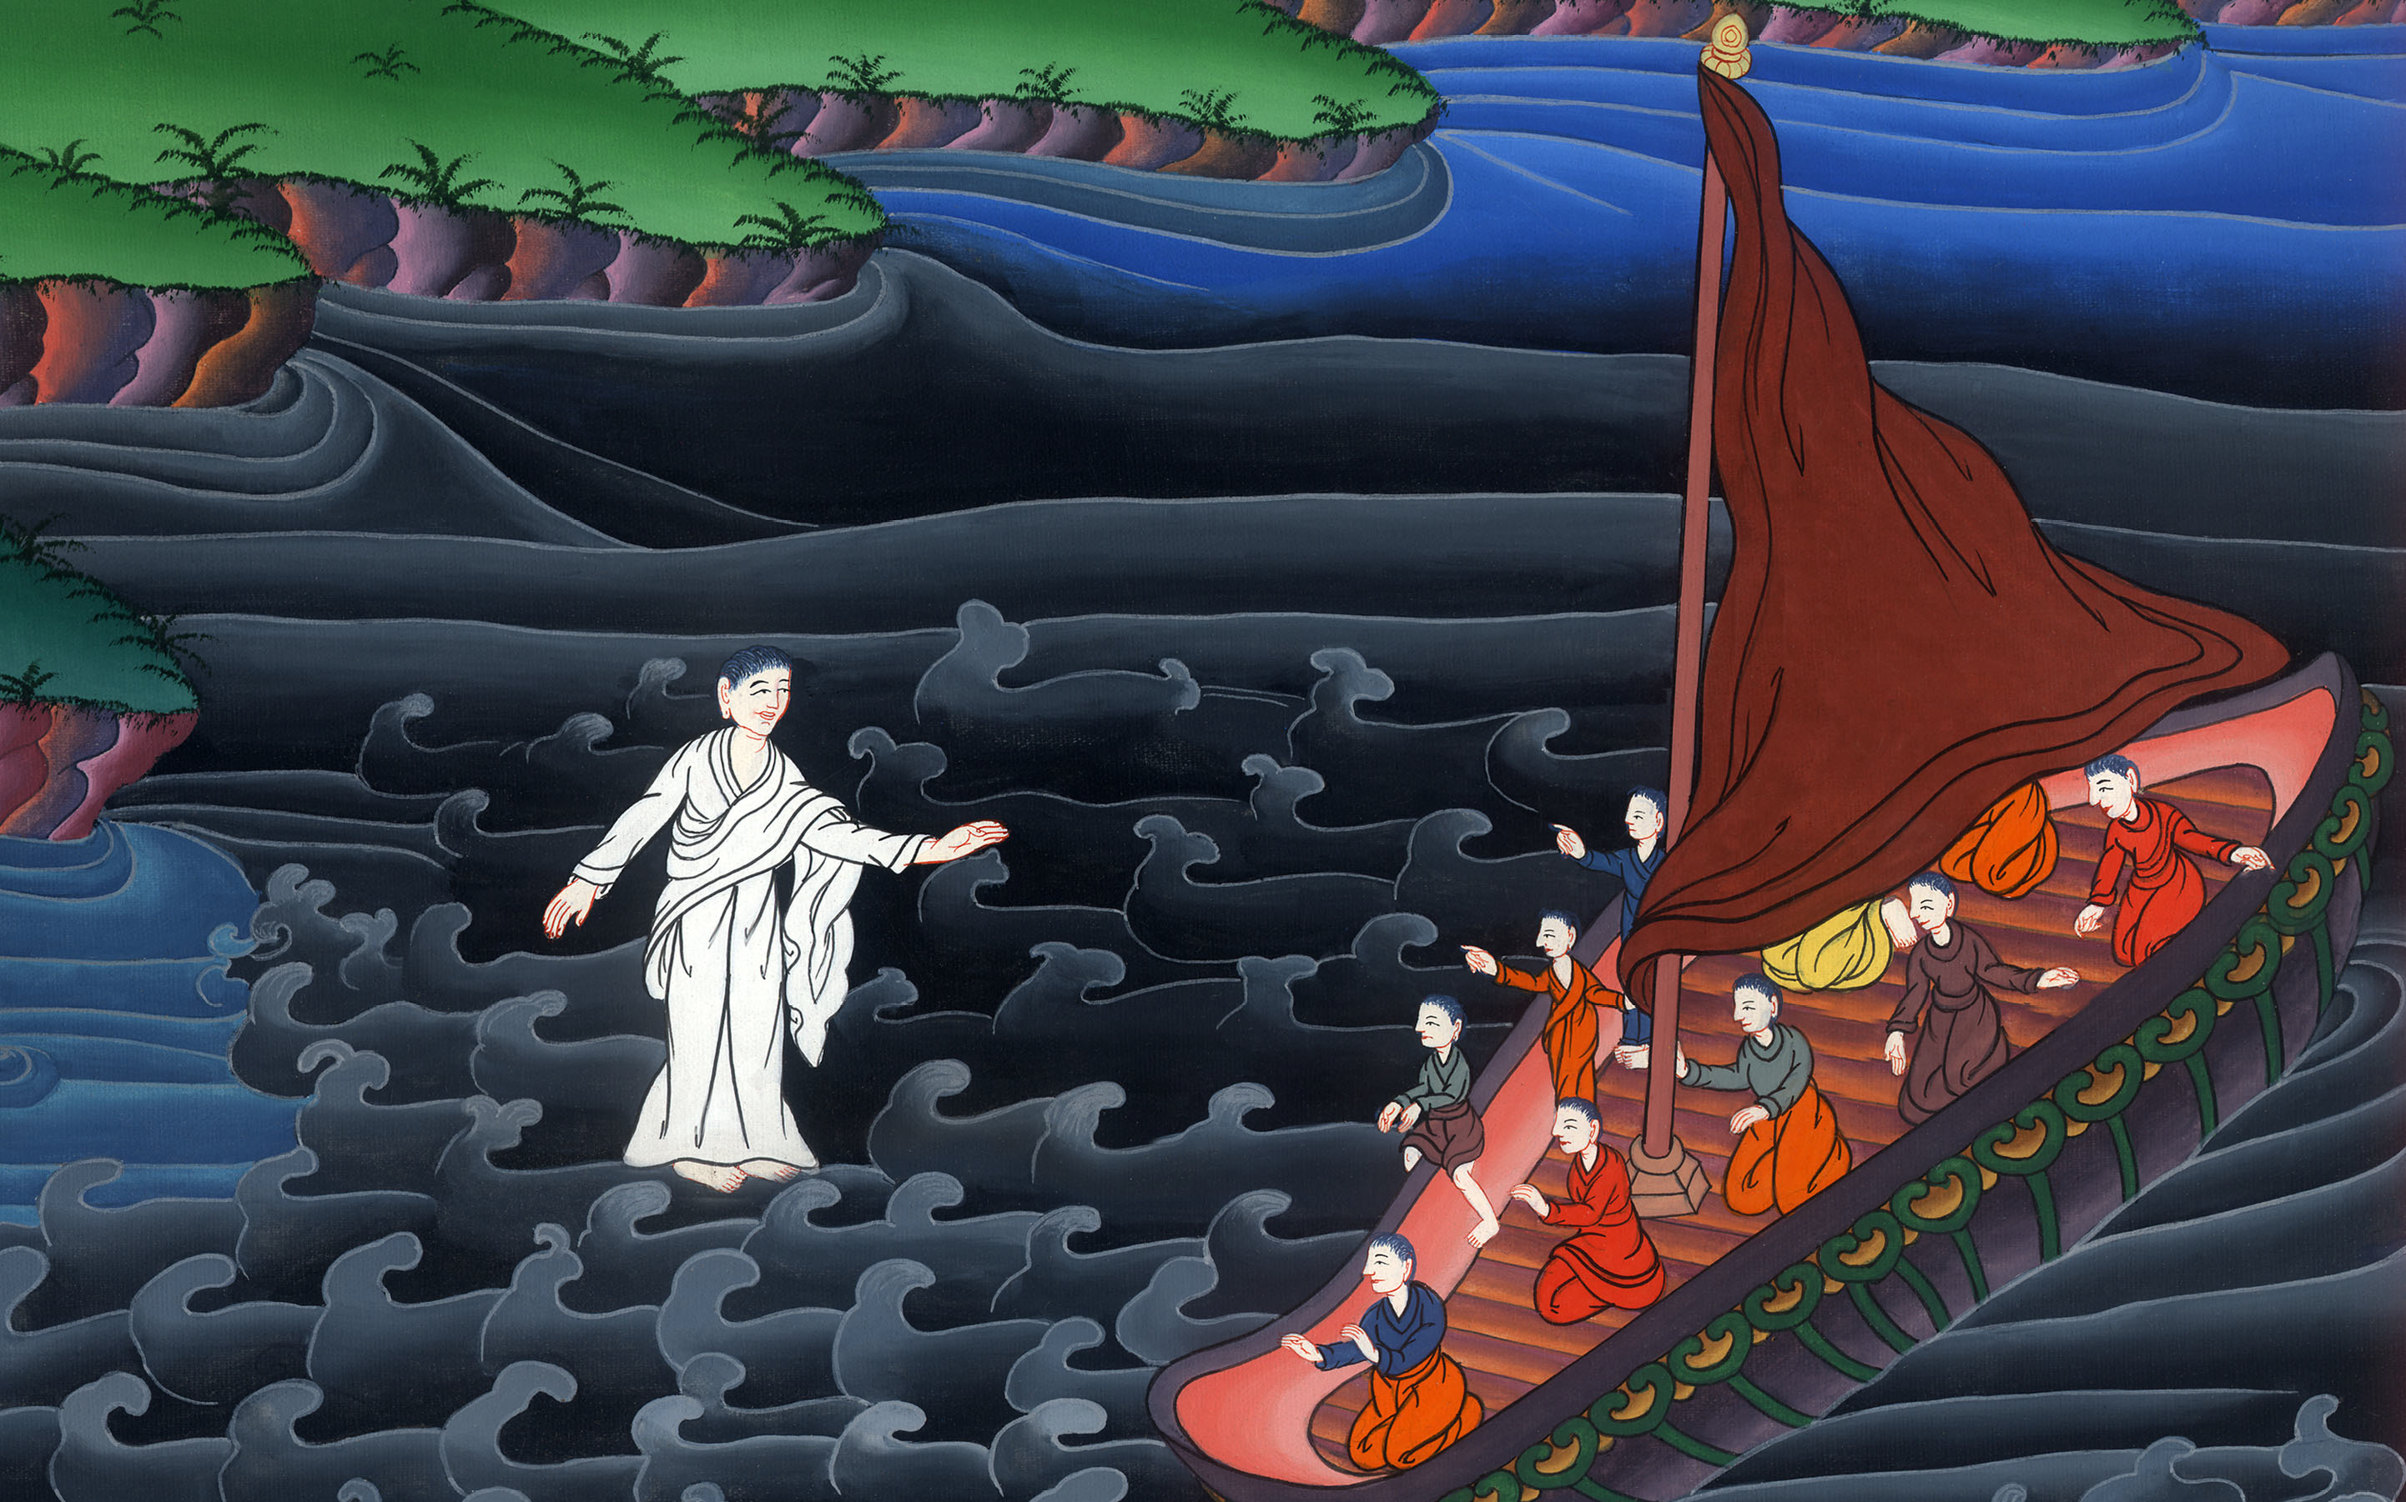
यीशु पानी पर चलते है - मत्ती 14:22-33
This work is licensed under a Creative Commons Attribution-ShareAlike 4.0 International License

Slide 3
5. Jesus walks on Water - Matthew 14:22-33
यीशु पानी पर चलते है - मत्ती 14:22-33

Slide 4
यीशु पानी पर चलते है - मत्ती 14:22-33

Slide 5
Matthew14:22 When He stepped ashore and saw a large crowd, He had compassion on them and healed their sick.
मत्ती 14:22 और उसने तुरन्त अपने चेलों को नाव पर चढ़ाया, कि वे उससे पहले पार चले जाएँ, जब तक कि वह लोगों को विदा करे।

Slide 6
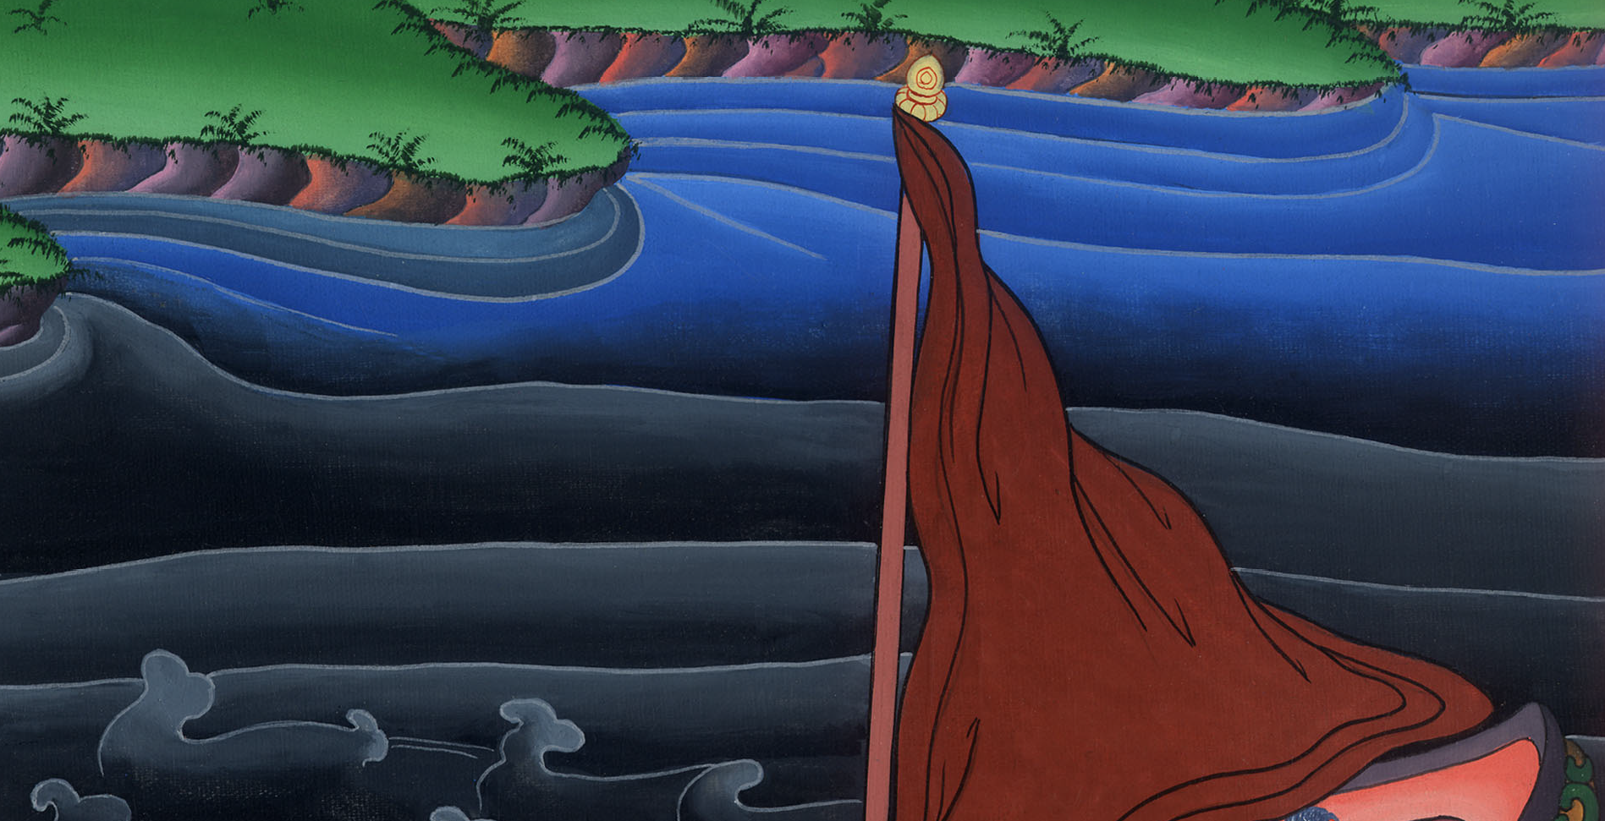
मत्ती 14:22

Slide 7
23After He had sent them away, He went up on the mountain by Himself to pray. When evening came, He was there alone,
23वह लोगों को विदा करके, प्रार्थना करने को अलग पहाड़ पर चढ़ गया; और साँझ को वह वहाँ अकेला था।

Slide 8
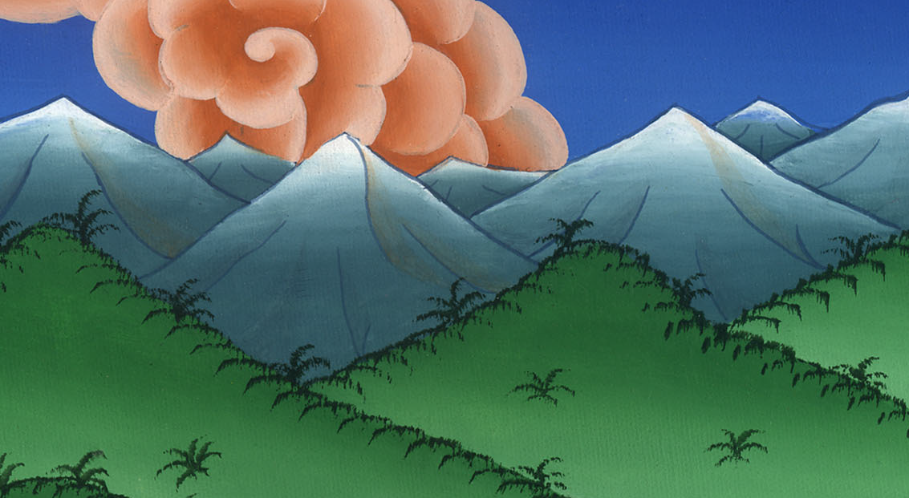
मत्ती 14:23

Slide 9
24but the boat was already far from land, buffeted by the waves because the wind was against it.
24उस समय नाव झील के बीच लहरों से डगमगा रही थी, क्योंकि हवा सामने की थी।

Slide 10
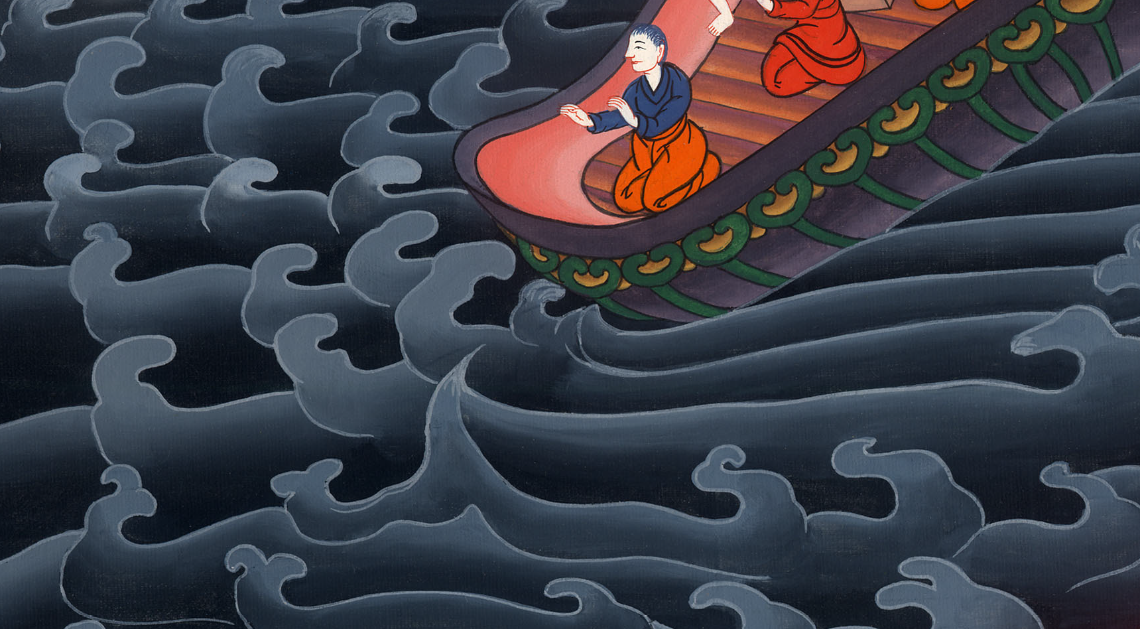
मत्ती 14:24

Slide 11
25During the fourth watch of the night, Jesus went out to them, walking on the sea.
25और वह रात के चौथे पहरc झील पर चलते हुए उनके पास आया।

Slide 12
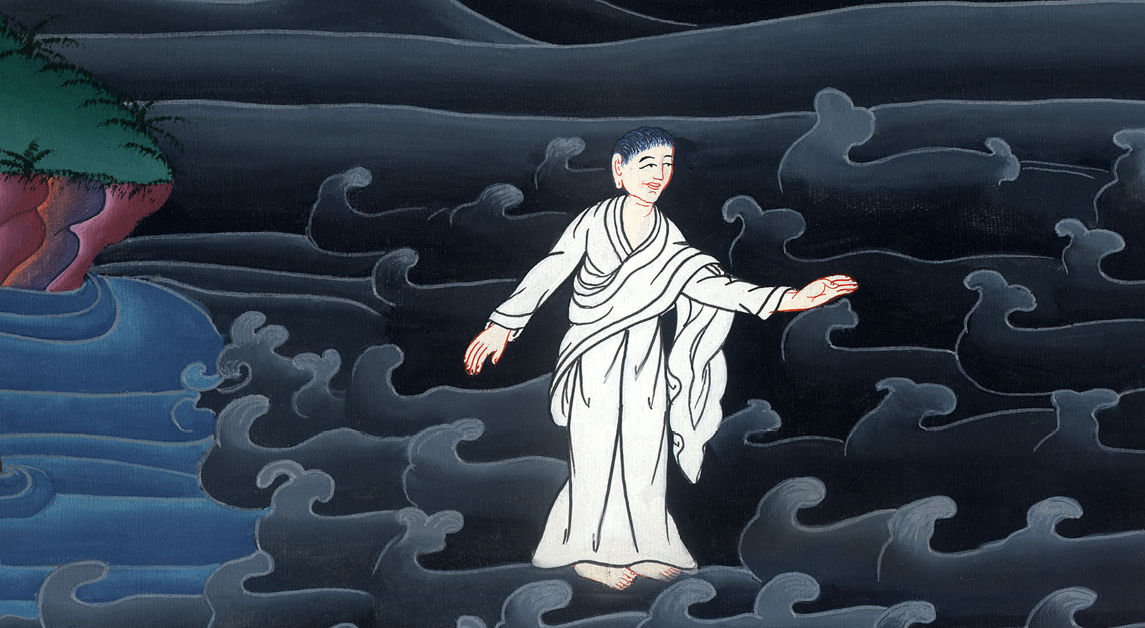
मत्ती 14:25

Slide 13
26When the disciples saw Him walking on the sea, they were terrified. “It’s a ghost!” they said, and cried out in fear.
27But Jesus spoke up at once: “Take courage! It is I. Do not be afraid.”
26चेले उसको झील पर चलते हुए देखकर घबरा गए, और कहने लगे, “वह भूत है,” और डर के मारे चिल्ला उठे।
27यीशु ने तुरन्त उनसे बातें की, और कहा, “धैर्य रखो, मैं हूँ; डरो मत।”

Slide 14
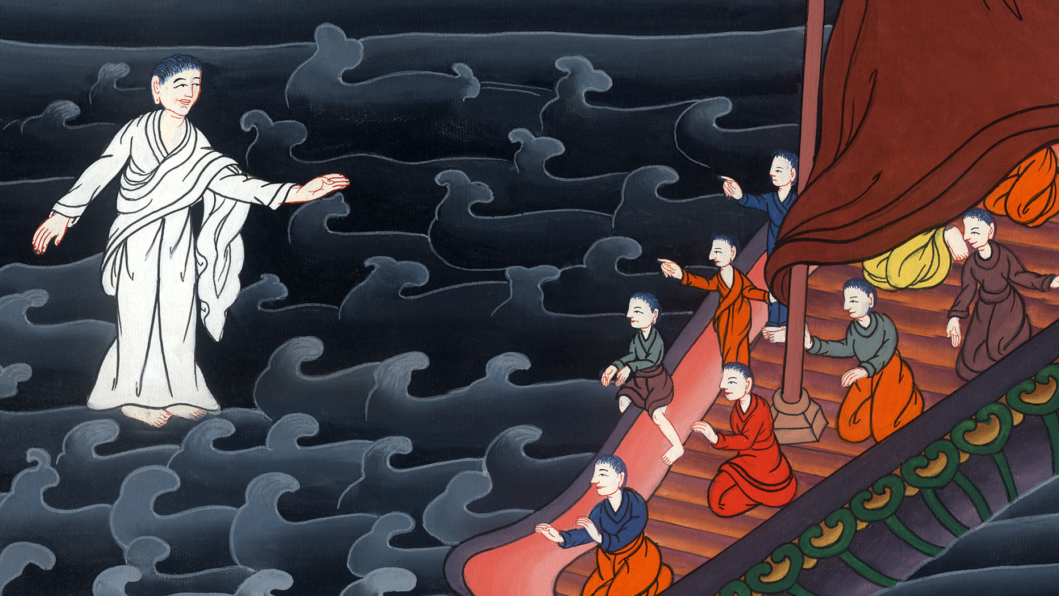
मत्ती 14:26,27

Slide 15
29“Come,” said Jesus.
Then Peter got down out of the boat, walked on the water, and came toward Jesus.
29उसने कहा, “आ!” तब पतरस नाव पर से उतरकर यीशु के पास जाने को पानी पर चलने लगा।

Slide 16
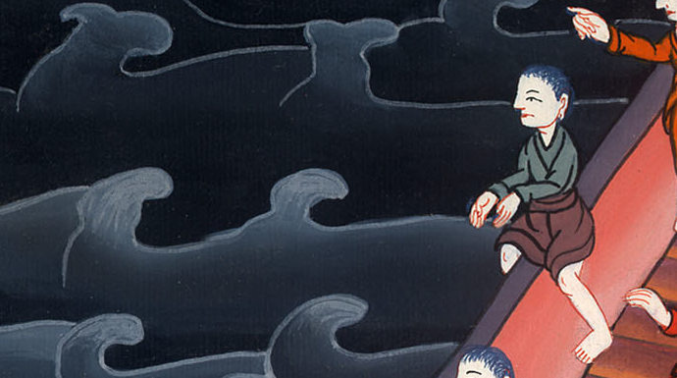
मत्ती 14:29

Slide 17
30But when he saw the strength of the wind, he was afraid, and beginning to sink, cried out, “Lord, save me!”
31Immediately Jesus reached out His hand and took hold of Peter. “You of little faith,” He said, “why did you doubt?”
30पर हवा को देखकर डर गया, और जब डूबने लगा तो चिल्लाकर कहा, “हे प्रभु, मुझे बचा।”
31यीशु ने तुरन्त हाथ बढ़ाकर उसे थाम लिया, और उससे कहा, “हे अल्प विश्वासी, तूने क्यों सन्देह किया?”

Slide 18
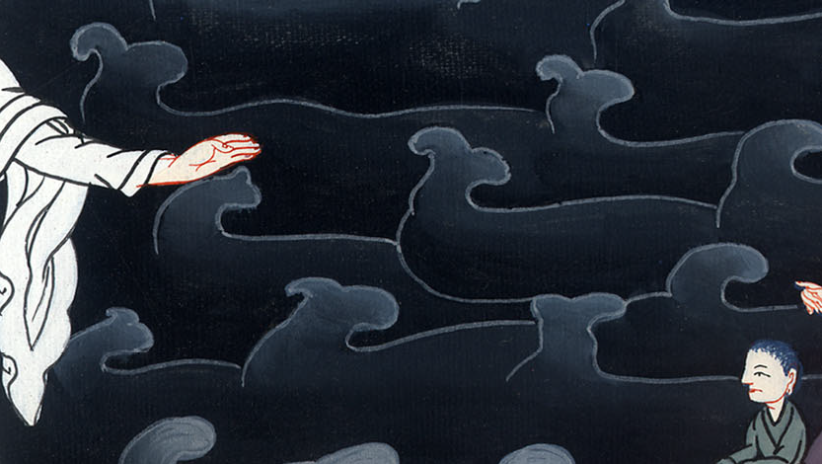
मत्ती 14:30,31

Slide 19
32And when they had climbed back into the boat, the wind died down. 33Then those who were in the boat worshiped Him, saying, “Truly You are the Son of God!”
32जब वे नाव पर चढ़ गए, तो हवा थम गई। 33इस पर जो नाव पर थे, उन्होंने उसकी आराधना करके कहा, “सचमुच, तू परमेश्वर का पुत्र है।”

Slide 20
मत्ती 14:32,33

