Slide 1
38-2
These materials are by the Kongki Ka Project and are made available to you under the terms of the Creative Commons Attribution ShareAlike license 4.0.
You have permission to share and redistribute these materials in any format and to make reasonable revisions and adaptations of this translation, provided that:
You include the above licence and source information.
If you redistribute these materials or create derivatives, you must distribute your contributions under the same license as the original.
The Holy Bible, Berean Standard Bible, BSB is produced in cooperation with Bible Hub, Discovery Bible, OpenBible.com, and the Berean Bible Translation Committee. This text of God's Word has been dedicated to the public domain.
Hindi text is from Free Bibles India. This translation is made available under the terms of a Creative Commons Attribution-ShareAlike 4.0 International License.
Notes:
Ch
38 The Teachings of Jesus
1. Eating with unclean hands - Matt 15:1-20; Mark 7:1-23 (Left Top)
2. Deaf Man healed - Mark 7:31-37 (Center Top)
3. Healing and feeding 4000 - Matthew 15:29-39; Mark 8:1-10 (Center)
4. Pharisees ask for a sign - Matt 16:1-4; Mark 8:11-13; Matt 12:38-42; Luke 11:29-
32 (Right Top)
5. Yeast of the Pharisees - Matt 16:5-12; Mark 8:14-21 (Right Bottom)
6. You are the Christ - Matt 16:13-20; Mark 8:27-30; Luke 9:18-21 (Left Bottom)
7. Carry your Cross - Matt 16:21-28; Mark 8:31-38; Luke 9:22-27 (Left near
Bottom)

Slide 2
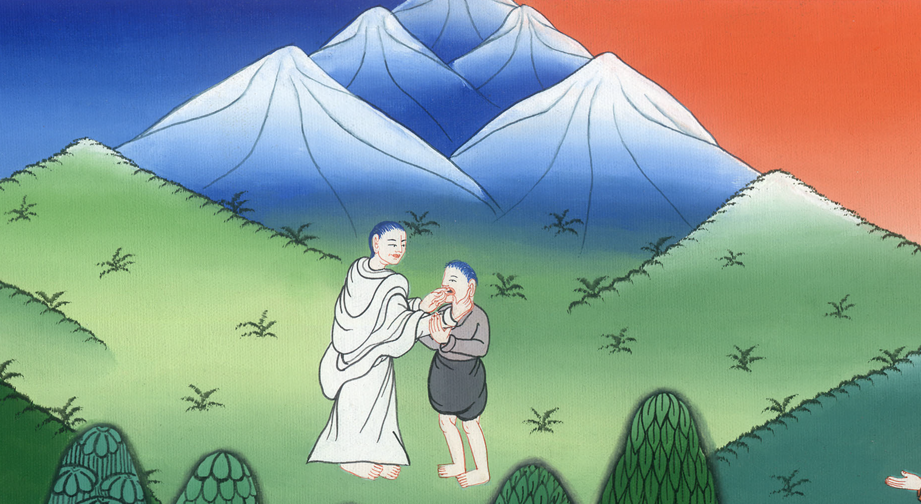
यीशु ने बहरे और गूंगे आदमी को चंगा किया - मरकुस 7:31-37
This work is licensed under a Creative Commons Attribution-ShareAlike 4.0 International License

Slide 3
Deaf and Dumb Man healed - Mark 7:31-37
यीशु ने बहरे और गूंगे आदमी को चंगा किया - मरकुस 7:31-37

Slide 4
यीशु ने बहरे और गूंगे आदमी को चंगा किया - मरकुस 7:31-37

Slide 5
(One day) 32Some people brought to Him a man who was deaf and hardly able to speak, and they begged Jesus to place His hand on him.
32और लोगों ने एक बहरे को जो हक्ला भी था, उसके पास लाकर उससे विनती की, कि अपना हाथ उस पर रखे।

Slide 6
मरकुस 7:32

Slide 7
33So Jesus took him aside privately, away from the crowd, and put His fingers into the man’s ears. Then He spit and touched the man’s tongue.
33तब वह उसको भीड़ से अलग ले गया, और अपनी उँगलियाँ उसके कानों में डाली, और थूककर उसकी जीभ को छुआ।

Slide 8
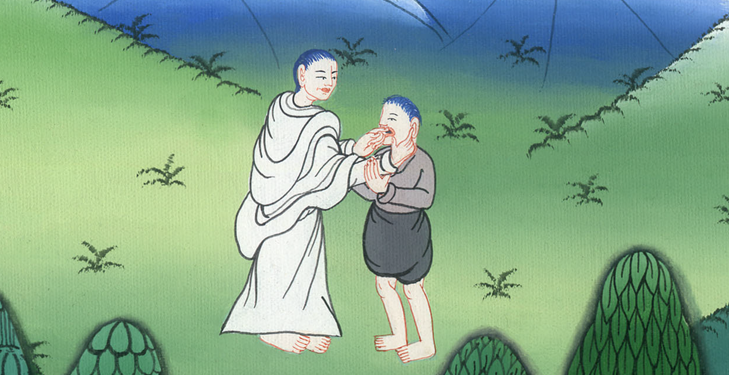
मरकुस 7:33

Slide 9
34And looking up to heaven, He sighed deeply and said to him, “Ephphatha!” (which means, “Be opened!”).
34और स्वर्ग की ओर देखकर आह भरी, और उससे कहा, “इप्फत्तह!” अर्थात् “खुल जा!”

Slide 10
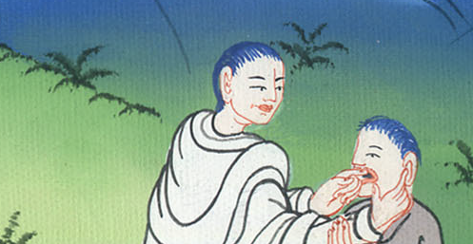
मरकुस 7:34

Slide 11
35Immediately the man’s ears were opened and his tongue was released, and he began to speak plainly.
35और उसके कान खुल गए, और उसकी जीभ की गाँठ भी खुल गई, और वह साफ-साफ बोलने लगा।

Slide 12
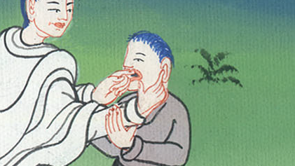
मरकुस 7:35

Slide 13
36Jesus ordered them not to tell anyone. But the more He ordered them, the more widely they proclaimed it.
36तब उसने उन्हें चेतावनी दी कि किसी से न कहना; परन्तु जितना उसने उन्हें चिताया उतना ही वे और प्रचार करने लगे।

Slide 14
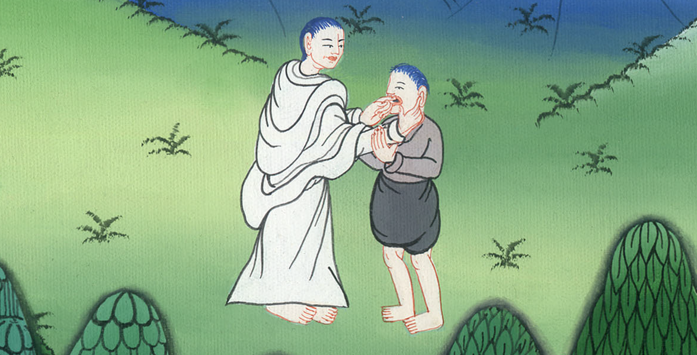
मरकुस 7:36

Slide 15
37The people were utterly astonished and said, “He has done all things well! He makes even the deaf hear and the mute speak!”
37और वे बहुत ही आश्चर्य में होकर कहने लगे, “उसने जो कुछ किया सब अच्छा किया है; वह बहरों को सुनने की, और गूँगों को बोलने की शक्ति देता है।”

Slide 16
मरकुस 7:37

