Slide 1
50-2
These materials are by the Kongki Ka Project and are made available to you under the terms of the Creative Commons Attribution ShareAlike license 4.0.
You have permission to share and redistribute these materials in any format and to make reasonable revisions and adaptations of this translation, provided that:
You include the above licence and source information.
If you redistribute these materials or create derivatives, you must distribute your contributions under the same license as the original.
The Holy Bible, Berean Standard Bible, BSB is produced in cooperation with Bible Hub, Discovery Bible, OpenBible.com, and the Berean Bible Translation Committee. This text of God's Word has been dedicated to the public domain.
Hindi text is from Free Bibles India. This translation is made available under the terms of a Creative Commons Attribution-ShareAlike 4.0 International License.
Notes:
Ch
50 Peter Arrested
1. James killed –Acts 12:1-2 (Left Top)
2. Peter arrested – Acts 12:3-11 (Right Top)
3. Peter goes to Mary’s House – Acts 12:12-17 (Right Bottom)
4. Herod kills guards – Acts 12:18-19 (Left Bottom)
5. Herod dies – Acts 12:20-25 (Left Center)

Slide 2
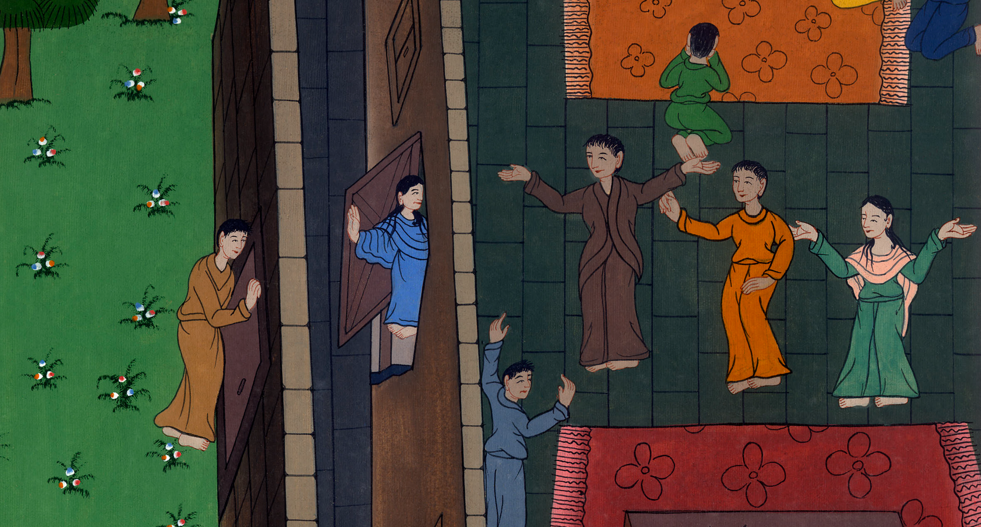
पतरस मरियम के घर गया - प्रेरितों के काम 12:12-17
This work is licensed under a Creative Commons Attribution-ShareAlike 4.0 International License

Slide 3
Peter goes to Mary’s House – Acts 12:12-17
पतरस मरियम के घर गया - प्रेरितों के काम 12:12-17

Slide 4
पतरस मरियम के घर गया - प्रेरितों के काम 12:12-17

Slide 5
12And when he had realized this, he went to the house of Mary the mother of John, also called Mark, where many people had gathered together and were praying.
12और यह सोचकर, वह उस यूहन्ना की माता मरियम के घर आया, जो मरकुस कहलाता है। वहाँ बहुत लोग इकट्ठे होकर प्रार्थना कर रहे थे।

Slide 6
प्रेरितों के काम 12:12

Slide 7
13He knocked at the outer gate, and a servant girl named Rhoda came to answer it.
13जब उसने फाटक की खिड़की खटखटाई तो रूदे^{b} नामक एक दासी सुनने को आई।

Slide 8
प्रेरितों के काम 12:13

Slide 9
14When she recognized Peter’s voice, she was so overjoyed that she forgot to open the gate, but ran inside and announced, “Peter is standing at the gate!”
14 और पतरस का शब्द पहचानकर, उसने आनन्द के मारे फाटक न खोला; परन्तु दौड़कर भीतर गई, और बताया कि पतरस द्वार पर खड़ा है।

Slide 10
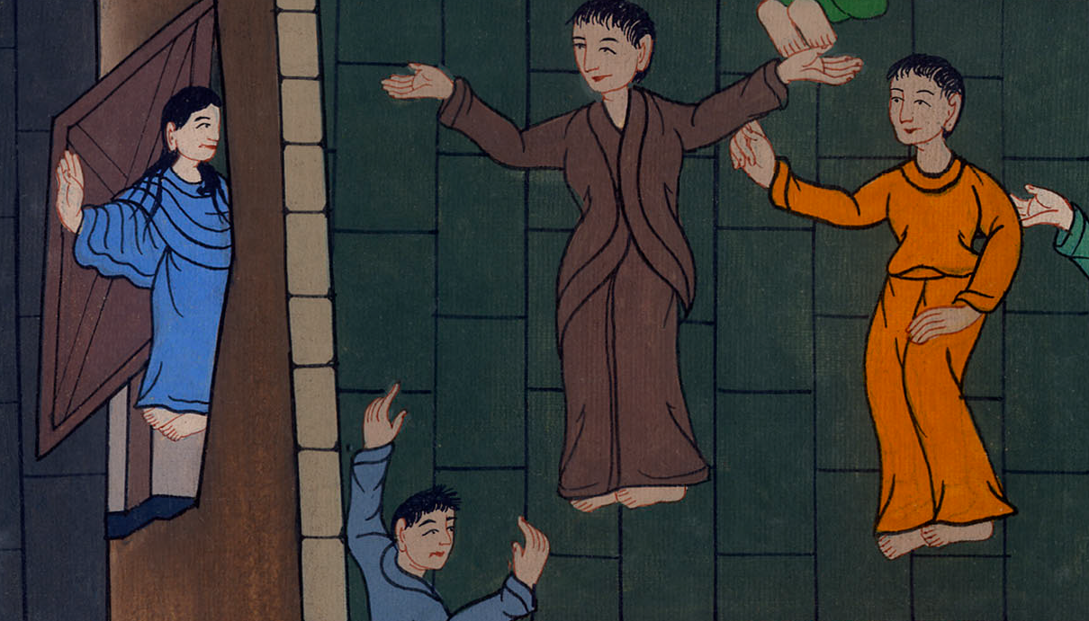
प्रेरितों के काम 12:14

Slide 11
15“You are out of your mind,” they told her. But when she kept insisting it was so, they said, “It must be his angel.”
15उन्होंने उससे कहा, “तू पागल है।” परन्तु वह दृढ़ता से बोली कि ऐसा ही है: तब उन्होंने कहा, “उसका स्वर्गदूत होगा।”

Slide 12
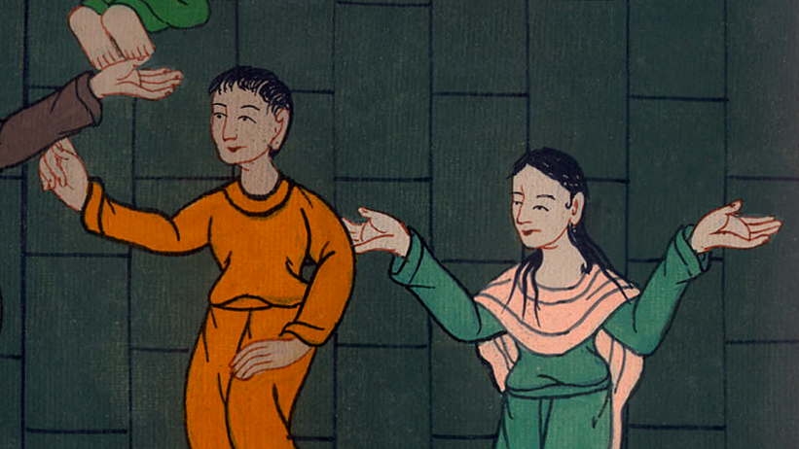
प्रेरितों के काम 12:15

Slide 13
16But Peter kept on knocking, and when they opened the door and saw him, they were astounded.
16परन्तु पतरस खटखटाता ही रहा अतः उन्होंने खिड़की खोली, और उसे देखकर चकित रह गए^{c}।

Slide 14
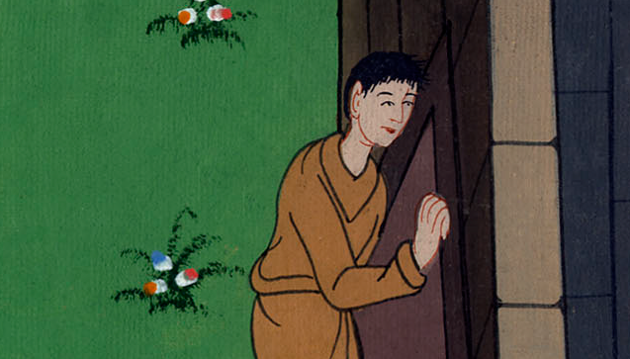
प्रेरितों के काम 12:16

Slide 15
17 तब उसने उन्हें हाथ से संकेत किया कि चुप रहें; और उनको बताया कि प्रभु किस रीति से मुझे बन्दीगृह से निकाल लाया है।…
17Peter motioned with his hand for silence, and he described how the Lord had brought him out of the prison…

Slide 16
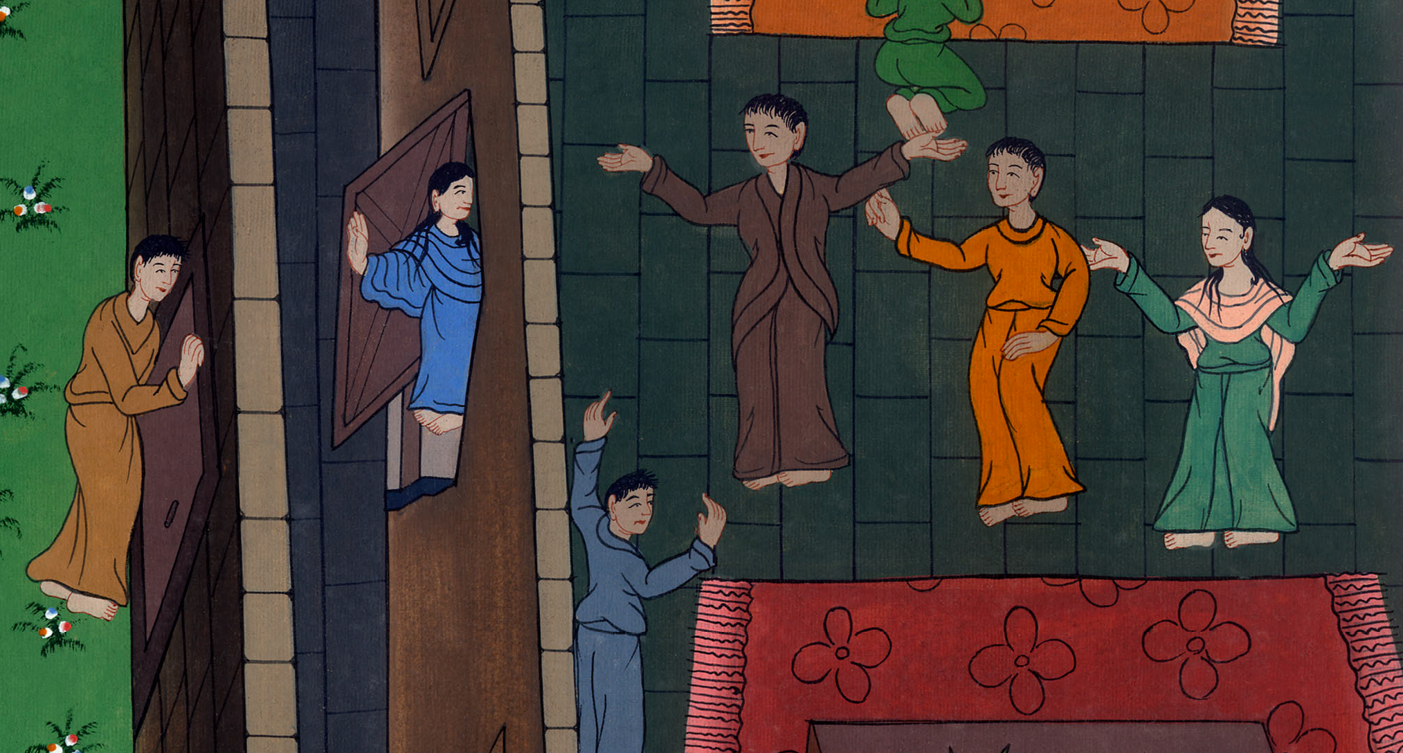
प्रेरितों के काम 12:17

Slide 17
…“Send word to James and to the brothers,” he said, and he left for another place.
…फिर कहा, “याकूब और भाइयों को यह बात कह देना।” तब निकलकर दूसरी जगह चला गया।

Slide 18
प्रेरितों के काम 12:17

