Slide 1
62-1
These materials are by the Kongki Ka Project and are made available to you under the terms of the Creative Commons Attribution ShareAlike license 4.0.
You have permission to share and redistribute these materials in any format and to make reasonable revisions and adaptations of this translation, provided that:
You include the above licence and source information.
If you redistribute these materials or create derivatives, you must distribute your contributions under the same license as the original.
The Holy Bible, Berean Standard Bible, BSB is produced in cooperation with Bible Hub, Discovery Bible, OpenBible.com, and the Berean Bible Translation Committee. This text of God's Word has been dedicated to the public domain.
Hindi text is from Free Bibles India. This translation is made available under the terms of a Creative Commons Attribution-ShareAlike 4.0 International License.
Notes:
Ch
P05 Kingdom Parables
1. The Wise and Foolish Builders - Luke 6:46-49 (Left Top)
2. The Rich Man and Lazarus Luke 16:19-31 (Right Top)
3. The Weeds - Matthew 13:24-30; 36-43 (Right Center)
4. The Hidden Treasure - Matt 13:44 (Center)
5. The Rich Fool - Luke 12:13-34 (Right Bottom)
6. The Ten Virgins - Matthew 25:1-13 (Left Bottom)
7. The Talents - Matthew 25:14-30 (Left Center)

Slide 2
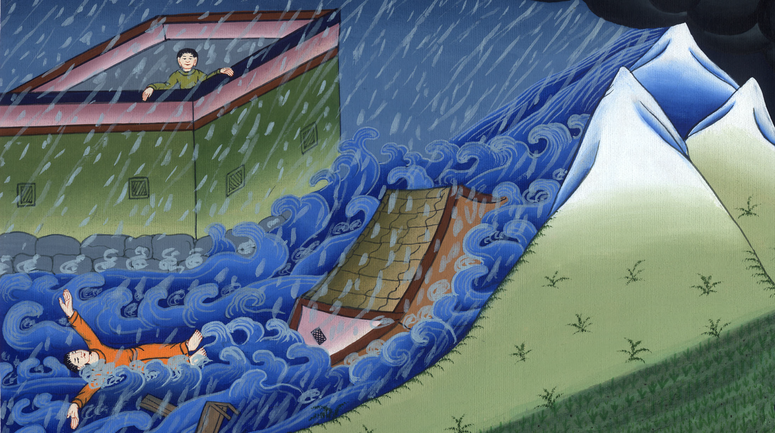
घर बनाने वाला बुद्धिमान और मूर्ख - लूका 6:46-49
This work is licensed under a Creative Commons Attribution-ShareAlike 4.0 International License

Slide 3
Kingdom Parables
The Wise and Foolish Builders - Luke 6:46-49
घर बनाने वाला
बुद्धिमान और मूर्ख - लूका 6:46-49

Slide 4
घर बनाने वाला बुद्धिमान और मूर्ख - लूका 6:46-49

Slide 5
46Why do you call Me ‘Lord, Lord,’ but not do what I say?
46 “जब तुम मेरा कहना नहीं मानते, तो क्यों मुझे ‘हे प्रभु, हे प्रभु,’ कहते हो?

Slide 6
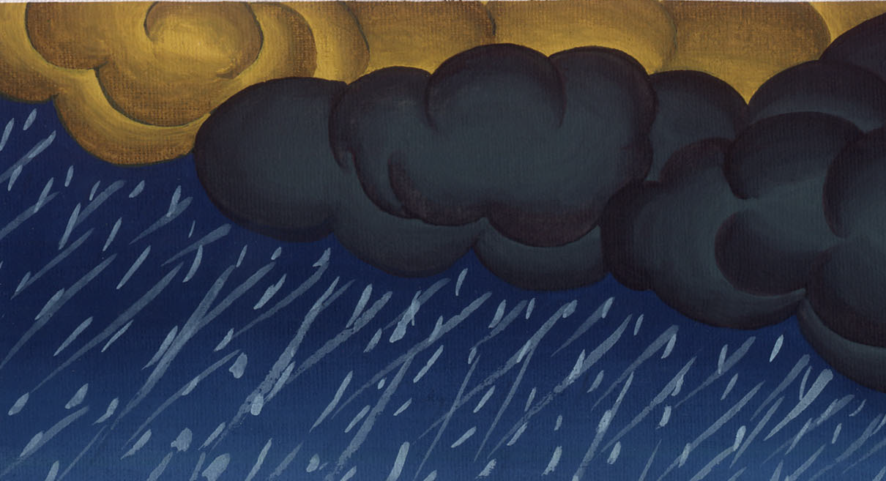
लूका 6:46

Slide 7
47I will show you what he is like who comes to Me and hears My words and acts on them:
47 जो कोई मेरे पास आता है, और मेरी बातें सुनकर उन्हें मानता है, मैं तुम्हें बताता हूँ कि वह किसके समान है?

Slide 8
लूका 6:47

Slide 9
48He is like a man building a house, who dug down deep and laid his foundation on the rock…
48 वह उस मनुष्य के समान है, जिसने घर बनाते समय भूमि गहरी खोदकर चट्टान में नींव डाली…

Slide 10
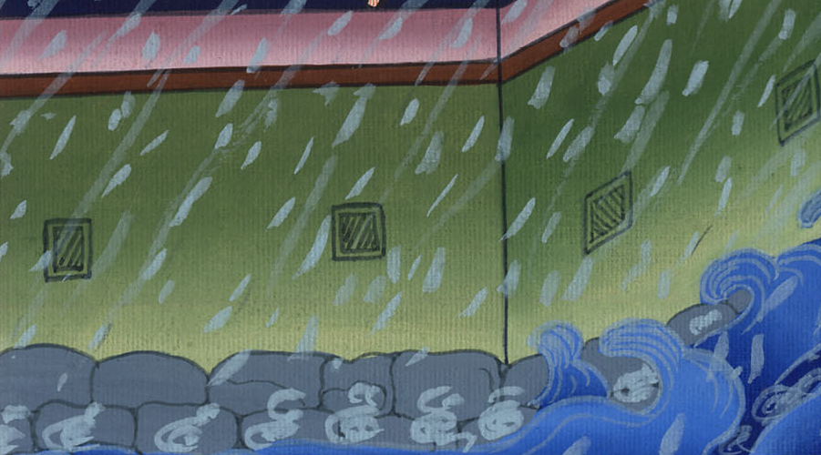
लूका 6:48

Slide 11
…When the flood came, the torrent crashed against that house but could not shake it, because it was well built.
…और जब बाढ़ आई तो धारा उस घर पर लगी, परन्तु उसे हिला न सकी; क्योंकि वह पक्का बना था।

Slide 12
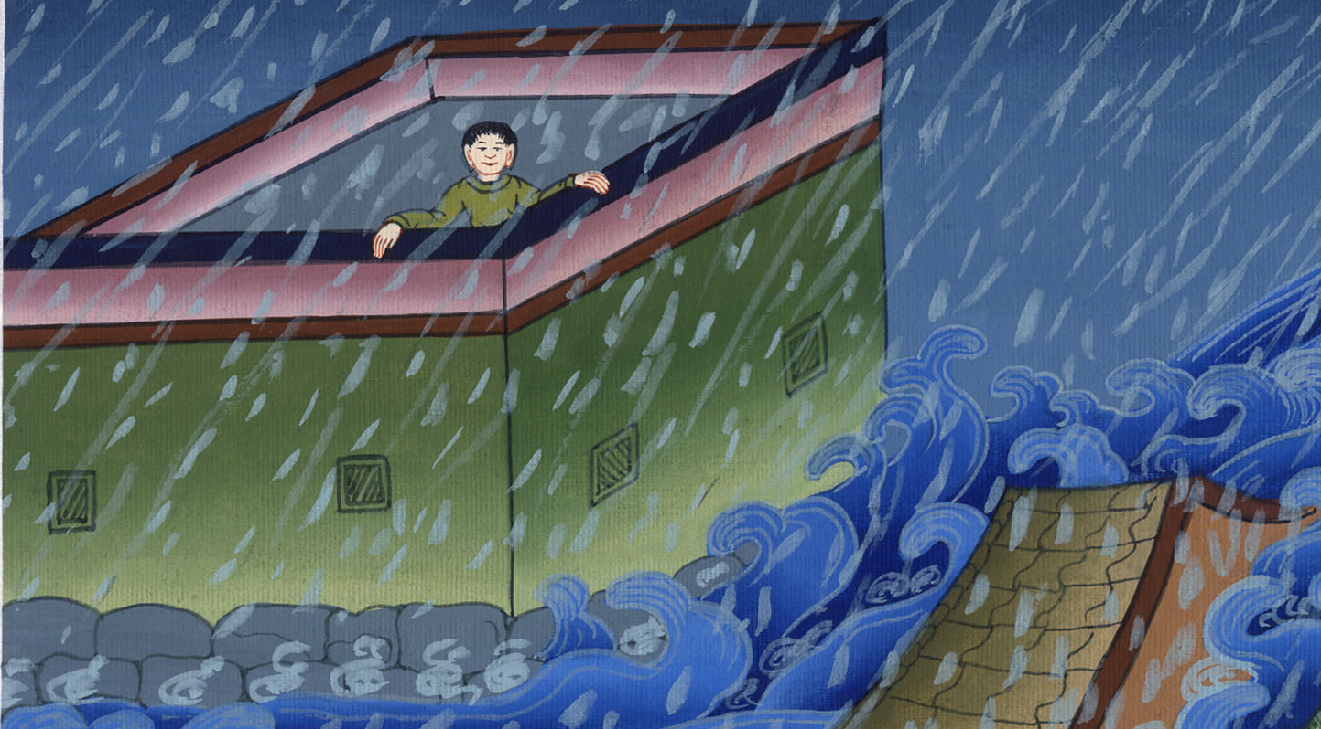
लूका 6:48

Slide 13
49But the one who hears My words and does not act on them is like a man who built his house on ground without a foundation…
49 परन्तु जो सुनकर नहीं मानता, वह उस मनुष्य के समान है, जिसने मिट्टी पर बिना नींव का घर बनाया।…

Slide 14
लूका 6:49

Slide 15
…The torrent crashed against that house, and immediately it fell—
…जब उस पर धारा लगी, तो वह तुरन्त गिर पड़ा…

Slide 16
लूका 6:49

Slide 17
…and great was its destruction!”
…और वह गिरकर सत्यानाश हो गया।”

Slide 18
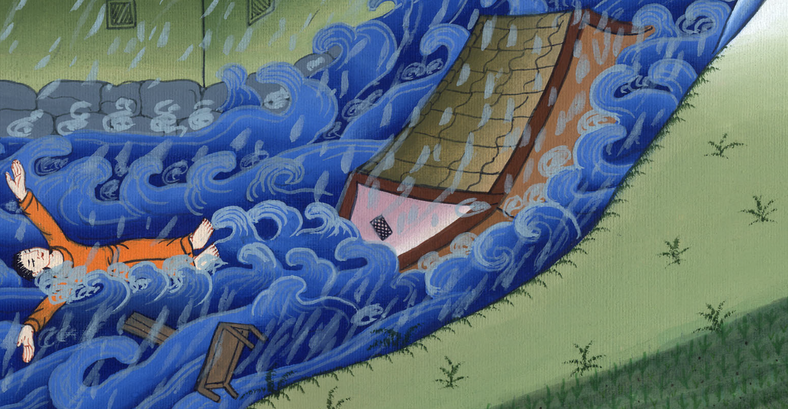
लूका 6:49

