Slide 1
62-4
These materials are by the Kongki Ka Project and are made available to you under the terms of the Creative Commons Attribution ShareAlike license 4.0.
You have permission to share and redistribute these materials in any format and to make reasonable revisions and adaptations of this translation, provided that:
You include the above licence and source information.
If you redistribute these materials or create derivatives, you must distribute your contributions under the same license as the original.
The Holy Bible, Berean Standard Bible, BSB is produced in cooperation with Bible Hub, Discovery Bible, OpenBible.com, and the Berean Bible Translation Committee. This text of God's Word has been dedicated to the public domain.
Hindi text is from Free Bibles India. This translation is made available under the terms of a Creative Commons Attribution-ShareAlike 4.0 International License.
Notes:
Ch
P05 Kingdom Parables
1. The Wise and Foolish Builders - Luke 6:46-49 (Left Top)
2. The Rich Man and Lazarus Luke 16:19-31 (Right Top)
3. The Weeds - Matthew 13:24-30; 36-43 (Right Center)
4. The Hidden Treasure - Matt 13:44 (Center)
5. The Rich Fool - Luke 12:13-34 (Right Bottom)
6. The Ten Virgins - Matthew 25:1-13 (Left Bottom)
7. The Talents - Matthew 25:14-30 (Left Center)

Slide 2
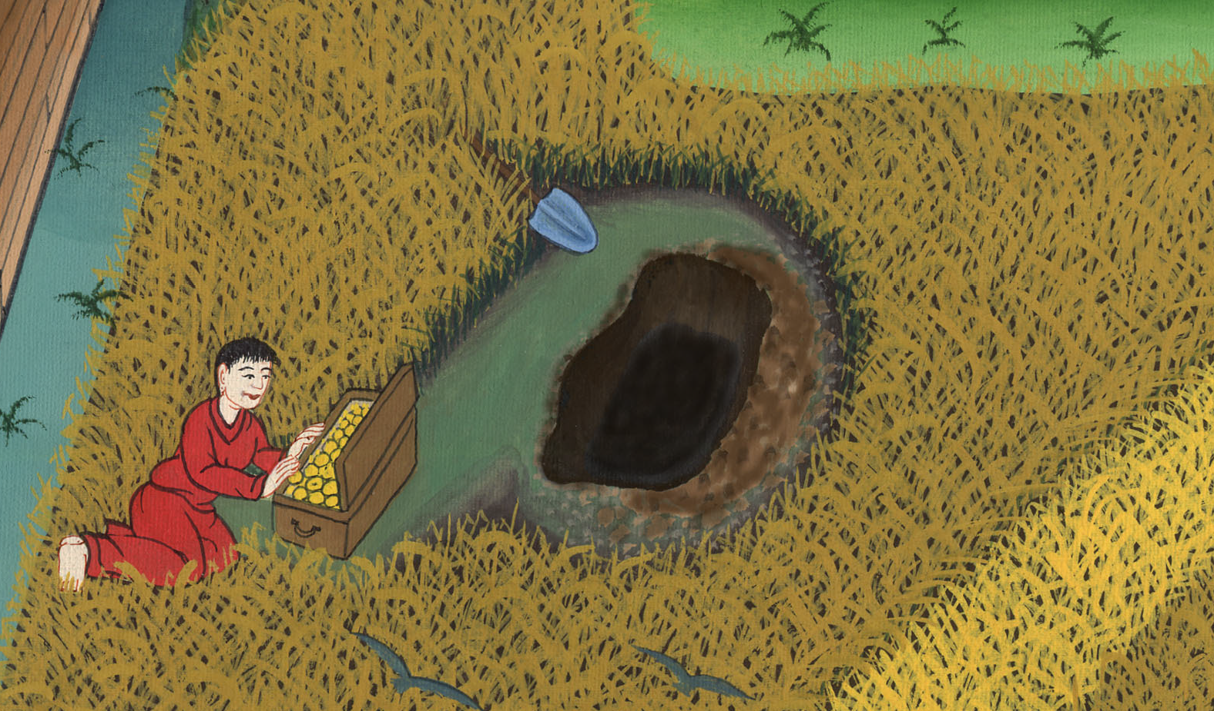
छिपा हुआ खज़ाना - मत्ती 13:44-46
This work is licensed under a Creative Commons Attribution-ShareAlike 4.0 International License

Slide 3
The Hidden Treasure - Matthew 13:44-46
छिपा हुआ खज़ाना –
मत्ती 13:44-46

Slide 4
छिपा हुआ खज़ाना - मत्ती 13:44-46

Slide 5
44The kingdom of heaven is like treasure hidden in a field…
44 44 “स्वर्ग का राज्य खेत में छिपे हुए धन के समान है…

Slide 6
मत्ती 13:44

Slide 7
When a man found it, he hid it again…
जिसे किसी मनुष्य ने पाकर छिपा दिया…

Slide 8
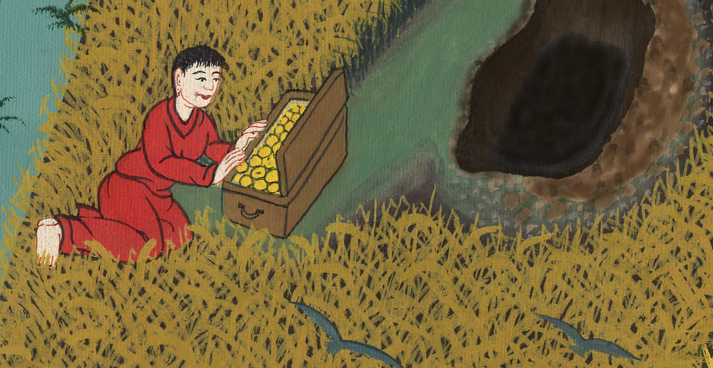
मत्ती 13:44

Slide 9
…and in his joy he went and sold all he had and bought that field.
…और आनन्द के मारे जाकर अपना सब कुछ बेचकर उस खेत को मोल लिया।

Slide 10
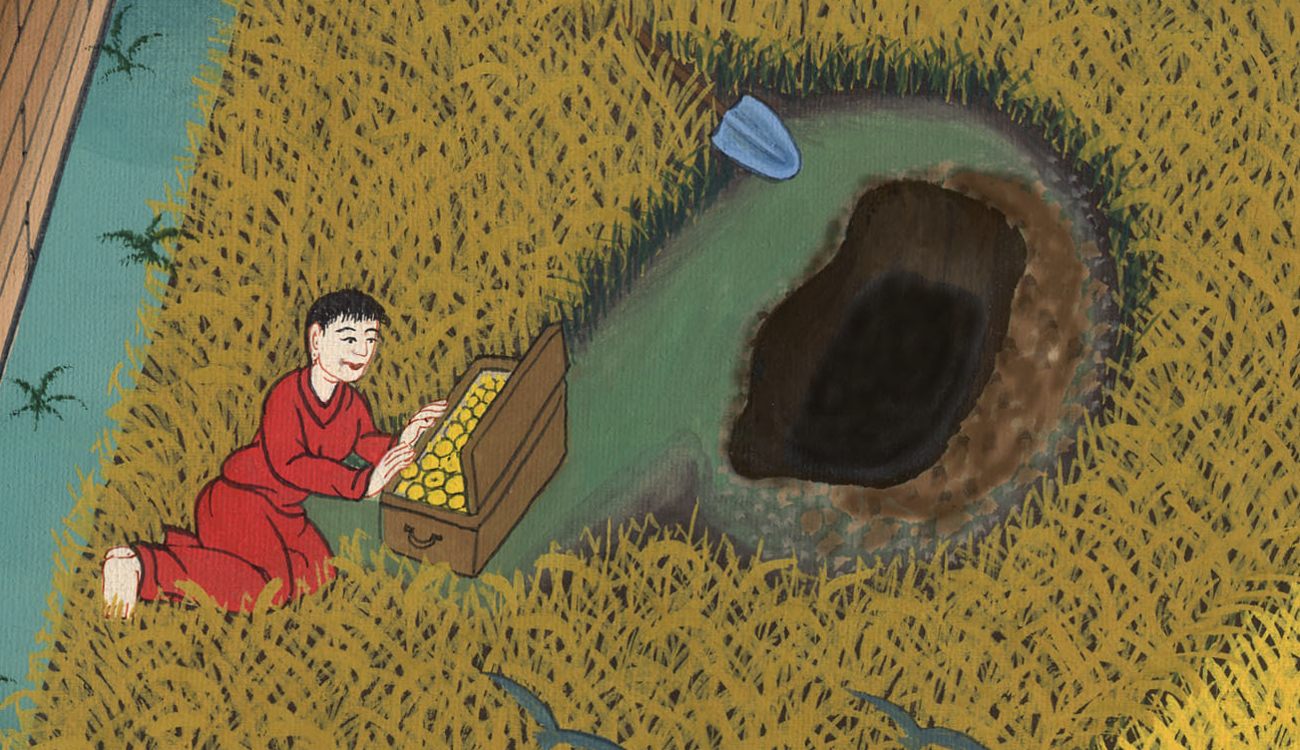
मत्ती 13:44

Slide 11
45Again, the kingdom of heaven is like a merchant in search of fine pearls.
45 फिर स्वर्ग का राज्य एक व्यापारी के समान है जो अच्छे मोतियों की खोज में था।

Slide 12
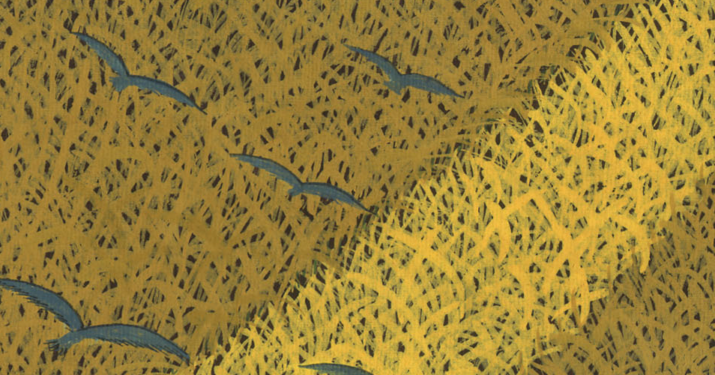
मत्ती 13:45

Slide 13
46When he found one very precious pearl, he went away and sold all he had and bought it.
46 जब उसे एक बहुमूल्य मोती मिला तो उसने जाकर अपना सब कुछ बेच डाला और उसे मोल ले लिया।

Slide 14
मत्ती 13:46

