Slide 1
02-1
These materials are by the Kongki Ka Project and are made available to you under the terms of the Creative Commons Attribution ShareAlike license 4.0.
You have permission to share and redistribute these materials in any format and to make reasonable revisions and adaptations of this translation, provided that:
You include the above licence and source information.
If you redistribute these materials or create derivatives, you must distribute your contributions under the same license as the original.
The Holy Bible, Berean Standard Bible, BSB is produced in cooperation with Bible Hub, Discovery Bible, OpenBible.com, and the Berean Bible Translation Committee. This text of God's Word has been dedicated to the public domain.
Tibetan text is from the The Holy Bible in Modern Literary Tibetan, New Tibetan Bible translation.
This translation is made available under the terms of the Creative Commons Attribution-NonCommercial-NoDerivatives 4.0 International license.
Notes:
ch

Slide 2
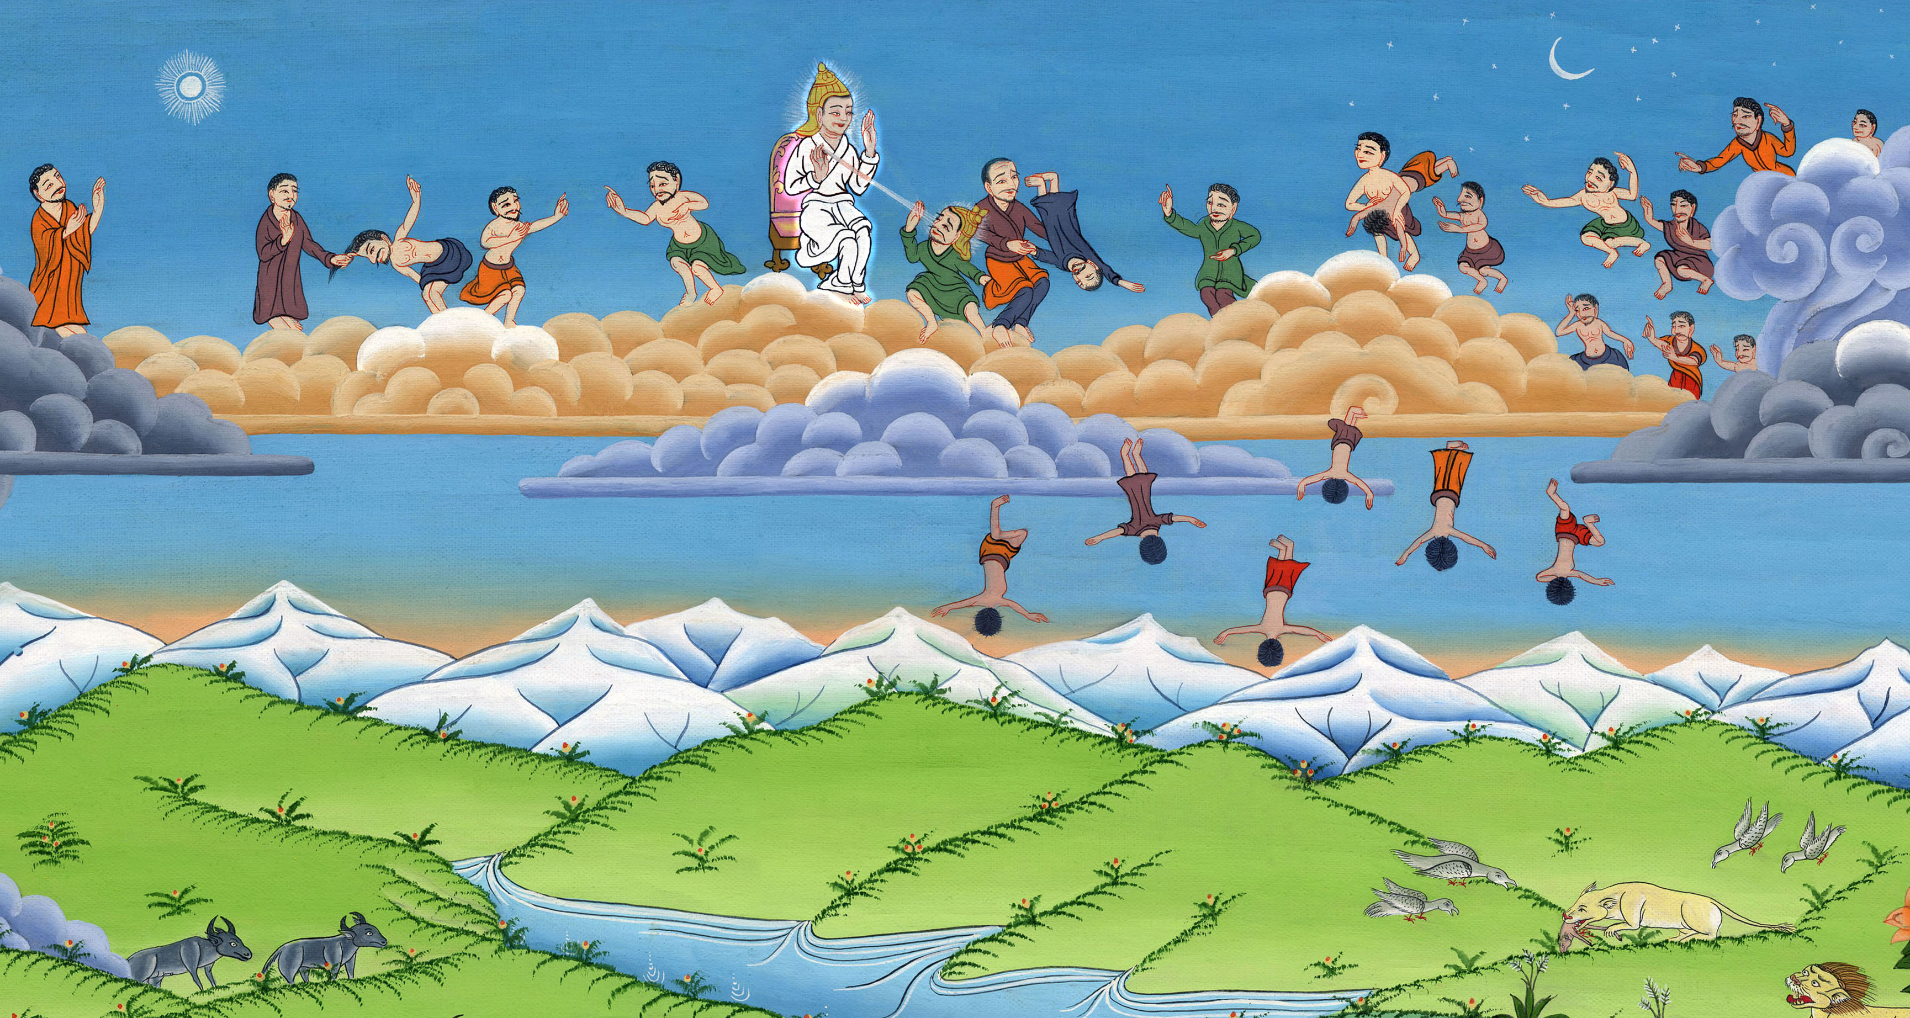
ཡེ་ཤ་ཡཱ 14:12-15, ཨི་ཛི་ཀི་ཨེལ 28:11-19
བདུད་ས་ཏན་གྱིས་སྡིག་པ།

Slide 3
The fall of Satan
- Ezekiel 28:11-19; Isaiah 14:12-15
ཡེ་ཤ་ཡཱ 14:12-15
ཨི་ཛི་ཀི་ཨེལ 28:11-19
བདུད་ས་ཏན་གྱིས་སྡིག་པ།

Slide 4
ཡེ་ཤ་ཡཱ 14:12-15, ཨི་ཛི་ཀི་ཨེལ 28:11-19
བདུད་ས་ཏན་གྱིས་སྡིག་པ།
This work is licensed under a Creative Commons Attribution-ShareAlike 4.0 International License

Slide 5
When God created the heavens and the earth it was beautiful and perfect. Then evil entered the earth, and man chose to disobey God. Because of this, the whole earth was no longer perfect, and there came much suffering to man and all of creation.

Slide 6
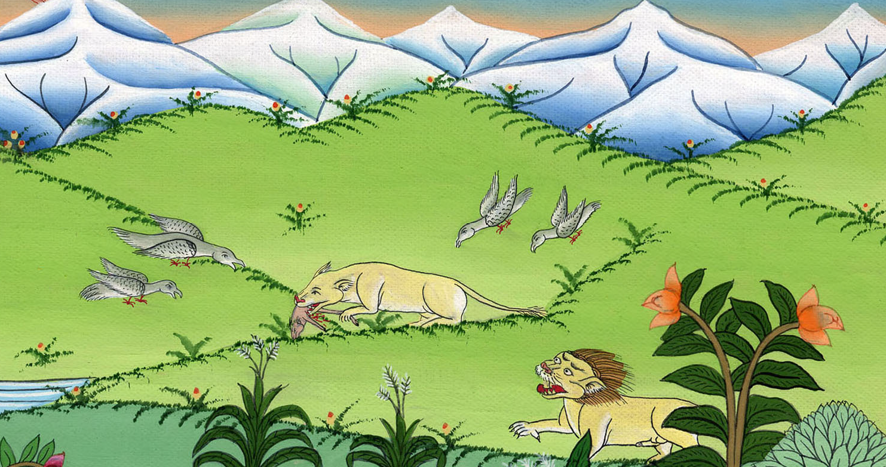

Slide 7
there were heavenly beings called angels who lived with God in his Heavenly kingdom. This is the story of one of these angels. We will call him Satan, or Lucifer.

Slide 8
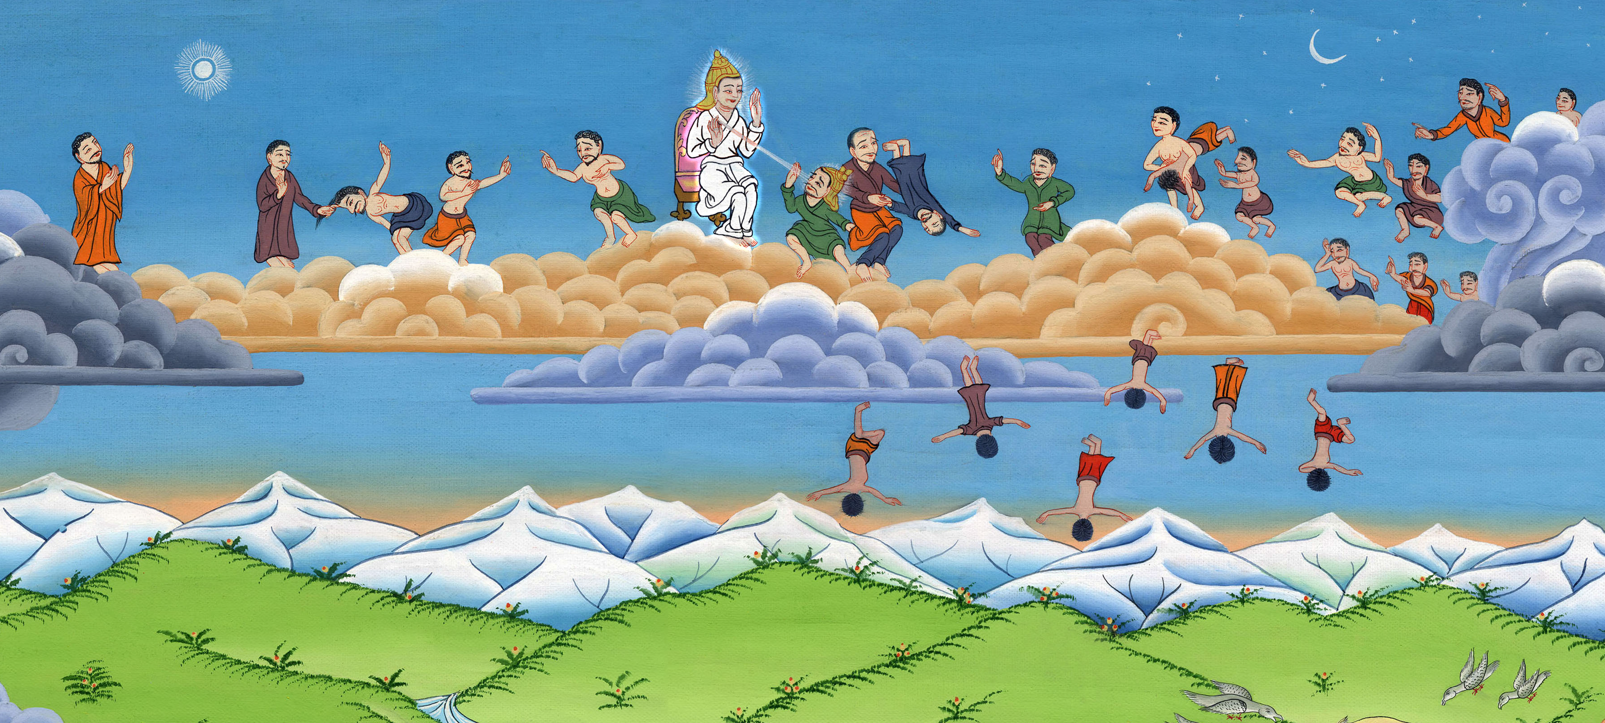
Notes:
At the time of Creation there were heavenly beings called angels who lived with God in his Heavenly kingdom. This is the story of one of these angels. We will call him, Lucifer, or the snake.

Slide 9
There was one angel who was more beautiful and wise than the others. God appointed him as a guardian angel above the others.

Slide 10
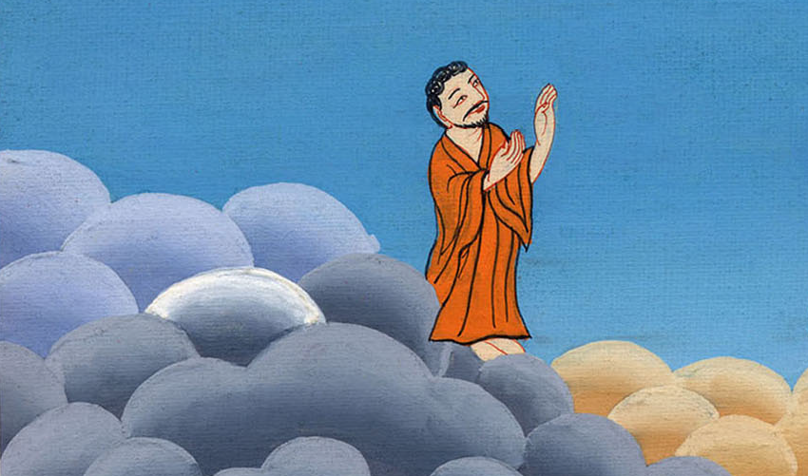
Notes:
There was one angel who was more beautiful and wise than the others. God appointed him as a guardian angel above the others.

Slide 11
From when he was created, this angel, Lucifer, did no wrong, but then he began to sin.

Slide 12
Notes:
From when he was created, this angel, Lucifer, did no wrong, but then he began to sin.

Slide 13
He said in his heart, ‘I will go up to the heavens. I’ll raise my throne above the stars of God. I’ll make myself like the Most High God.’

Slide 14
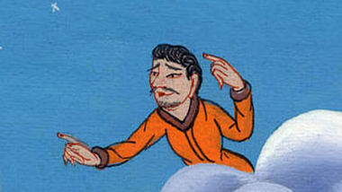
Notes:
He said in his heart, ‘I will go up to the heavens. I’ll raise my throne above the stars of God. I’ll make myself like the Most High God.’

Slide 15
Then a war began in heaven. A third of the angels joined with Lucifer and rebelled against God. God’s angels fought against Lucifer and his angels

Slide 16
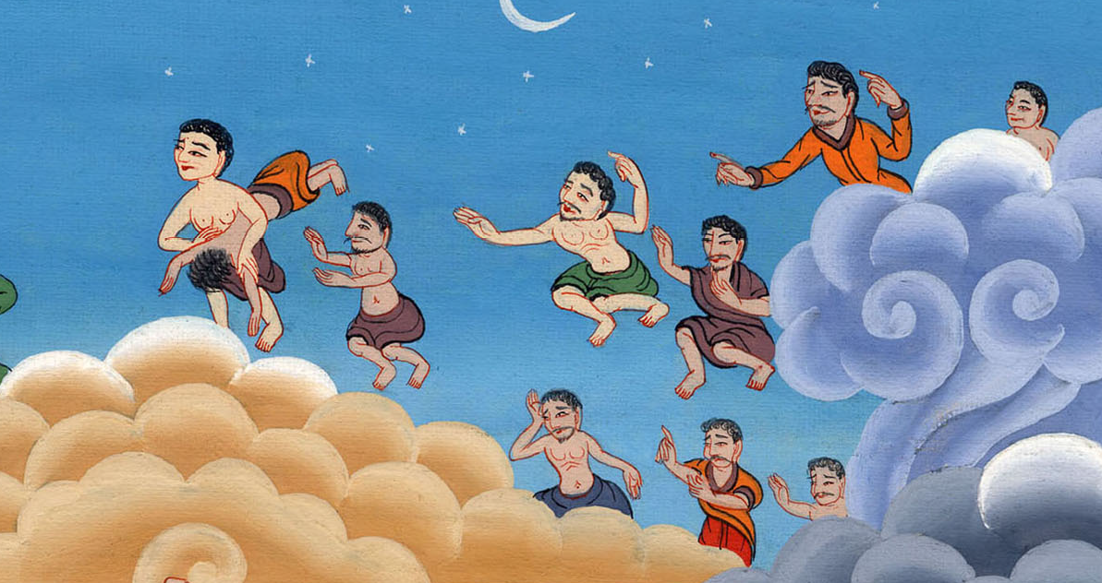
Notes:
Then a war began in heaven. A third of the angels joined with Lucifer and rebelled against God. God’s angels fought against Lucifer and his angels

Slide 17
Lucifer was thrown down to the earth, and his angels with him.

Slide 18
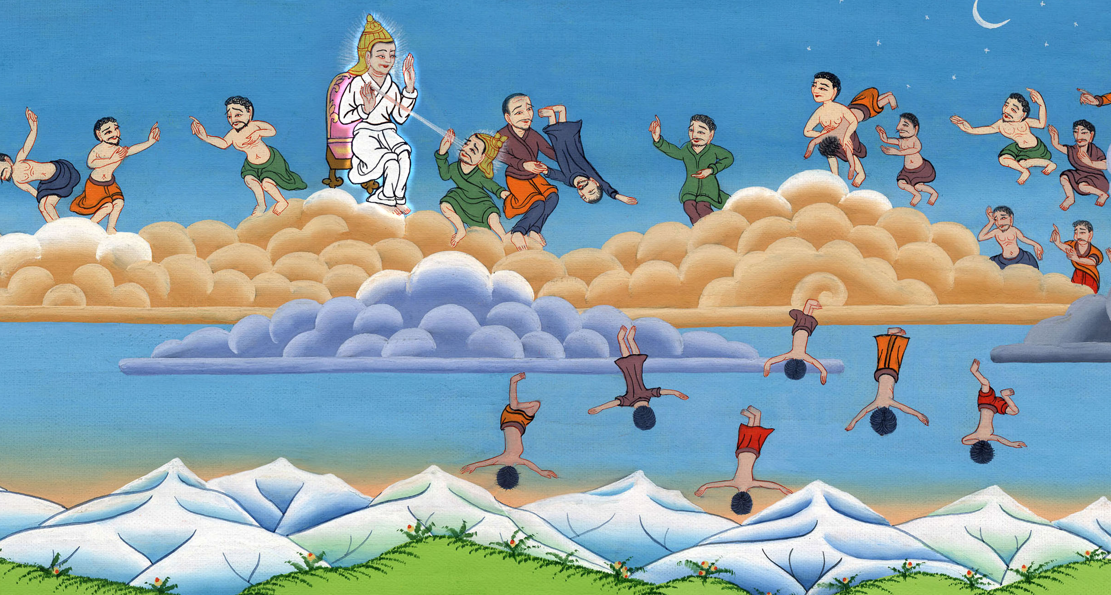
Notes:
Lucifer was thrown down to the earth, and his angels with him.

Slide 19
God said to Lucifer: I sent you away from my mountain in shame. I drove you away from my presence

Slide 20
Notes:
God said to Lucifer: I sent you away from my mountain in shame. I drove you away from my presence

Slide 21
You thought you were so handsome ^{that it made your heart proud.} You thought you were so glorious ^{that it spoiled your wisdom.} So I threw you down to the earth.

Slide 22
Notes:
17 You thought you were so handsome ^{that it made your heart proud.} You thought you were so glorious ^{that it spoiled your wisdom.} So I threw you down to the earth.

Slide 23
Still today Lucifer is here. We call him Satan, the snake or the devil. It is he who leads the whole world on the wrong path. He brings evil to this world.

Slide 24
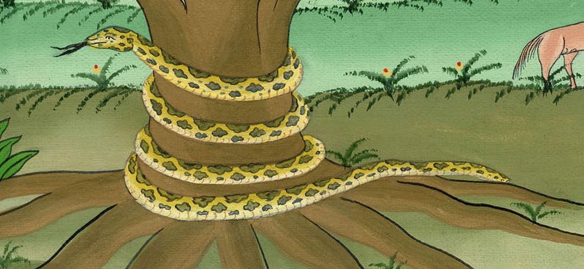
Notes:
Still today Lucifer is here. We call him Satan, the snake or the devil. It is he who leads the whole world on the wrong path. He brings evil to this world.

