Slide 1
02-3
These materials are by the Kongki Ka Project and are made available to you under the terms of the Creative Commons Attribution ShareAlike license 4.0.
You have permission to share and redistribute these materials in any format and to make reasonable revisions and adaptations of this translation, provided that:
You include the above licence and source information.
If you redistribute these materials or create derivatives, you must distribute your contributions under the same license as the original.
The Holy Bible, Berean Standard Bible, BSB is produced in cooperation with Bible Hub, Discovery Bible, OpenBible.com, and the Berean Bible Translation Committee. This text of God's Word has been dedicated to the public domain.
Tibetan text is from the The Holy Bible in Modern Literary Tibetan, New Tibetan Bible translation.
This translation is made available under the terms of the Creative Commons Attribution-NonCommercial-NoDerivatives 4.0 International license.

Slide 2
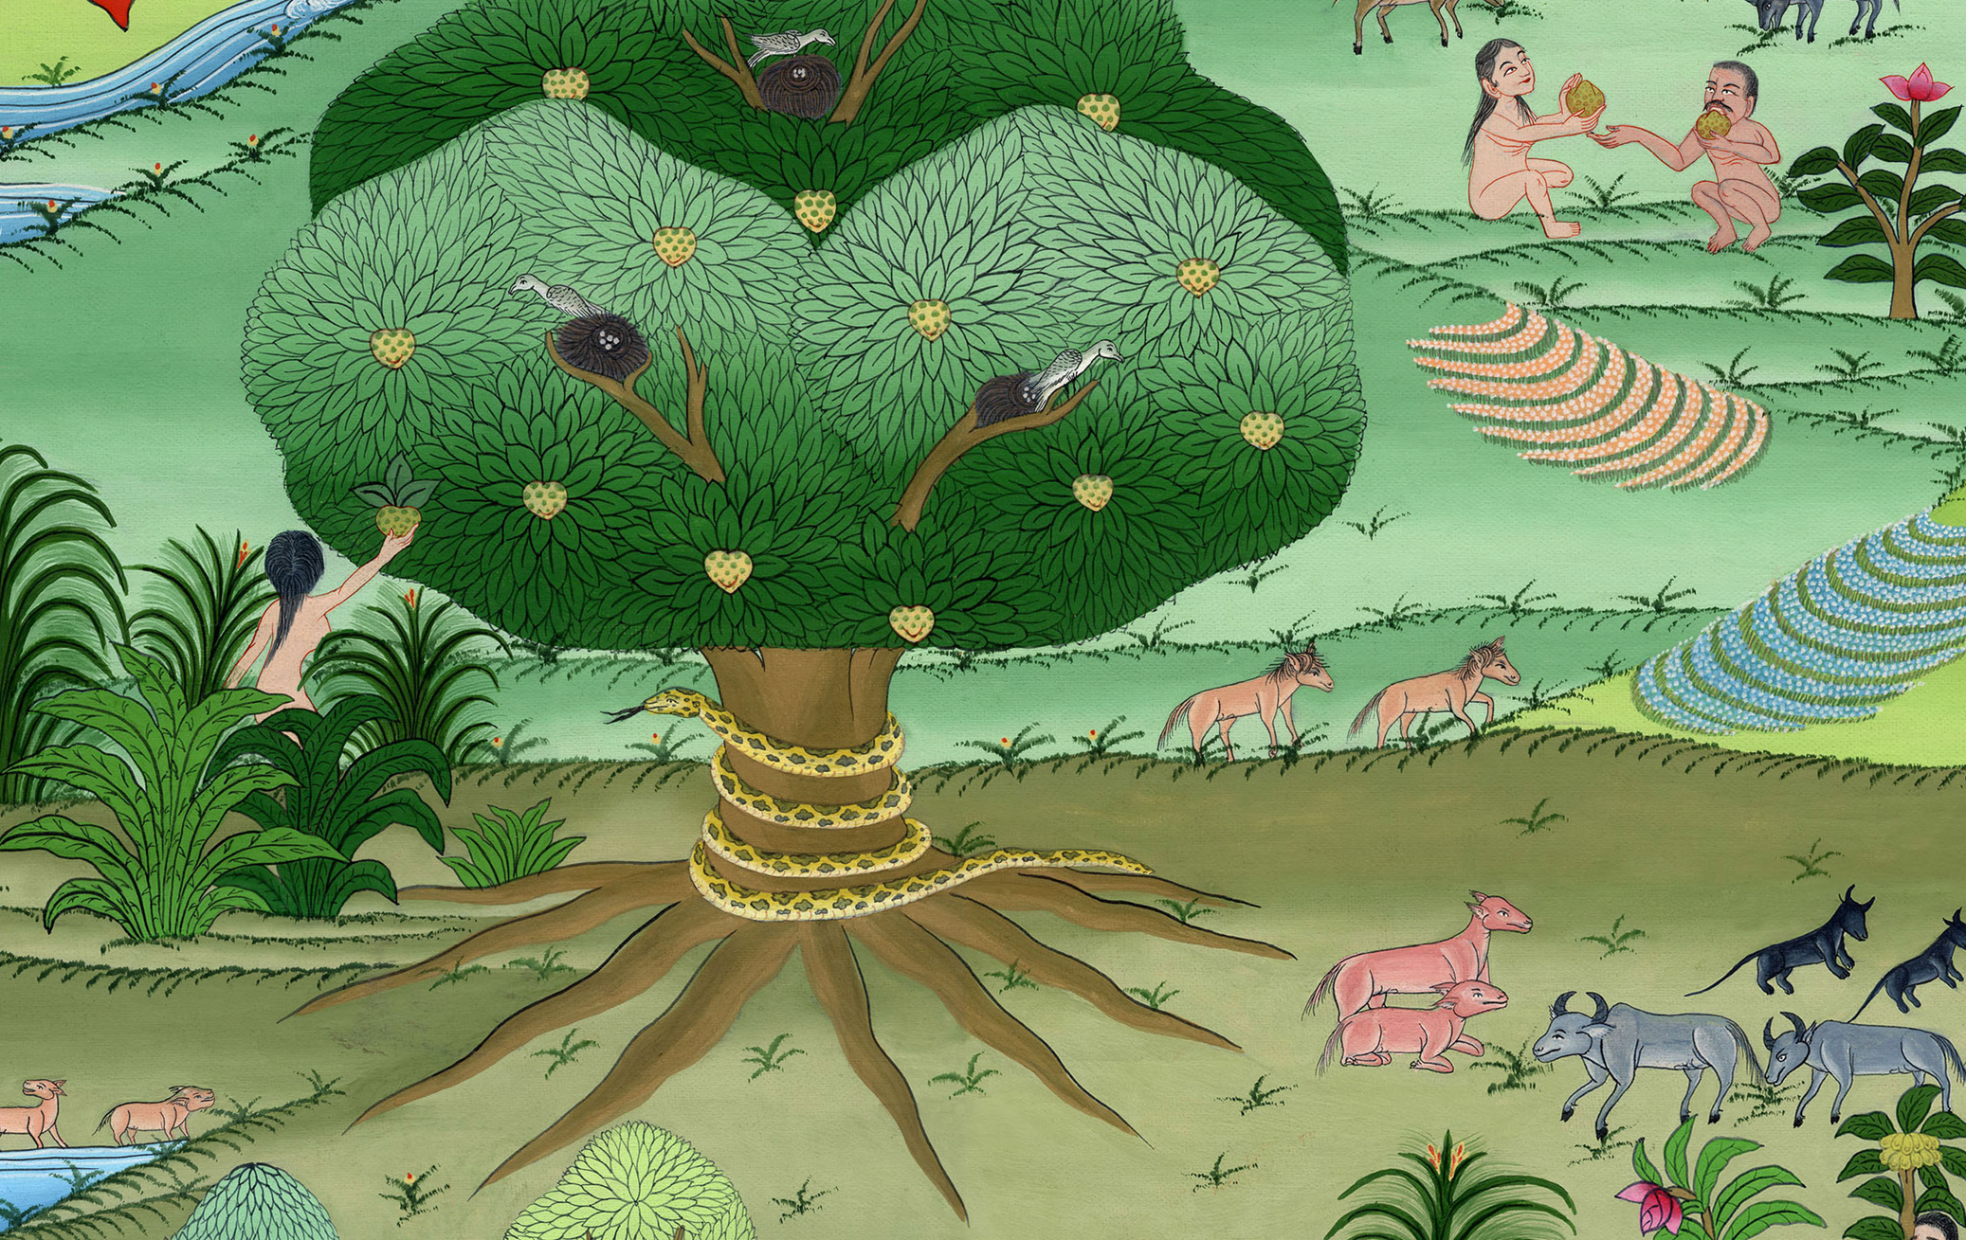
བཀོད་པ 3:7-13
ཁོང་གཉིས་ཡིབ།

Slide 3
Hiding from God - Gen 3:7-13 (Right Bottom)
བཀོད་པ 3:7-13
ཁོང་གཉིས་ཡིབ།

Slide 4
བཀོད་པ 3:7-13
ཁོང་གཉིས་ཡིབ།
This work is licensed under a Creative Commons Attribution-ShareAlike 4.0 International License

Slide 5
The woman and the man disobeyed and ate of the fruit God had commanded not to eat.
7And the eyes of both of them were opened, and they knew that they were naked; so they sewed together fig leaves and made coverings for themselves.
7དེར་ཁོ་གཉིས་ཀྱི་མིག་ཟུང་གསལ་པོར་གྱུར་ཏེ་རང་ལུས་གཅེར་བུ་ཡིན་པ་མཐོང༌བས། སེ་ཡབ་ཤིང་གི་ལོ་མ་བསླས་ནས་རང་ཉིད་ལ་སྨད་གོས་བཟོས༌སོ།།
Notes:
They hide from God - Gen 3:7-13
The woman and the man disobeyed and ate of the fruit God had commanded not to eat.
. ⁷ Then both of them knew things they had never known before. They realized they were naked.
So they sewed together fig leaves and made clothes for themselves.

Slide 6
བཀོད་པ 3:7

Slide 7
8Then the man and his wife heard the voice of the Lord God walking in the garden in the breeze of the day, and they hid themselves from the presence of the Lord God among the trees of the garden.
8དེ་ནས་བསིལ་རླུང་ལྡང་བའི་དུས༌སུ། དཀོན་མཆོག་ཡ་ཝཱེ་ལྡུམ་རའི་ནང་དུ་ཕེབས་པ༌དང༌། སྐྱེས་པ་དེ་དང་ཁོའི་ཆུང་མ་གཉིས་ཀྱིས་ཁོང་ཉིད་ཕེབས་པའི་སྒྲ་ཐོས་ནས་སྡོང་གསེབ་ཏུ་ཁོང་ལ་གཡོལ་བ༌རེད།
Notes:
⁸ Then the man and his wife heard the Lord God walking in the garden. It was during the coolest time of the day. They hid from the Lord God among the trees of the garden.

Slide 8
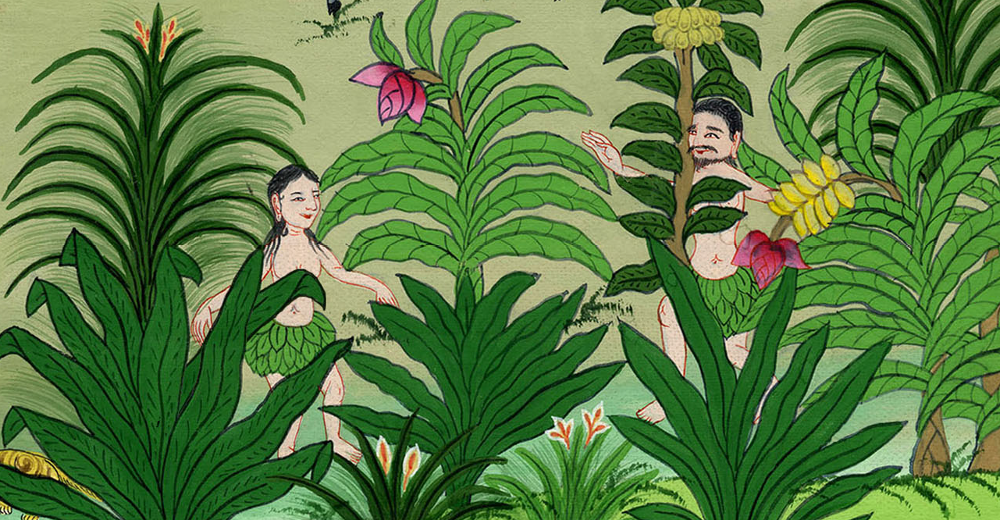
བཀོད་པ 3:8

Slide 9
9But the Lord God called out to the man, “Where are you?”
9དཀོན་མཆོག་ཡ་ཝཱེས་སྐྱེས་པ་དེ་ལ་ཁྱོད་གང་དུ་ཡོད་ཅེས་དྲིས་པ༌ན།

Slide 10
བཀོད་པ 3:9

Slide 11
10“I heard Your voice in the garden,” he replied, “and I was afraid because I was naked; so I hid myself.”
10ཁོ་ན༌རེ། ངས་ལྡུམ་རའི་ནང་ཁྱེད་ཀྱི་སྒྲ་ཐོས་པས་འཇིགས༌ཤིང༌། བདག་གི་ལུས་པོ་གཅེར་བུ་ཡིན་པས་སྦས་པ་ཡིན་ཞེས་སྨྲས༌སོ།།
Notes:
¹⁰ “I heard you in the garden,” the man answered. “I was afraid, because I was naked. So I hid.”

Slide 12
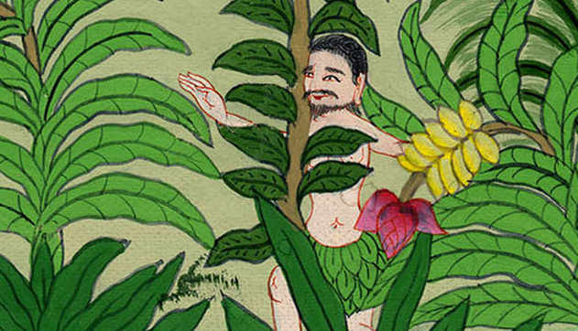
བཀོད་པ 3:10

Slide 13
11“Who told you that you were naked?” asked the Lord God. “Have you eaten from the tree of which I commanded you not to eat?”
11ཡང་ཁོང་གིས་འདི་སྐད༌དུ། ཁྱོད་ཀྱི་ལུས་གཅེར་བུ་ཡིན་པ་སུ་ཞིག་གིས་སྨྲས༌སམ། བདག་གིས་བཟའ་མི་རུང་བར་བཀའ་བསྒོས་པའི་ཤིང་ཏོག་དེ་ཟོས་སམ་ཞེས་དྲིས་པ༌ན།
Notes:
¹¹ The Lord God said, “Who told you that you were naked? Have you eaten fruit from the tree I commanded you not to eat from?”

Slide 14
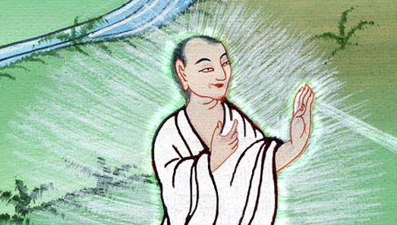
བཀོད་པ 3:11

Slide 15
12 'ཁོ་ན༌རེ། ཁྱེད་ཀྱིས་བདག་ལ་གནང་ཞིང་བདག་དང་འགྲོགས་པའི་བུད་མེད་དེས་ལྗོན་ཤིང་དེའི་ཤིང་ཏོག་བདག་ལ་སྤྲད་པས་ངས་ཀྱང་ཟོས་པ་ཡིན་ཞེས༌སྨྲས། '
12And the man answered, “The woman whom You gave me, she gave me fruit from the tree, and I ate it.”
Notes:
12 The man said, “It’s the fault of the woman you put here with me. She gave me some fruit from the tree. And I ate it.”

Slide 16
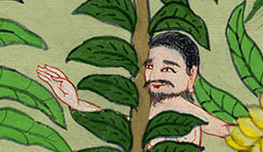
བཀོད་པ 3:12

Slide 17
13Then the Lord God said to the woman, “What is this you have done?”
13དེ་ནས་དཀོན་མཆོག་ཡ་ཝཱེས་བུད་མེད་དེ་ལ་འདི་སྐད༌དུ། ཁྱོད་ཀྱིས་ཅི་ཞིག་བྱས་སམ་ཞེས་དྲིས་པ༌ལ།
Notes:
¹³ Then the Lord God said to the woman, “What have you done?”

Slide 18
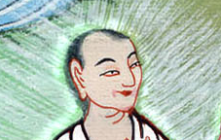
བཀོད་པ 3:13

Slide 19
“The serpent deceived me,” she replied, “and I ate.”
ཁོ་མོ་ན༌རེ། སྦྲུལ་གྱིས་བདག་ལ་བསླུ་བྲིད་བྱས་པས་བདག་གིས་ཟོས་པ་ཡིན་ཞེས་སྨྲས༌སོ།།
Notes:
The woman said, “The serpent tricked me. That’s why I ate the fruit.

Slide 20
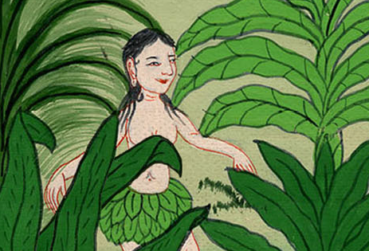
བཀོད་པ 3:13

Slide 21
The man and woman knew that they had disobeyed God’s command. They made excuses and blamed one another.
Notes:
The man and woman knew that they had disobeyed God’s command. They made excuses and blamed one another.

Slide 22
